Slide 1
How Food Coloring Mixes in Water
By: Annabel Miller, Gillian Stitt, Owen Sullivan, Stephanie Kusguen

Slide 2
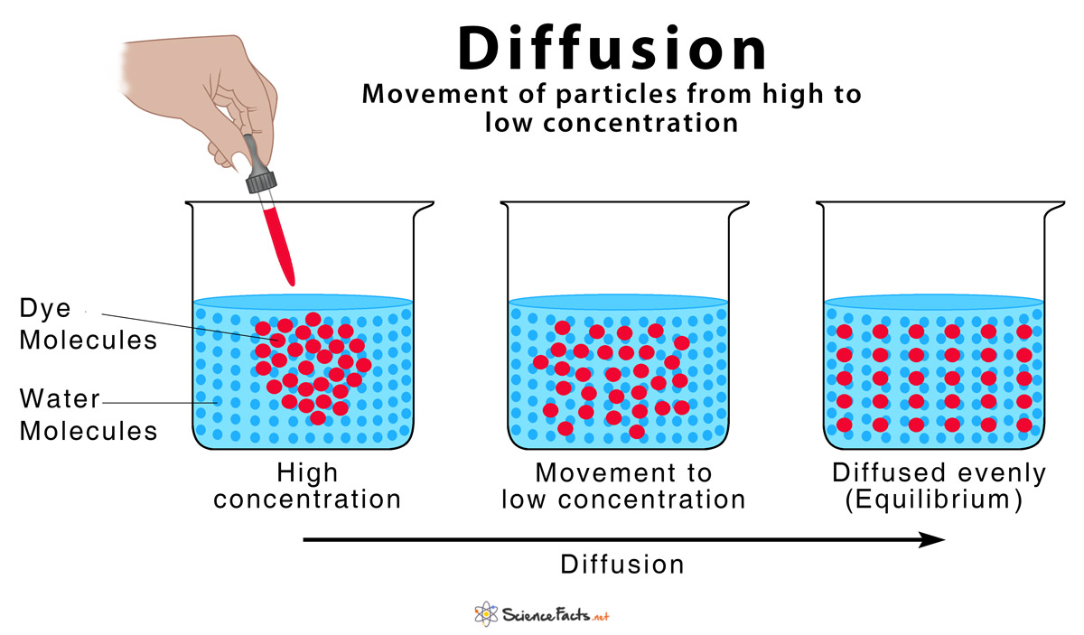
Diffusion
When particles mix as a result of their movement, this is known as diffusion. Diffusion typically moves from high concentration to low concentration. Water is the solvent while food coloring is the solute and they mix to make a solution.
This image shows the movement of dye molecules as diffusion progresses.

Slide 3
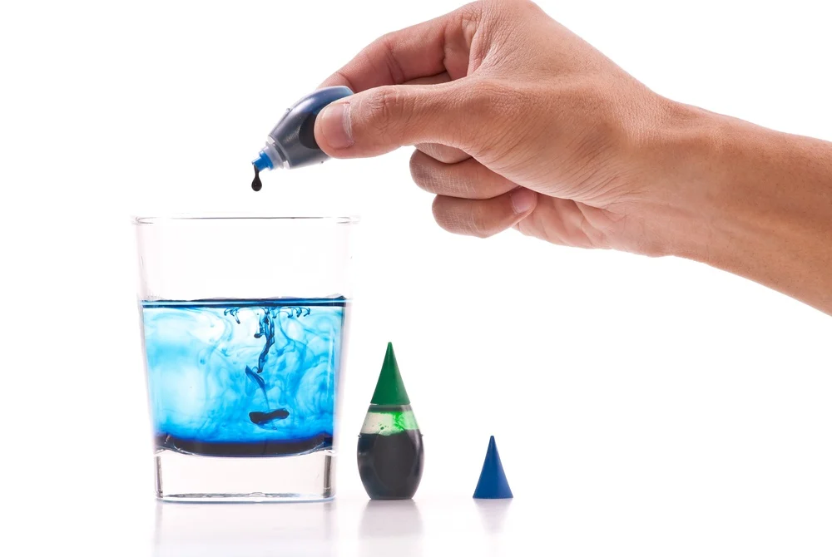
Gravity/Density
When you add a drop of food coloring to water there is a difference in relative densities of the two substances. The relative density of the food coloring is higher that the density of waters which causes the food coloring to sink to the bottom of the water. This is because the gravity is pulling the substance with greater relative density down before it can fully diffuse into the water. The random movement of food coloring particles and the help of stirring can speed up the diffusion.

Slide 4
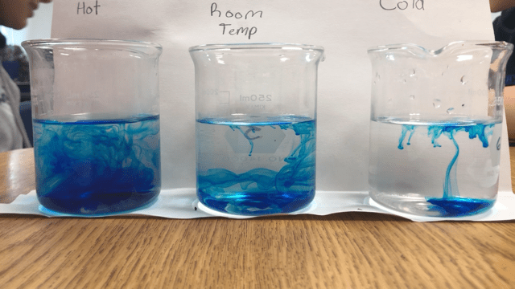
Temperature
Temperature in chemistry is often defined as a measure of the average kinetic energy of molecules in a substance. This means that temperature measures how fast the molecules are moving around. When the temperature of the substance rises, the molecules gain energy, and they move faster than the molecules in a cool substance. Since the molecules in warm water have more energy than those in cold or room temperature water, they are able to push past each other quicker, therefore, dispersing the food coloring faster.
This image shows how food coloring is diffused in water using three different temperatures.

Slide 5
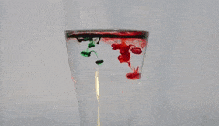
Conclusion
In cases where food coloring is dropped into water from above, it immediately tries to sink to the bottom due to gravity. It encounters the water molecules, which are moving around at a variable speed due to temperature, and the sinking food coloring molecules spread around between the water molecules. Diffusion continues until a mixture of food coloring and water is made.
In short: Gravity, Density and Temperature affect the speed of Diffusion, and Diffusion results in the mixes of food coloring and water that we observe.

Slide 6
References
https://sciencing.com/hot-less-dense-cold-water-6326030.html
http://depts.washington.edu/cmditr/modules/lum/color.html
https://www.biologyonline.com/dictionary/diffusion

