Slide 1
Hash Tables Without Linked Lists
Chapter 5

Slide 2
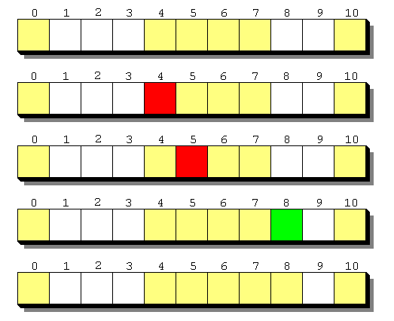
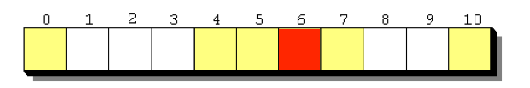
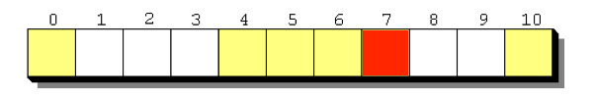
Linear Probing
Linear Probing
Notes:
Linear probing tries +1, +2, +3, …
Quadratic probing tries +1, +4, +9, +16, …
The other difference is that in quadratic probing, if a spot is taken, you just keep going (DON’T keep all the people hashing to the same box together).
This is because x^2 grows fast enough that it is actually faster to search every x^2 spots to the end of the table rather than worry about moving things around.

Slide 3
Quadratic Probing
Quadratic Probing
Add values from a quadratic function
Notes:
Linear probing tries +1, +2, +3, …
Quadratic probing tries +1, +4, +9, +16, …
The other difference is that in quadratic probing, if a spot is taken, you just keep going (DON’T keep all the people hashing to the same box together).
This is because x^2 grows fast enough that it is actually faster to search every x^2 spots to the end of the table rather than worry about moving things around.

Slide 4
Double Hashing
Double Hashing
Step size determined by a second function:
hashA(val) : 4
hashB(val) : 2
Notes:
While linear probing uses a step size of 1 and quadratic probing uses a step size of n^2 – (n-1)^2, double hashing uses a second hash function to determine the step size.
This second hash function must return a value greater than 0 and less than the size of the array.
Unlike the alternative collision-resolution methods of linear probing and quadratic probing, the interval depends on the data, so that values mapping to the same location have different bucket sequences; this minimizes repeated collisions and the effects of clustering.

Slide 5
Hash Tables with Worst-Case O(1) Access
Cuckoo Hashing
Hopscotch Hashing

Slide 6
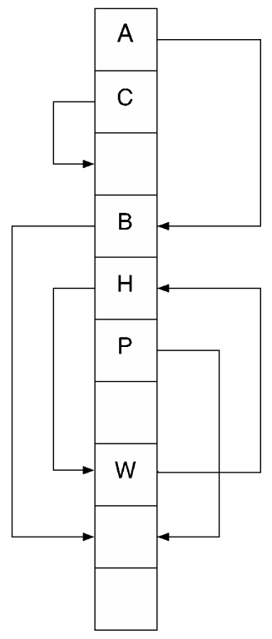
Cuckoo Hashing
Cuckoo Hashing:
Use two hash functions to provide an alternative entry point
Notes:
I am in the box h1 tells me to go to.
If someone else gets stuck in my box (collision), then I move to where h2 says to go
Can be implemented using a single table as shown on the right or using two tables indexed separately as shown in the following slides

Slide 7
Cuckoo Hashing - Example
Cuckoo Hashing:
Two hashing functions are used to address two different locations, the item must be placed in one of these two locations
Table 1
0
1
2
3
4
Table 2
0
1
2
3
4
Two hash functions are used, the first indexing Table 1 and the second indexing Table 2
Notes:
This property limits finding an item to running both hash functions and looking in the two indexed locations

Slide 8
Cuckoo Hashing - Example
Insert A:
Table 1 location is vacant, use location from first hash function for A.
Table 1
0 | A
1
2
3
4
Table 2
0
1
2
3
4
A: 0, 2

Slide 9
Cuckoo Hashing - Example
Insert B:
Table 1 location is occupied (by A). Displace A in Table 1 location to its Table 2 using the second hash function for A; this location is vacant.
The table 1 location is now vacant for B.
Table 1
0 | B
1
2
3
4
Table 2
0
1
2 | A
3
4
A: 0, 2
B: 0, 0

Slide 10
Cuckoo Hashing - Example
Insert C:
Table 1 location is vacant. Use location from first hash function for C
Table 1
0 | B
1 | C
2
3
4
Table 2
0
1
2 | A
3
4
A: 0, 2
B: 0, 0
C: 1,4

Slide 11
Cuckoo Hashing - Example
Insert D:
Table 1 location is occupied (by C). Displace C in Table 1 location to its Table 2 using the second hash function for C; this location is vacant.
The table 1 location is now vacant for D.
Table 1
0 | B
1 | D
2
3
4
Table 2
0
1
2 | A
3
4 | C
A: 0, 2
B: 0, 0
C: 1,4
D: 1, 0

Slide 12
Cuckoo Hashing - Example
Insert E:
Table 1 location is vacant. Use location from first hash function for E
Table 1
0 | B
1 | D
2
3 | E
4
Table 2
0
1
2 | A
3
4 | C
A: 0, 2
B: 0, 0
C: 1,4
D: 1, 0
E: 3, 2

Slide 13
Cuckoo Hashing - Example
Insert F:
Table 1 location is occupied (by E). Displace E in Table 1 location to its Table 2 using the second hash function for E; this location is also occupied...
Table 1
0 | B
1 | D
2
3 | F
4
Table 2
0
1
2 | EA
3
4 | C
A: 0, 2
B: 0, 0
C: 1,4
D: 1, 0
E: 3, 2
F: 3, 4

Slide 14
Cuckoo Hashing - Example
Displace A:
A is in Table 2, use first hash function to displace A to table 1, this location is also occupied...
Table 1
0 | AB
1 | D
2
3 | F
4
Table 2
0
1
2 | E
3
4 | C
A: 0, 2
B: 0, 0
C: 1,4
D: 1, 0
E: 3, 2
F: 3, 4

Slide 15
Cuckoo Hashing - Example
Displace B:
B is in Table 1, use second hash function to displace B to table 2, this location is vacant.
Table 1
0 | A
1 | D
2
3 | F
4
Table 2
0 | B
1
2 | E
3
4 | C
A: 0, 2
B: 0, 0
C: 1,4
D: 1, 0
E: 3, 2
F: 3, 4
Notes:
In the worst case a cycle will result where a previous location is indexed in a subsequent displacement. In this situation the tables will need to be expanded and rehashed. Cycles are unlikely when the load factor is less than 0.5 however long chains of displacements are inefficient so typically expansion/rehashing will typically occur either upon log(n) displacements occurring when attempting to insert an item or reaching a load factor of 0.4

Slide 16
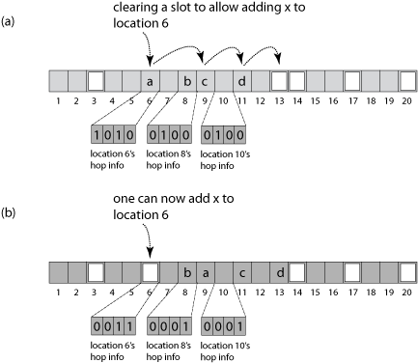
Hopscotch Hashing
Hopscotch Hashing:
Restrict each value to a range of consecutive locations in the table
Notes:
In hopscotch hashing a given item will always be inserted-into and found-in the neighborhood of its hashed bucket. In other words, it will always be found either in its original hashed array entry, or in one of the next H-1 neighboring entries.
The “hop” information at a location indexed by the hash function (location H) is encoded as a bit string where 1’s indicate locations that are occupied by an item hashing to H while 0’s indicate locations that are either vacant or occupied by values that hash to other values (!= H). The position of each bit starts from the left most bit representing location H and the remaining bits consecutive locations to the right.

Slide 17
Hopscotch Hashing - Example
 | Item | Hop
...
6 | C | 1000
7 | A | 1100
8 | D | 0010
9 | B | 1000
10 | E | 0000
11 | G | 1000
12 | F | 1000
13 |  | 0000
14 |  | 0000
...
A: 7
B: 9
C: 6
D: 7
E: 8
F: 12
G: 11
Starting with the following table:

Slide 18
Hopscotch Hashing - Example
 | Item | Hop
...
6 | C | 1000
7 | A | 1100
8 | D | 0010
9 | B | 1000
10 | E | 0000
11 | G | 1000
12 | F | 1000
13 |  | 0000
14 |  | 0000
...
 | Item | Hop
...
6 | C | 1000
7 | A | 1100
8 | D | 0010
9 | B | 1000
10 | E | 0000
11 |  | 0010
12 | F | 1000
13 | G | 0000
14 |  | 0000
...
 | Item | Hop
...
6 | C | 1000
7 | A | 1100
8 | D | 0010
9 | B | 1010
10 | E | 0000
11 | H | 0010
12 | F | 1000
13 | G | 0000
14 |  | 0000
...
A: 7
B: 9
C: 6
D: 7
E: 8
F: 12
G: 11
H: 9
Insert H:

Slide 19
Hopscotch Hashing - Example
 | Item | Hop
...
6 | C | 1000
7 | A | 1100
8 | D | 0010
9 | B | 1010
10 | E | 0000
11 | H | 0010
12 | F | 1000
13 | G | 0000
14 |  | 0000
...
 | Item | Hop
...
6 | C | 1000
7 | A | 1100
8 | D | 0010
9 | B | 1010
10 | E | 0000
11 | H | 0001
12 | F | 1000
13 |  | 0000
14 | G | 0000
...
 | Item | Hop
...
6 | C | 1000
7 | A | 1100
8 | D | 0010
9 | B | 1010
10 | E | 0000
11 | H | 0001
12 |  | 0100
13 | F | 0000
14 | G | 0000
...
A: 7
B: 9
C: 6
D: 7
E: 8
F: 12
G: 11
H: 9
I: 6
Insert I:

Slide 20
Hopscotch Hashing - Example
 | Item | Hop
...
6 | C | 1000
7 | A | 1100
8 | D | 0010
9 | B | 1010
10 | E | 0000
11 | H | 0001
12 |  | 0100
13 | F | 0000
14 | G | 0000
...
 | Item | Hop
...
6 | C | 1000
7 | A | 1100
8 | D | 0010
9 |  | 0011
10 | E | 0000
11 | H | 0001
12 | B | 0100
13 | F | 0000
14 | G | 0000
...
 | Item | Hop
...
6 | C | 1001
7 | A | 1100
8 | D | 0010
9 | I | 0011
10 | E | 0000
11 | H | 0001
12 | B | 0100
13 | F | 0000
14 | G | 0000
...
A: 7
B: 9
C: 6
D: 7
E: 8
F: 12
G: 11
H: 9
I: 6
Insert I (continued):

Slide 21
Picture References
https://commons.wikimedia.org/wiki/File:Cuckoo.svg
https://en.wikipedia.org/wiki/Hopscotch_hashing#/media/File:Hopscotch-wiki-example.gif

