Slide 1
CPSC 2120: Algorithms and Data Structures
Overview

Slide 2
Course Material
Data Structures
Tasks
  Sorting
  Searching
Analysis
Algorithms and Design

Slide 3
Course Material
Data Structures
Tasks
  Sorting
  Searching
Analysis
Algorithms and Design

Slide 4
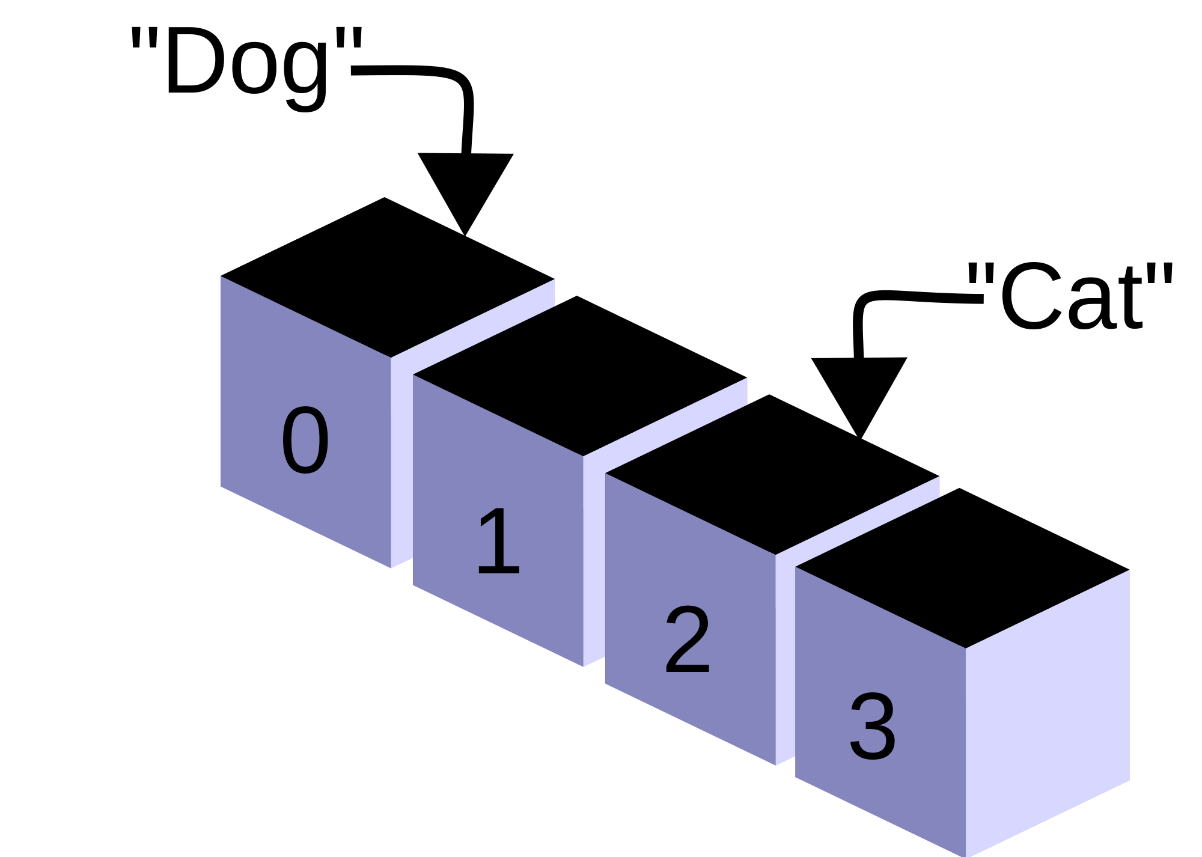
Arrays
https://commons.wikimedia.org/wiki/File:CPT-programming-array.svg

Slide 5
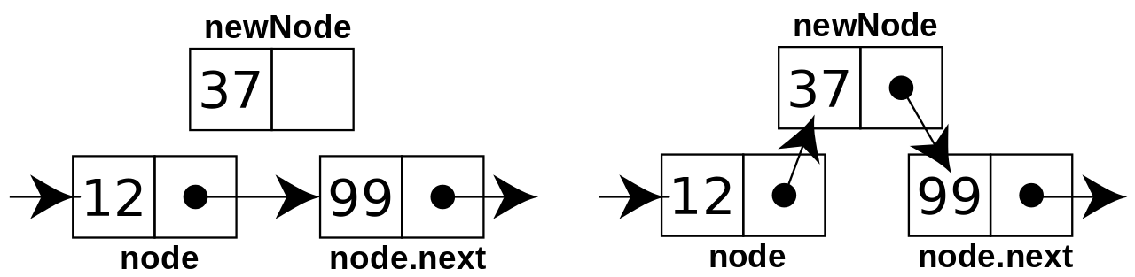
Linked List
https://en.wikipedia.org/wiki/File:CPT-LinkedLists-addingnode.svg

Slide 6
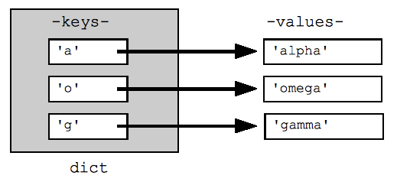
Dictionary/Map
https://commons.wikimedia.org/wiki/File:GooglePythonClass_Day1_Part3_Pic.jpg

Slide 7
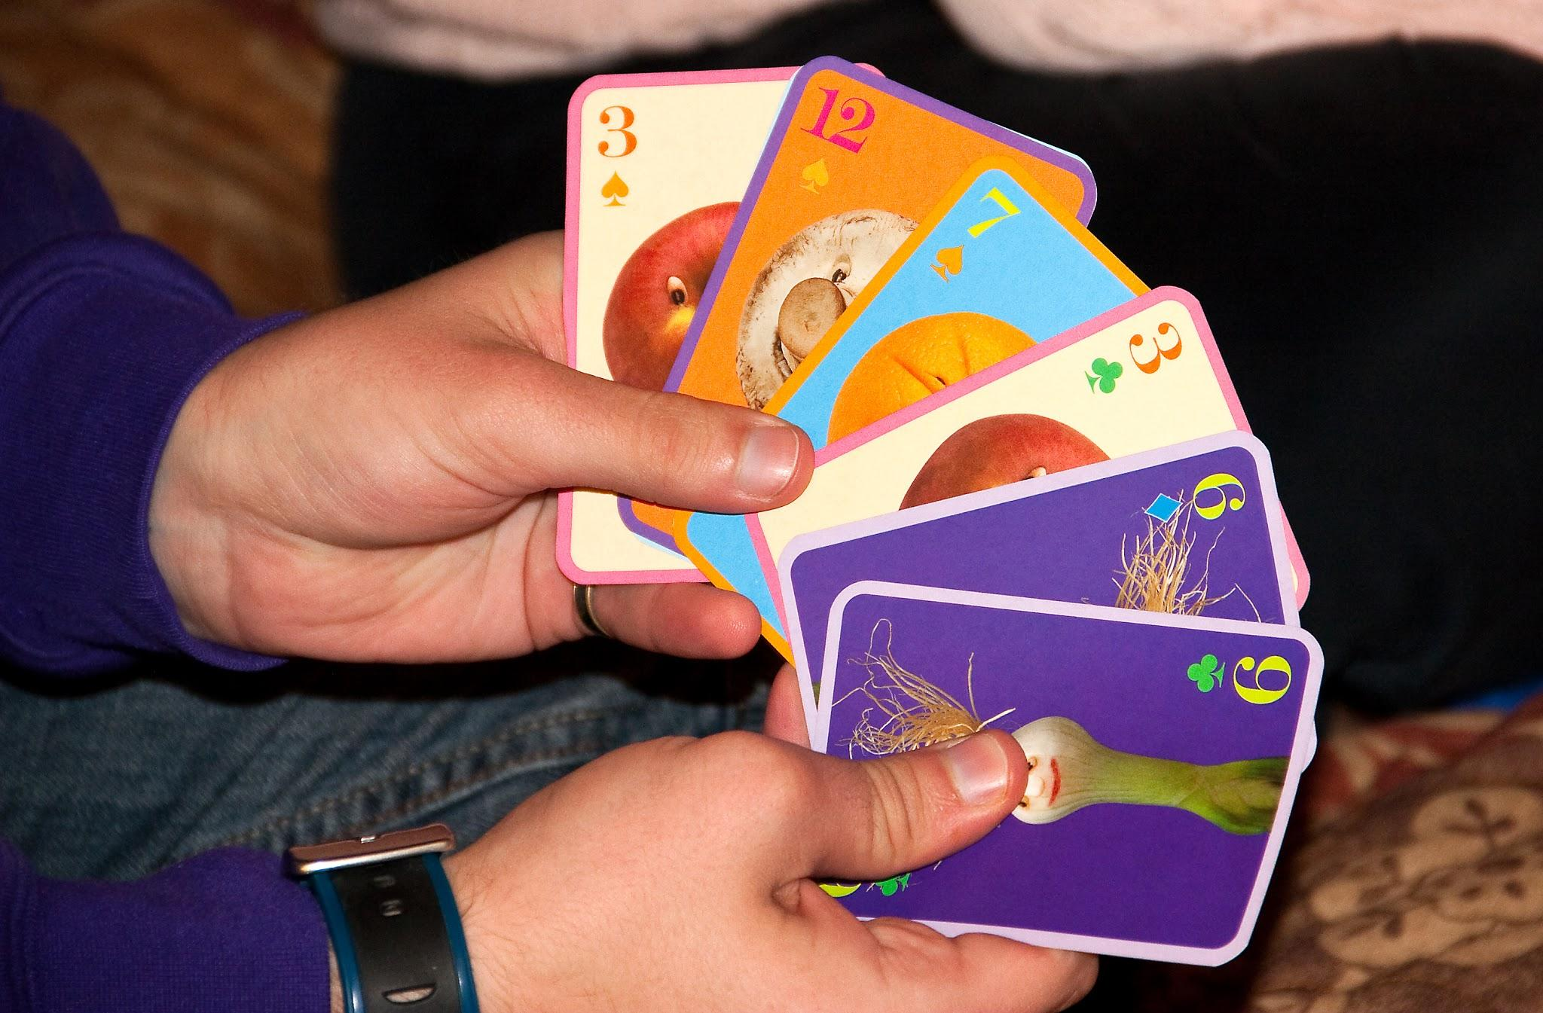
Set
https://pxhere.com/en/photo/270789

Slide 8
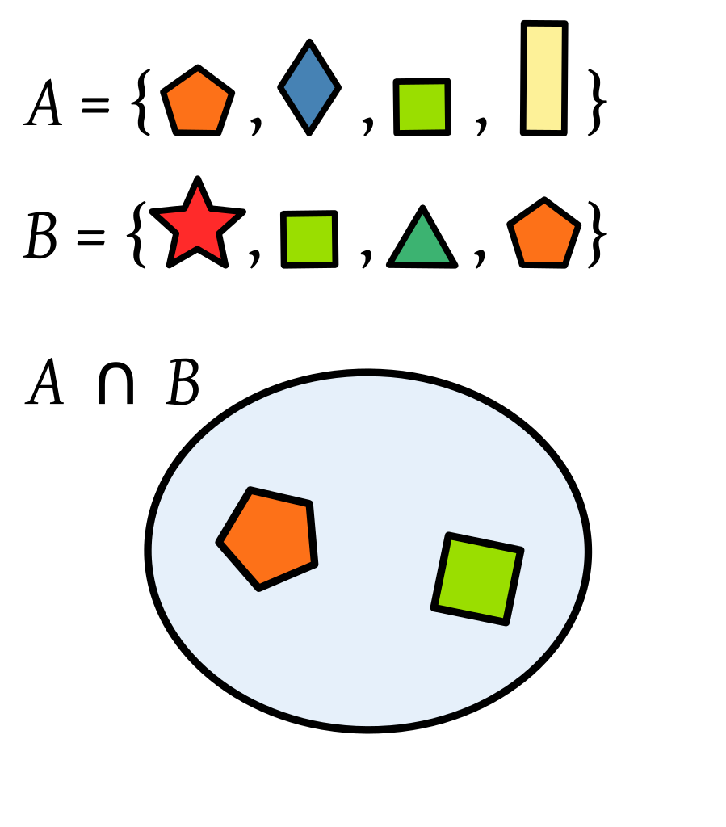
Set
https://en.m.wikipedia.org/wiki/File:PolygonsSetIntersection.svg

Slide 9
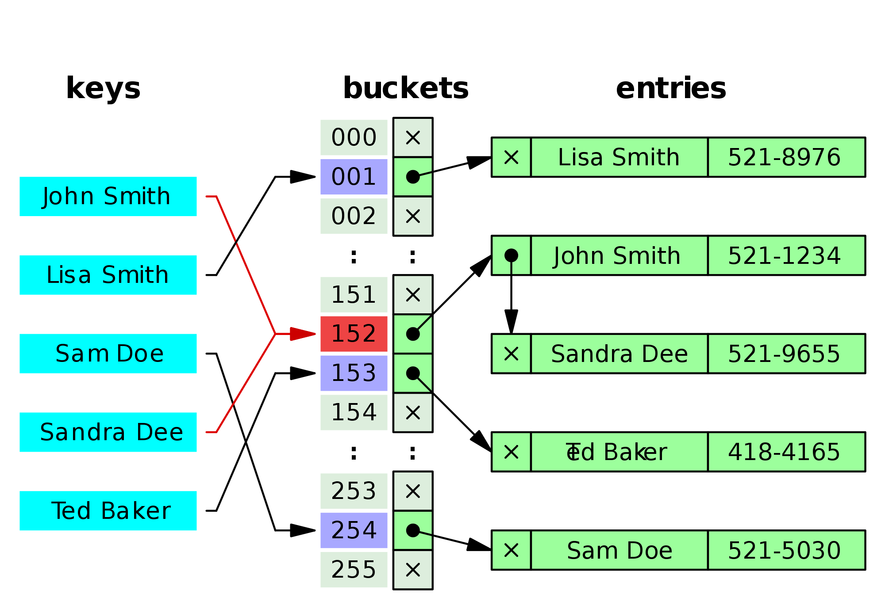
Hash Table
https://commons.wikimedia.org/wiki/File:Hash_table_5_0_1_1_1_1_1_LL.svg

Slide 10
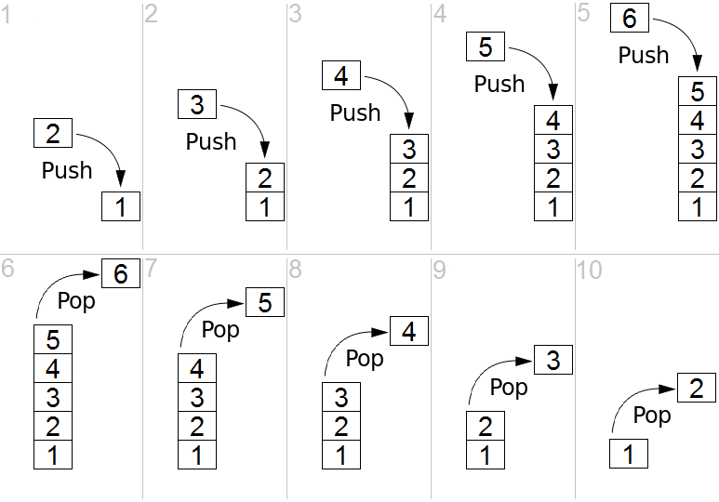
Stack
https://commons.wikimedia.org/wiki/File:Lifo_stack.png

Slide 11
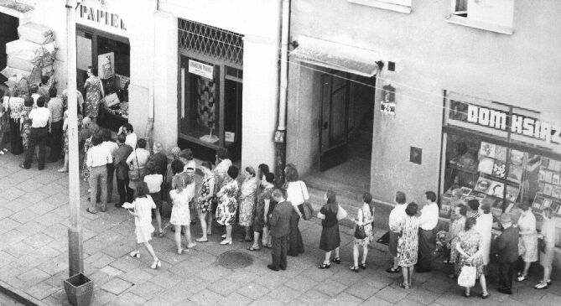
Queue
https://commons.wikimedia.org/wiki/File:Kolejka.jpeg

Slide 12
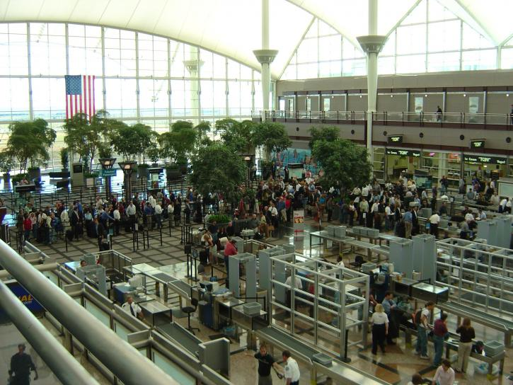
Priority Queue
https://pixnio.com/people/crowd/airport-security-lines

Slide 13
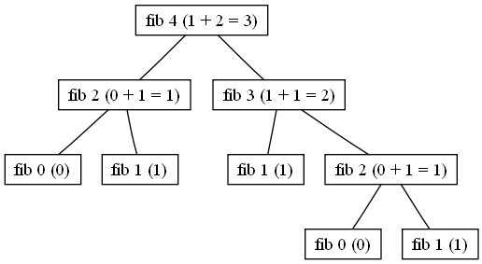
Tree
nhttps://commons.wikimedia.org/wiki/File:Fib_4.png

Slide 14
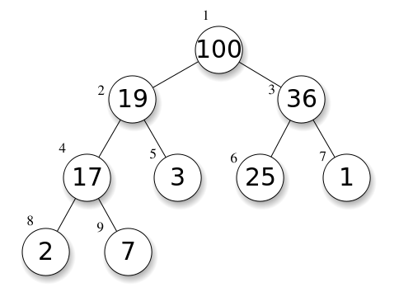
Heap
https://upload.wikimedia.org/wikipedia/commons/b/b0/Max-Heap-index.svg
Notes:
Max-heap: a tree satisfying a (max) heap structure (i.e. each node’s value is smaller than its parent’s value)

Slide 15
Course Material
Data Structures
Tasks
  Sorting
  Searching
Analysis
Algorithms and Design

Slide 16
Course Material
Data Structures
Tasks
  Sorting
  Searching
Analysis
Algorithms and Design

Slide 17
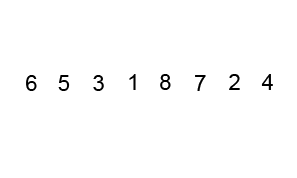
Sorting - Bubble Sort
https://en.wikipedia.org/wiki/Bubble_sort#/media/File:Bubble-sort-example-300px.gif

Slide 18
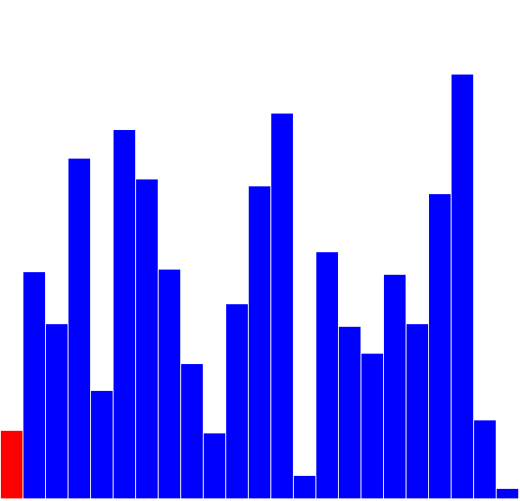
Sorting - Selection Sort
https://commons.wikimedia.org/wiki/File:%D0%A1%D0%BE%D1%80%D1%82%D0%B8%D1%80%D0%B0%D1%9A%D0%B5_%D1%81%D0%B5%D0%BB%D0%B5%D0%BA%D1%86%D0%B8%D1%98%D0%BE%D0%BC.gif
Notes:
Select the smallest remaining element, put it next

Slide 19
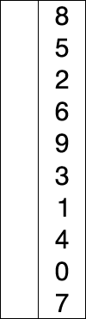
Sorting - Selection Sort
https://upload.wikimedia.org/wikipedia/commons/9/94/Selection-Sort-Animation.gif

Slide 20
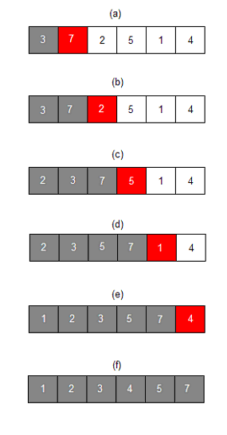
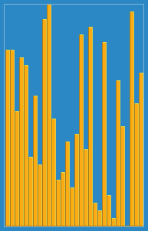
Sorting - Insertion Sort
https://commons.wikimedia.org/wiki/File:Insertion_sort_001.PNG
https://en.wikipedia.org/wiki/Insertion_sort#/media/File:Insertion_sort.gif
Notes:
Take the next number in the array, insert it where it should go

Slide 21
Sorting - Insertion Sort
https://commons.wikimedia.org/wiki/File:Insertion_sort_001.PNG

Slide 22
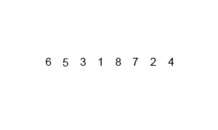
Sorting - Mergesort
https://upload.wikimedia.org/wikipedia/commons/c/cc/Merge-sort-example-300px.gif

Slide 23

Sorting - QuickSort
https://commons.wikimedia.org/wiki/File:Quicksort-example.gif

Slide 24
Sorting - Heap Sort
Better Selection Sort
Uses Heap structure rather than linear search to find next value

Slide 25
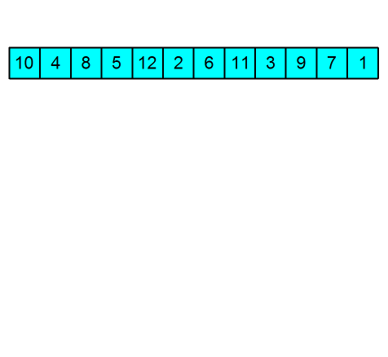
Sorting - Heap Sort
Better Selection Sort
Uses Heap structure rather than linear search to find next value
https://upload.wikimedia.org/wikipedia/commons/f/fe/Heap_sort_example.gif

Slide 26
Course Material
Data Structures
Tasks
  Sorting
  Searching
Analysis
Algorithms and Design

Slide 27
Searching - Linear Search

Slide 28
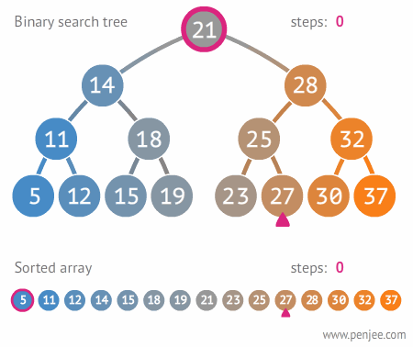
Searching - Binary Search
https://commons.wikimedia.org/wiki/File:Binary_search_tree_example.gif

Slide 29
Searching - Algorithms
Covered in algorithms section

Slide 30
Course Material
Data Structures
Tasks
  Sorting
  Searching
Analysis
Algorithms and Design

Slide 31
How To Compare?
Asymptotic
Best-Worst-Average Case
Deterministic vs Stochastic
Basic vs Amortized
O, o, Ω, ω, Θ

Slide 32
O(n²) | ≤ k*n²
o(n) | < k*n
Ω(n³) | ≥ k*n³
ω(n^{1.5}) | > k*n^{1.5}
Θ(log(n)) | = k*log(n)
How To Compare?

Slide 33
Course Material
Data Structures
Tasks
  Sorting
  Searching
Analysis
Algorithms and Design

Slide 34
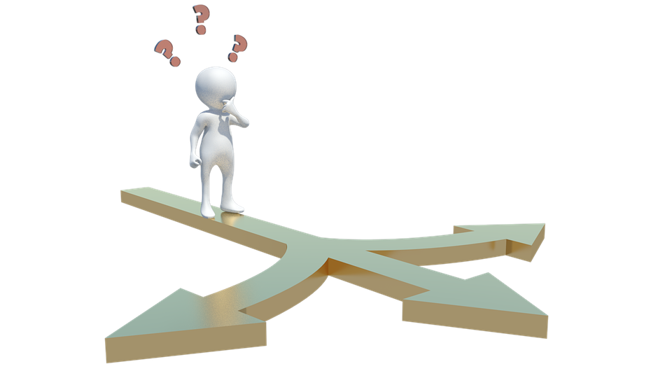
Algorithms vs Design Principles
https://pixabay.com/en/choice-arrow-question-mark-path-3183317/

Slide 35
Algorithms
Exhaustive Search
Divide and Conquer
Iterative Refinement
Greedy Algorithms
Dynamic Programming
Random Algorithms
Heuristics
Graph Algorithms

Slide 36
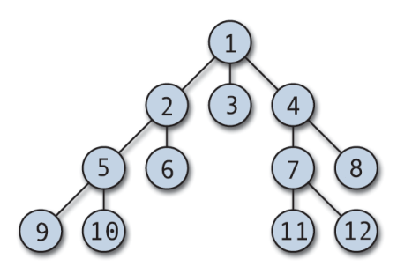
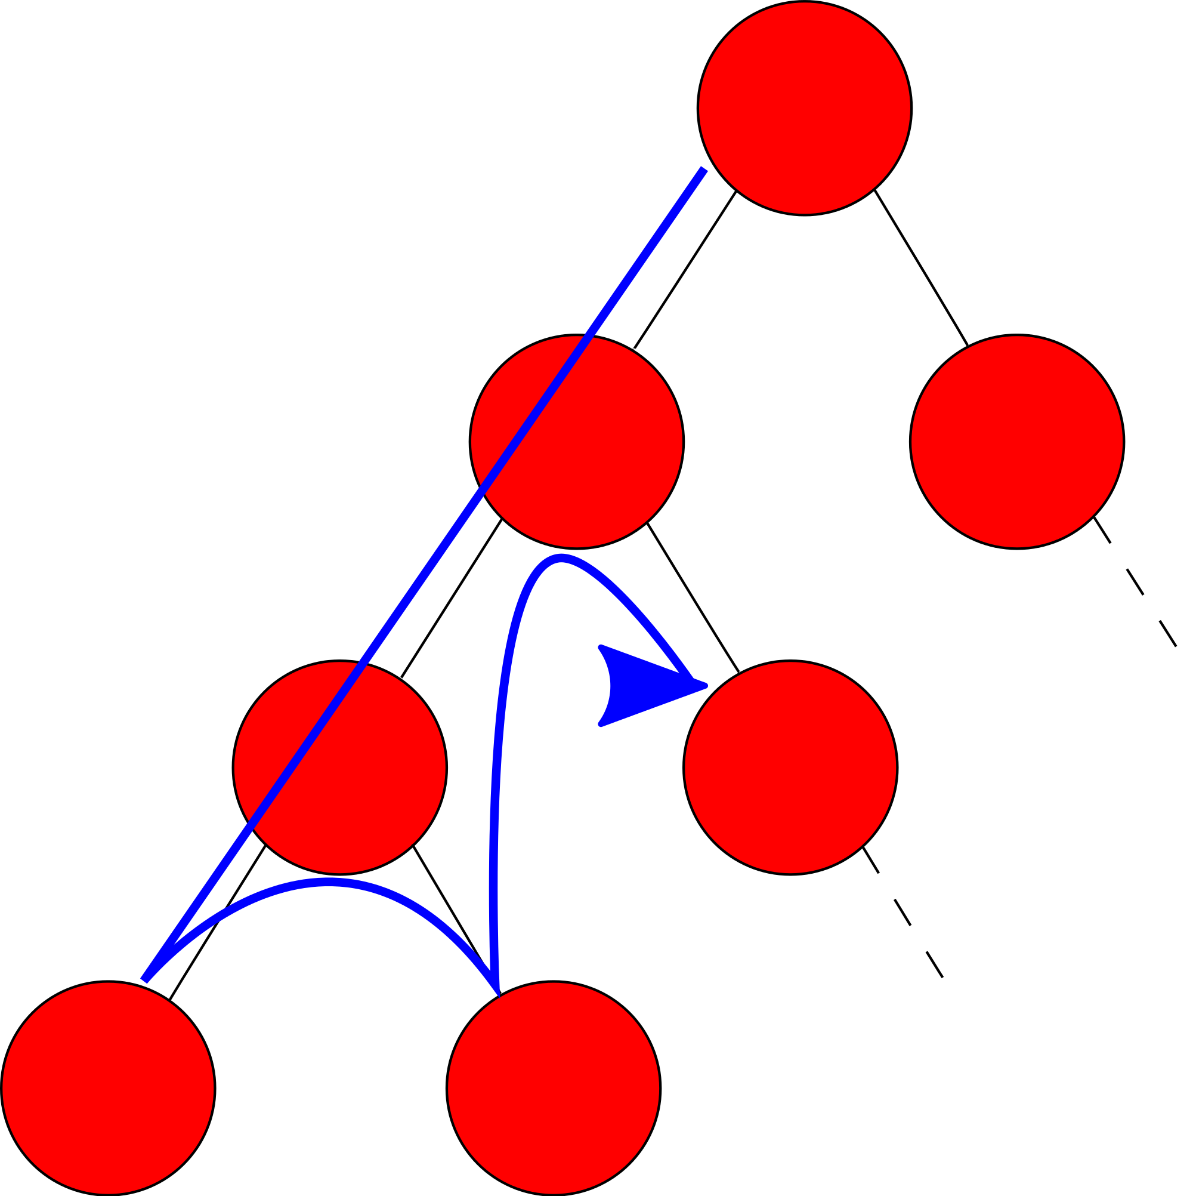
Templates - Exhaustive Search
https://commons.wikimedia.org/wiki/File:Depth_first_search.svg
https://commons.wikimedia.org/wiki/File:Breadth-first-tree.png

Slide 37
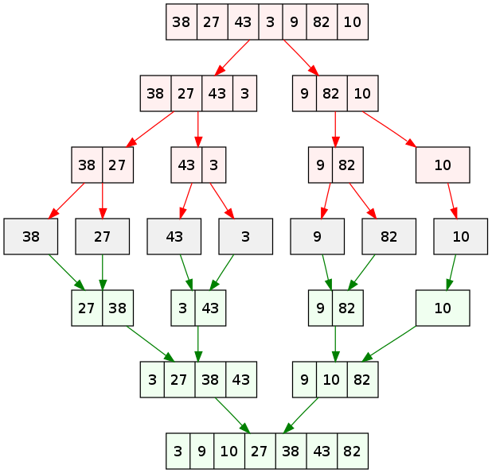
Templates - Divide and Conquer
https://en.wikipedia.org/wiki/Divide_and_conquer_algorithm#/media/File:Merge_sort_algorithm_diagram.svg

Slide 38
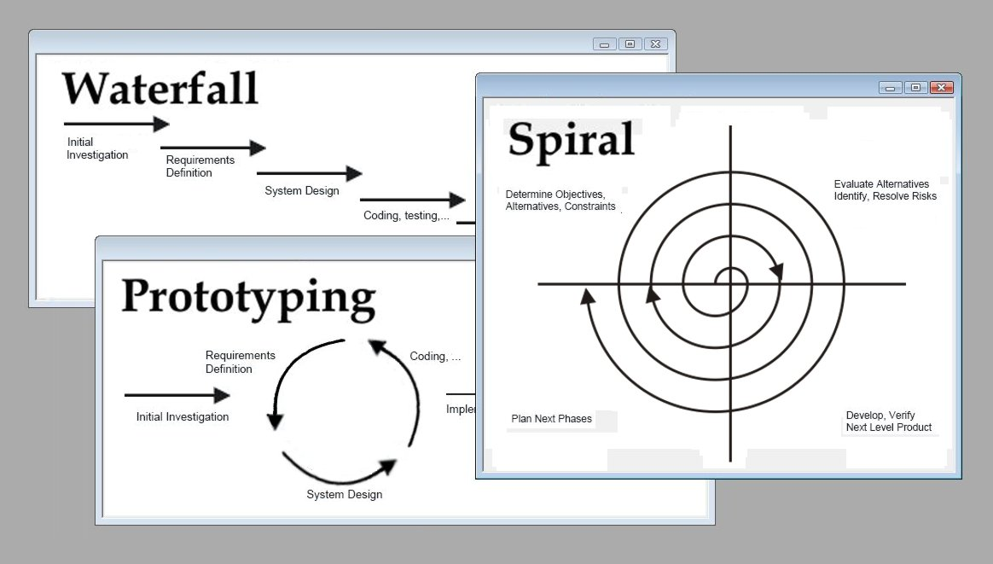
Templates - Iterative Refinement
https://commons.wikimedia.org/wiki/File:Software_development_methodologies.jpg

Slide 39
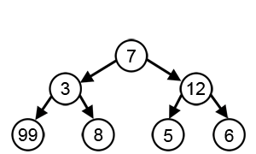
Templates - Greedy Algorithms
https://en.wikipedia.org/wiki/Greedy_algorithm#/media/File:Greedy-search-path-example.gif

Slide 40
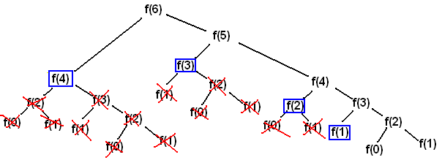
Templates - Dynamic Programming
https://commons.wikimedia.org/wiki/File:Algorithms-F6CallTreeMemoized.png

Slide 41
Dynamic Programming vs Divide-and-Conquer

Slide 42
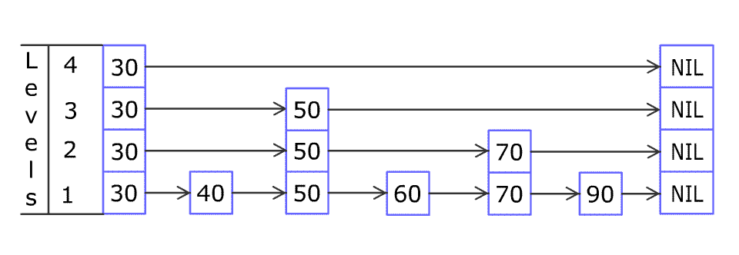
Templates - Random Algorithms
https://upload.wikimedia.org/wikipedia/commons/2/2c/Skip_list_add_element-en.gif

Slide 43
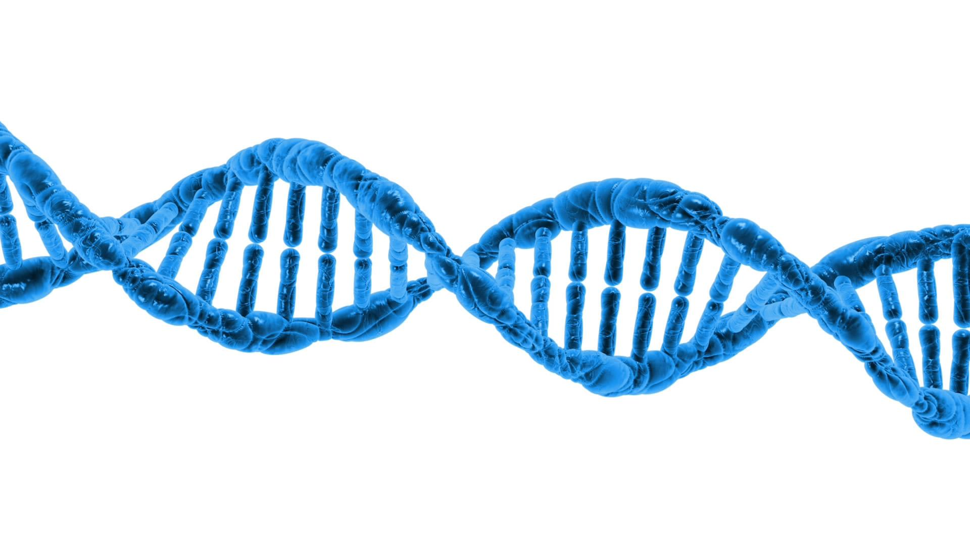
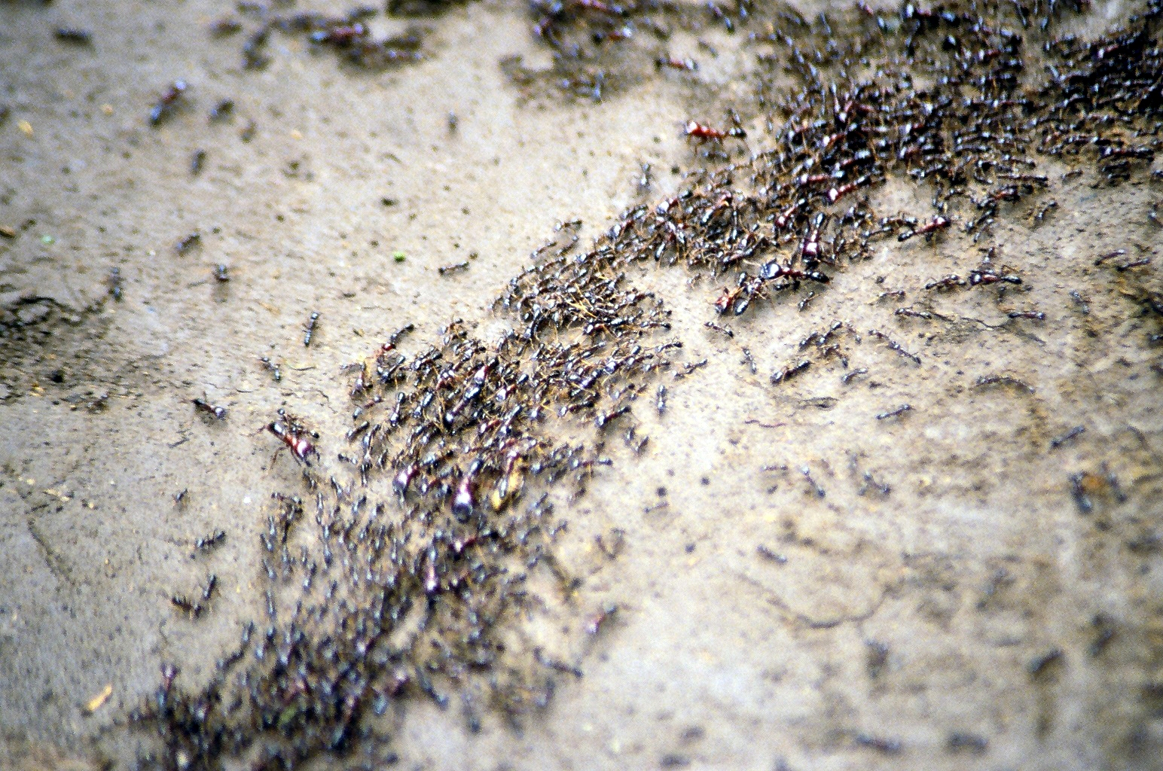
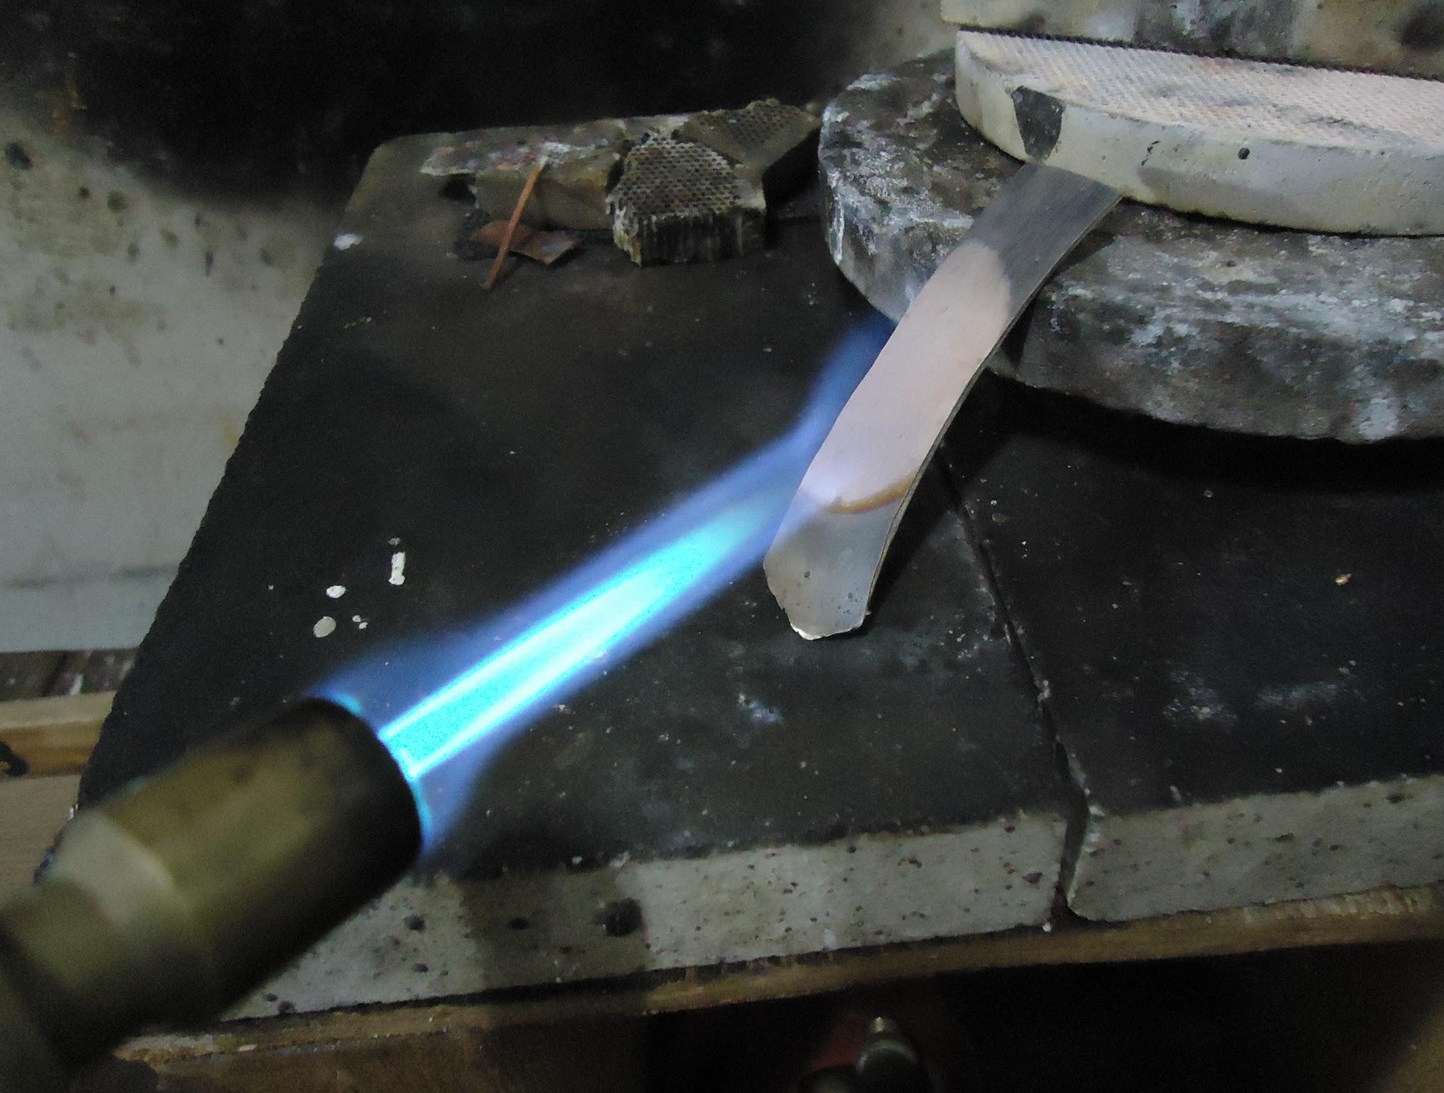
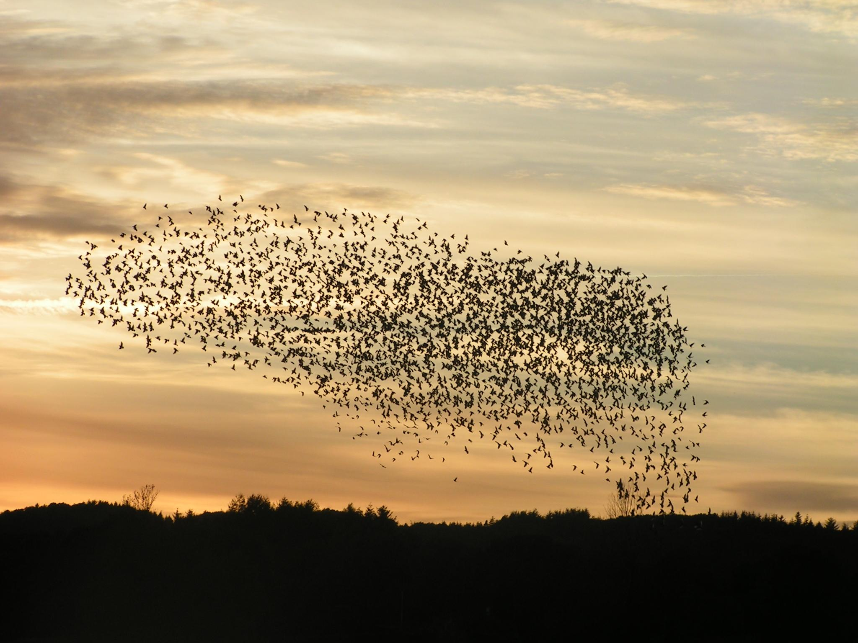
Templates - Heuristics
https://commons.wikimedia.org/wiki/File:Annealing_a_silver_strip.JPG
https://commons.wikimedia.org/wiki/File:Safari_ants.jpg
https://commons.wikimedia.org/wiki/File:Fugle,_%C3%B8rns%C3%B8_073.jpg
https://www.publicdomainpictures.net/en/view-image.php?image=42718&picture=dna

Slide 44
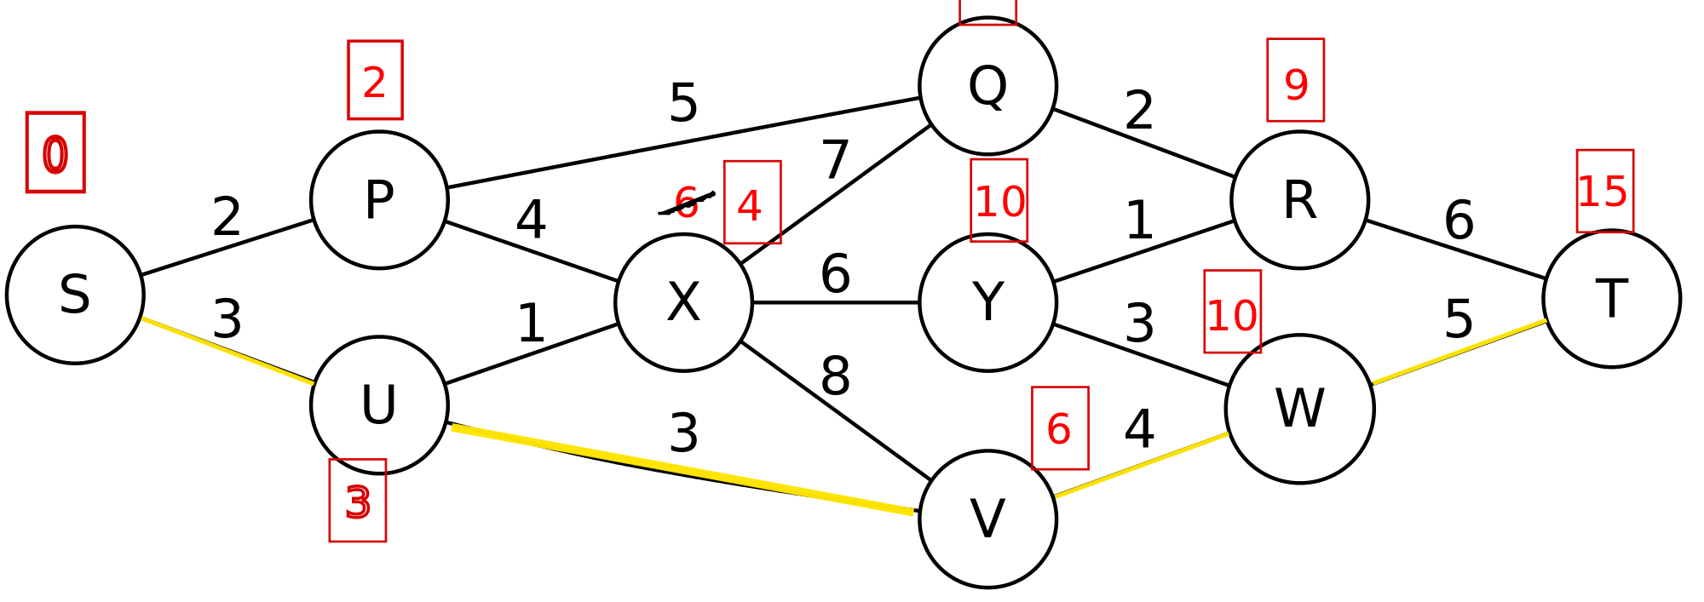
Templates - Graph Algorithms
https://commons.wikimedia.org/wiki/File:Dijkstra_algorithm_13.svg

Slide 45
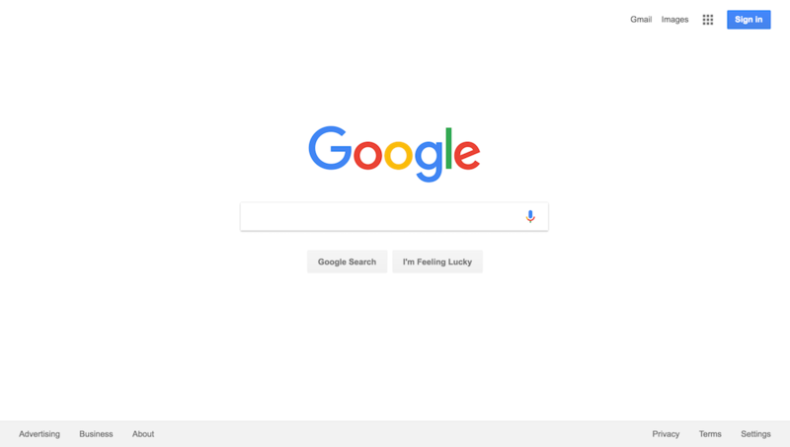
Templates - Graph Algorithms
https://en.wikipedia.org/wiki/Google
Notes:
There is one particularly famous graph algorithm - PageRank: the foundation for Google’s search engine

