Slide 1
Chapter 11 : Water
Part 1

Slide 2
A Disappearing Resource
Lake Chad in Africa
5,000 years ago area much wetter
Lake has receded ever since
Lake has decreased over 90% since 1973
  Climate change
  Deforestation
  Human overuse
Notes:
2

Slide 3
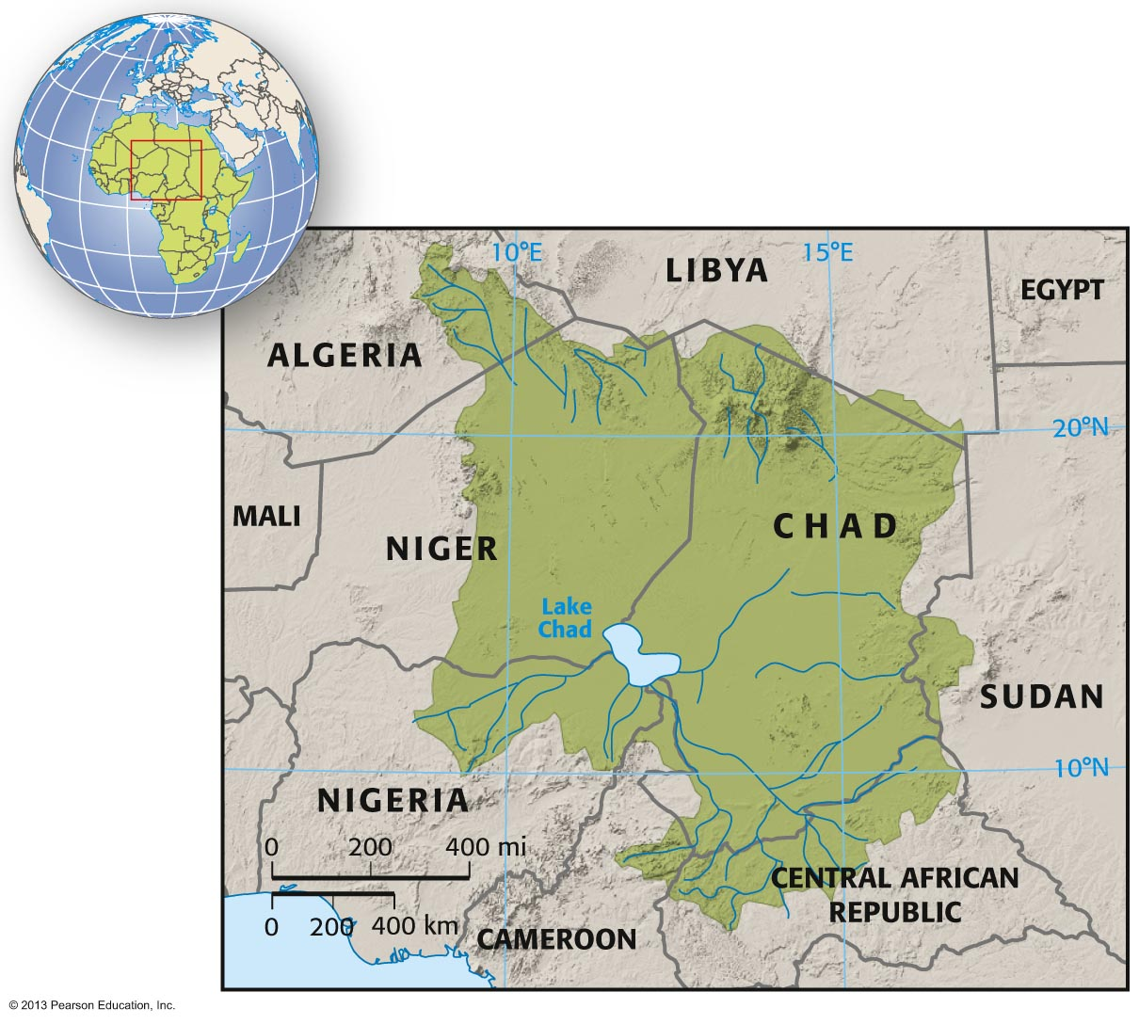
Notes:
3

Slide 4
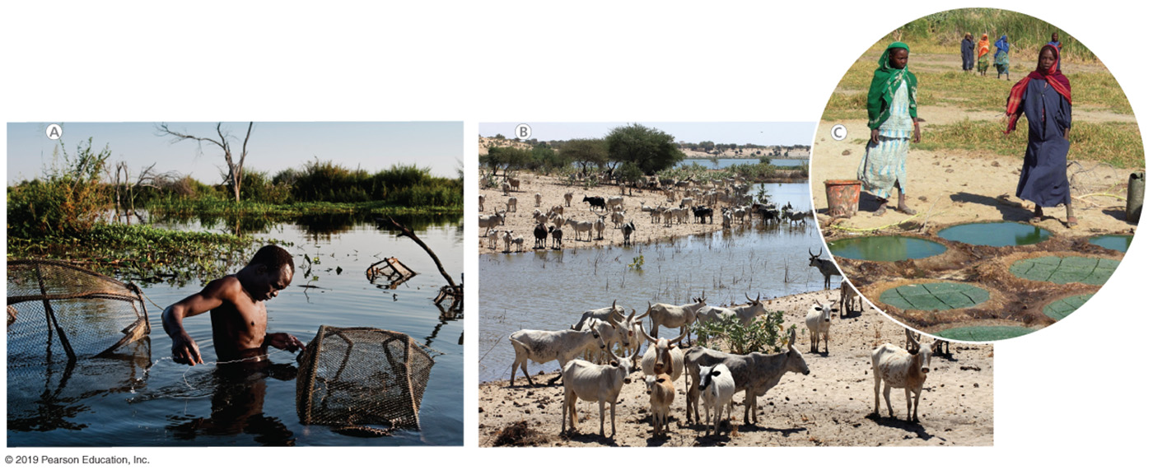
Notes:
4

Slide 5
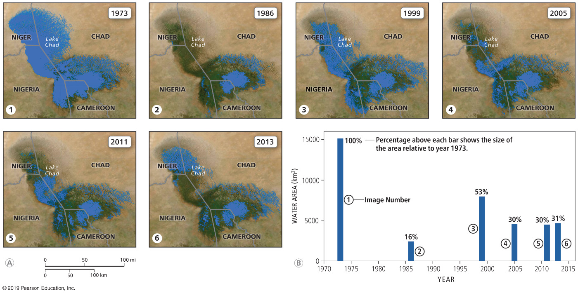
Notes:
5

Slide 6
11.1 Water World
The global water budget
  Over 70% of Earth's surface is covered with water
  Equal amount of water evaporates as precipitates
    Precipitation has three fates
      Evaporation
      Flow over land
        Rivers, streams
    Percolate to groundwater
Notes:
6

Slide 7
11.1 Water World
Where is Earth’s fresh water?
Earth’s surface 70% water
  97.5% salty, 1.74% frozen, 0.001% in soil
  1% fresh water
Fresh water not evenly distributed
  Baseline water stress
    Total annual water withdrawals as a percent of annual flow in that region
Notes:
7

Slide 8
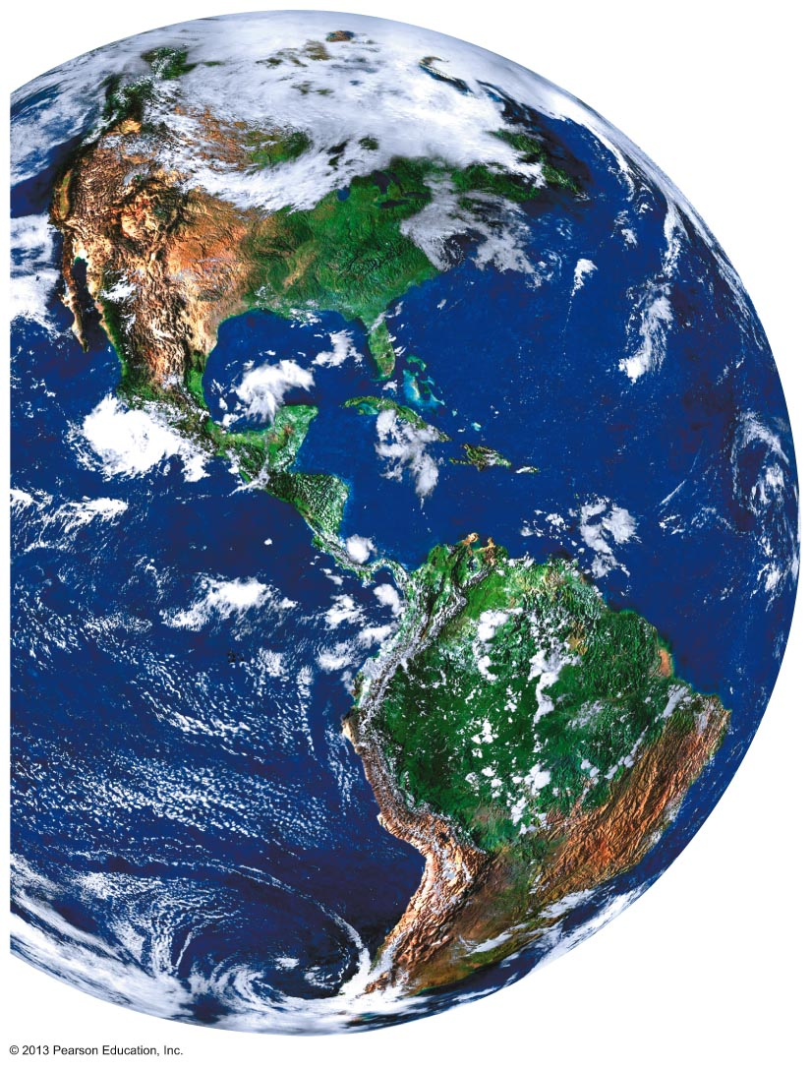
Notes:
8

Slide 9
11.1 Water World
Geography of the hydrologic cycle
  Source of water varies by time and region
  Ocean and near coasts
    ~100% of rain from ocean
  Inland
    Considerable proportion from evapotranspiration
    Example: 25–50% of rain in Amazon from evapotranspiration
Notes:
9

Slide 10
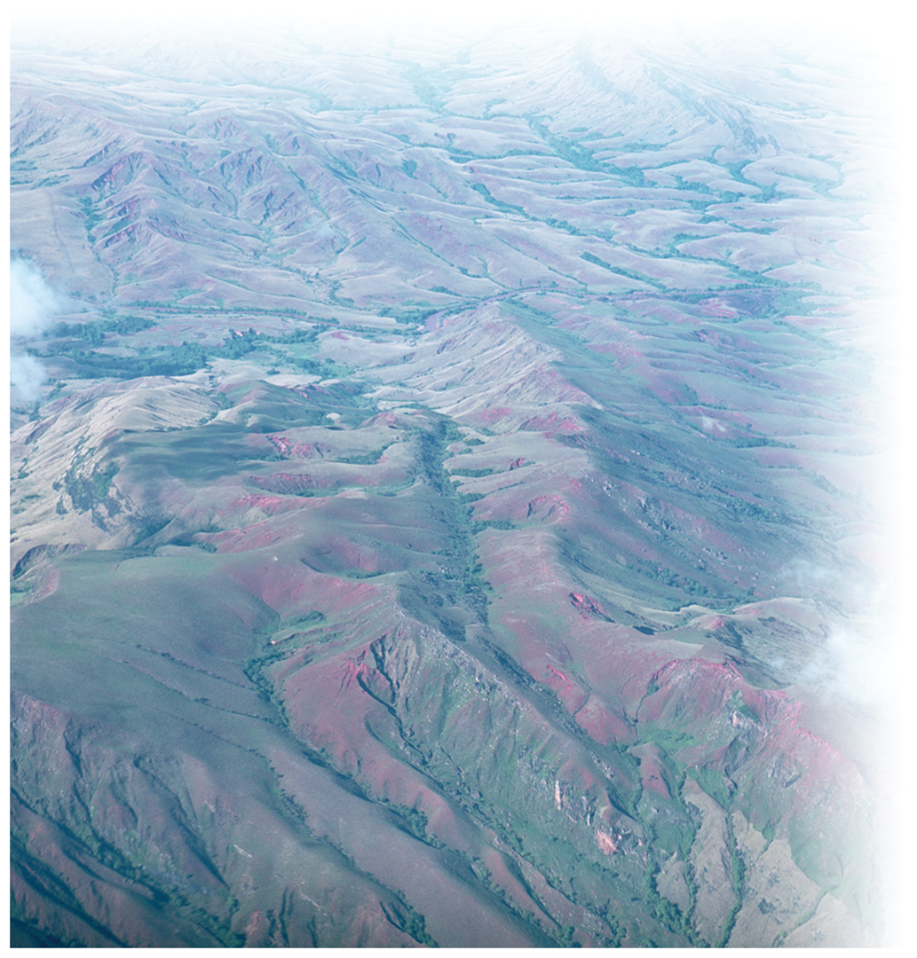
Notes:
10

Slide 11
11.1 Water World
Watersheds
  Area of land that drains to form a river or lake
  Also called drainage basins
  Separated by geological features
    Mountains, plateaus
  Open watersheds
      Eventually drain to sea
  Closed watersheds
      Do not drain to sea
Notes:
11

Slide 12
11.1 Water World
Essential ecosystem services
Supporting services
  Photosynthesis, nutrient movement, food webs
Regulatory services
  Temperature regulation, pH buffering
Provisioning services
  Drinking water, agriculture
Notes:
12

Slide 13
11.1 Water World
Human water use
  Use over half of water flowing in Earth’s streams
  Nonconsumptive uses
    Water use that returns to streams/aquifers
      Hydroelectric power, wastewater in septic systems
  Consumptive uses
    Water not returned
      Irrigation
      Industrial use
Notes:
13

Slide 14
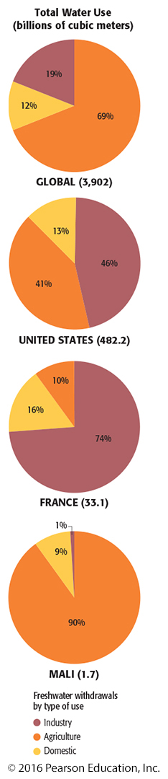
Notes:
14

Slide 15
11.2 Groundwater
Water that resides in rocks and soil beneath the ground
  0.3% of Earth’s water
Most in aquifers
  Layers of sediment and rock saturated with water
    Wide variation of volume of water stored
Notes:
15

Slide 16
11.2 Groundwater
Characteristics of groundwater
  From rain that does not evaporate or run off
  Percolates through rock to the water table
    Water table—underground depth where rock and sediment are completely saturated
  Recharge zone
    Area from which water enters water table from surface
  Discharge zone
    Groundwater flows to surface
Notes:
16

Slide 17
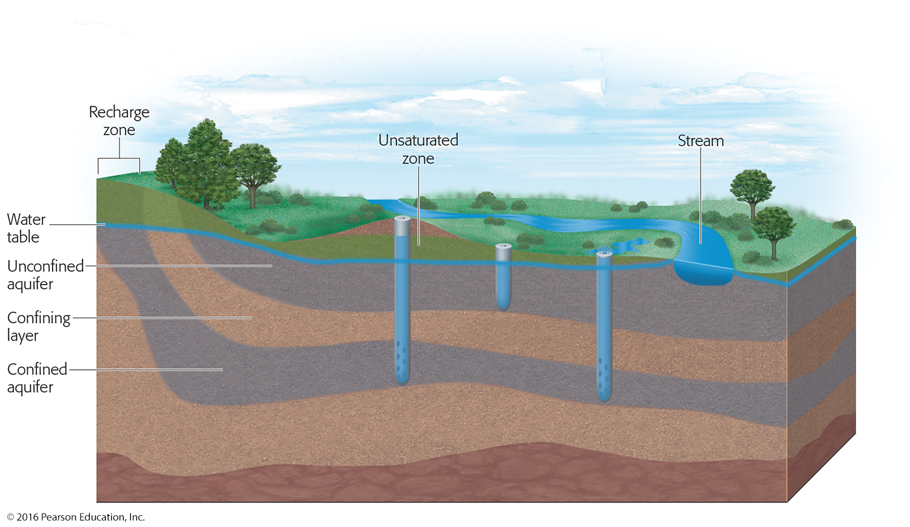
Notes:
17

Slide 18
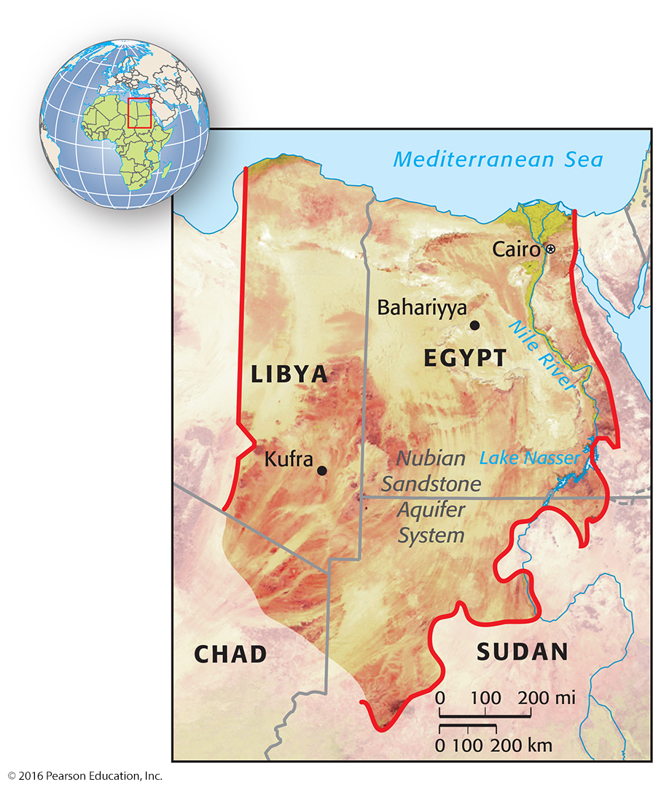
Notes:
18

Slide 19
11.2 Groundwater
Human use and impacts
  Extraction
    Agriculture (68%)
    Industrial (21%)
    Domestic (11%)
  Some areas, extraction exceeds recharge
    Arid areas especially
  Primary drinking water source for many
  Pollution
    Faulty septic systems, chemical storage tank leaks
Notes:
19

Slide 20
11.3 Water Distribution
Too much water—flood control
  Flooding natural occurrence
  Seasonal volumes of rain or snowmelt
  Annual flood cycles support rich agricultural areas
    Nile
    Mississippi
Notes:
20

Slide 21
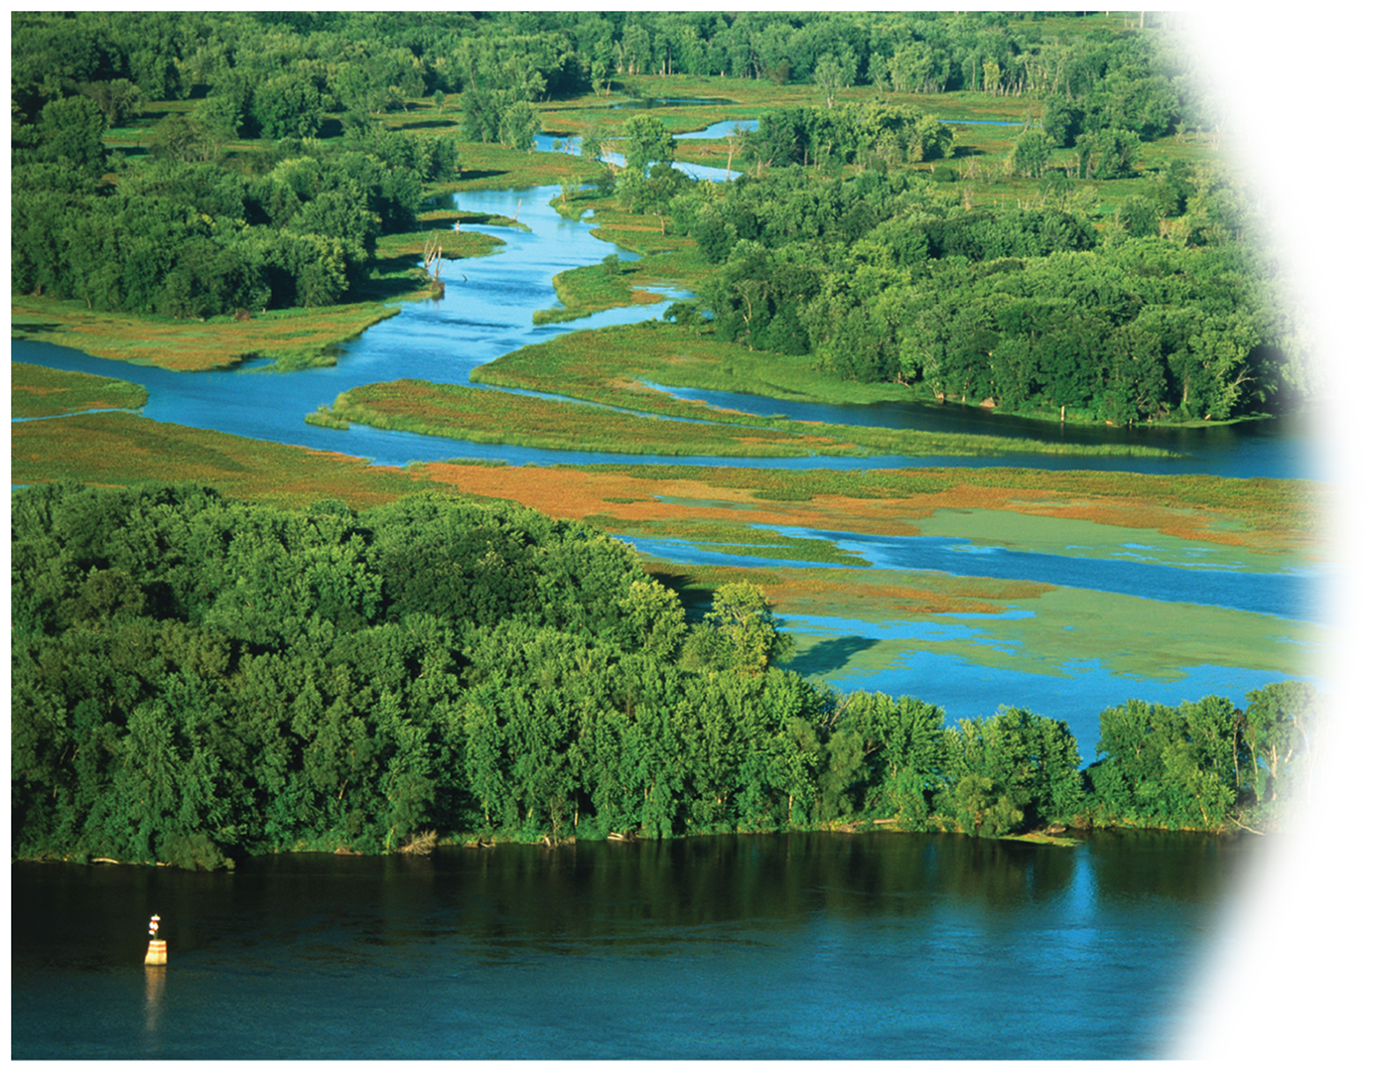
Notes:
21

Slide 22
11.3 Water Distribution
Too much water—flood control
  Urban systems—challenges
  Impervious surfaces
    Pavement, roofs
    Do not absorb rainfall
  Water channeled through storm drains to bodies of water
    30–50% of urban surface runoff goes into water bodies
    5% of forested system runoff goes into water bodies
Notes:
22

Slide 23
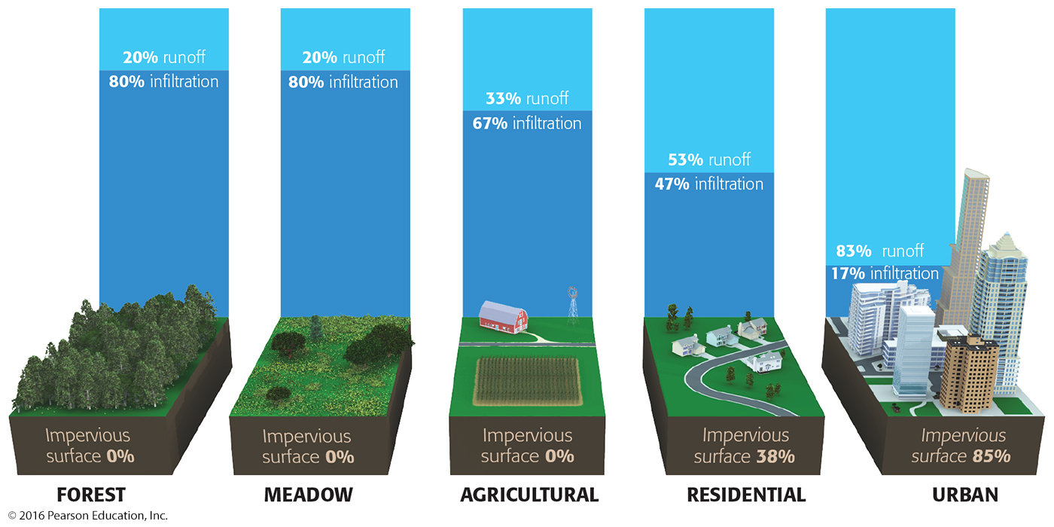
Notes:
23

Slide 24
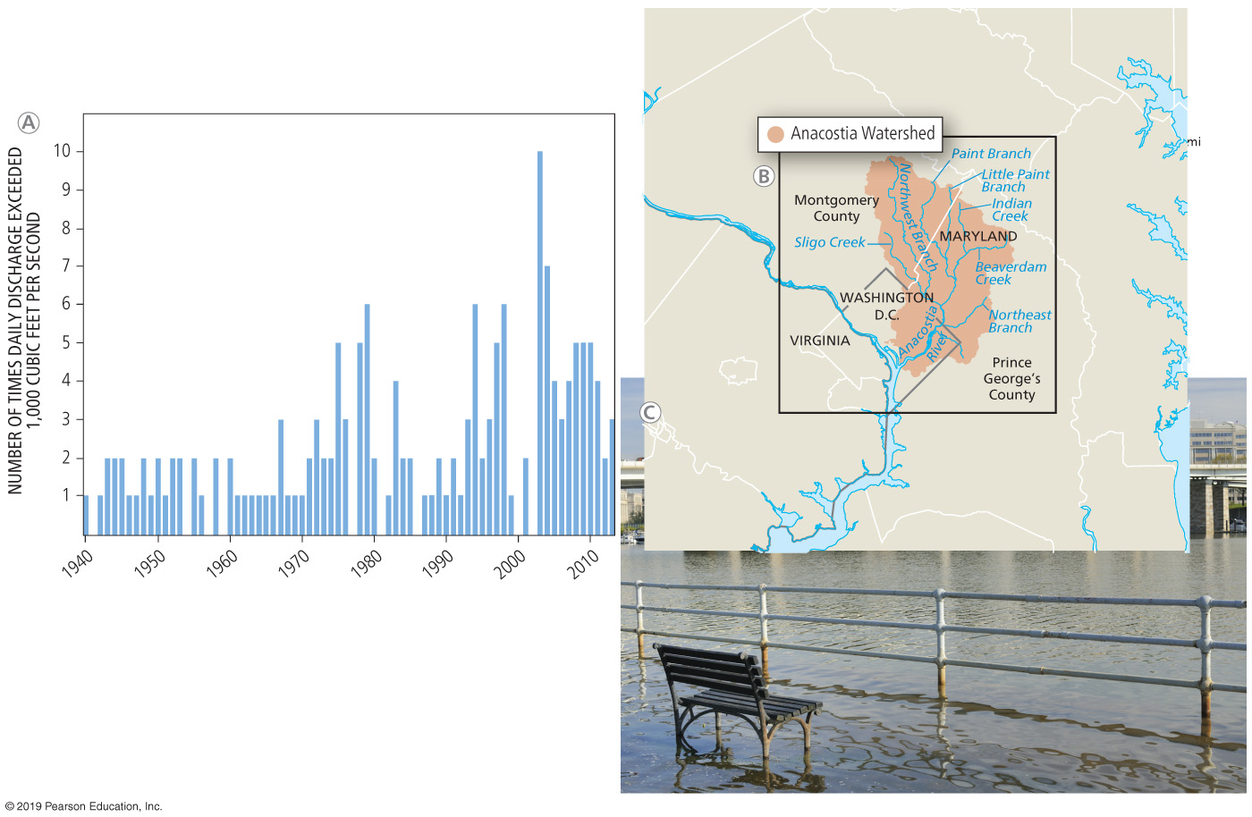
Notes:
24

Slide 25
11.3 Water Distribution
Too much water—flood control
  Growing paved areas and deforestation reducing flood control ecosystem service
  Single deciduous tree in North Carolina can transpire 100 gallons per day
  City solutions
    Increasing green space
    Using pervious pavement
      Allows percolation
    Green roofs
      Retain 75% of rainwater
Notes:
25

Slide 26
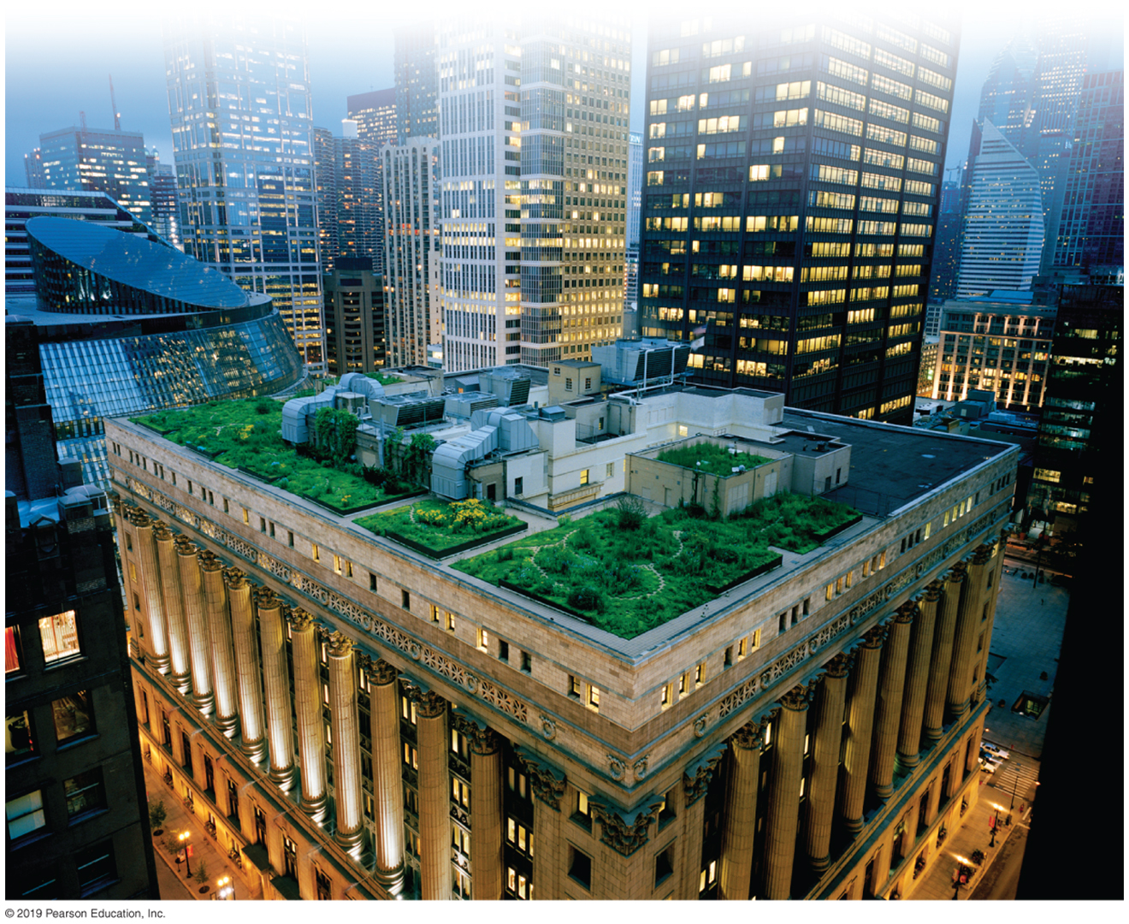
Notes:
26

Slide 27
11.3 Water Distribution
Too little water
  Overdrawing surface water
    Throughout history, water diverged from lakes and streams
    Overdrawing may deplete and alter water bodies
  Overdrawing groundwater
    Use of aquifers for agricultural and drinking water
    Aquifers can be emptied
Notes:
27

Slide 28
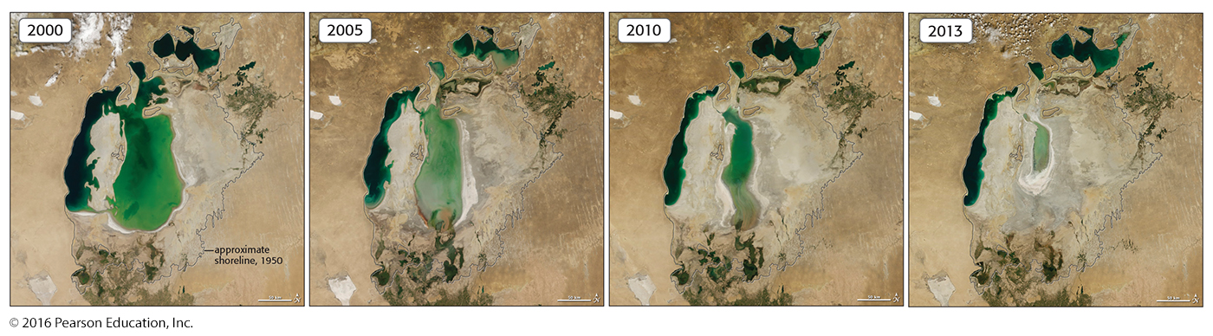
Notes:
28

Slide 29
11.3 Water Distribution
Subsidence
  Sinking of land above an aquifer
    May occur slowly
      Example: pole in California has sunk 33 feet in 50 years
      Venice, Italy sinking at 2 mm/year
    May occur quickly
      Sinkhole
Notes:
29

Slide 30
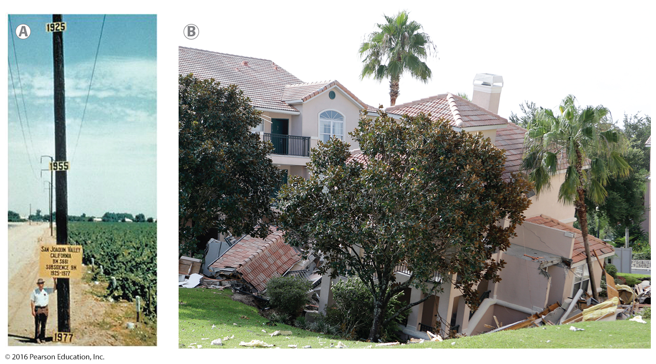
Notes:
30

Slide 31
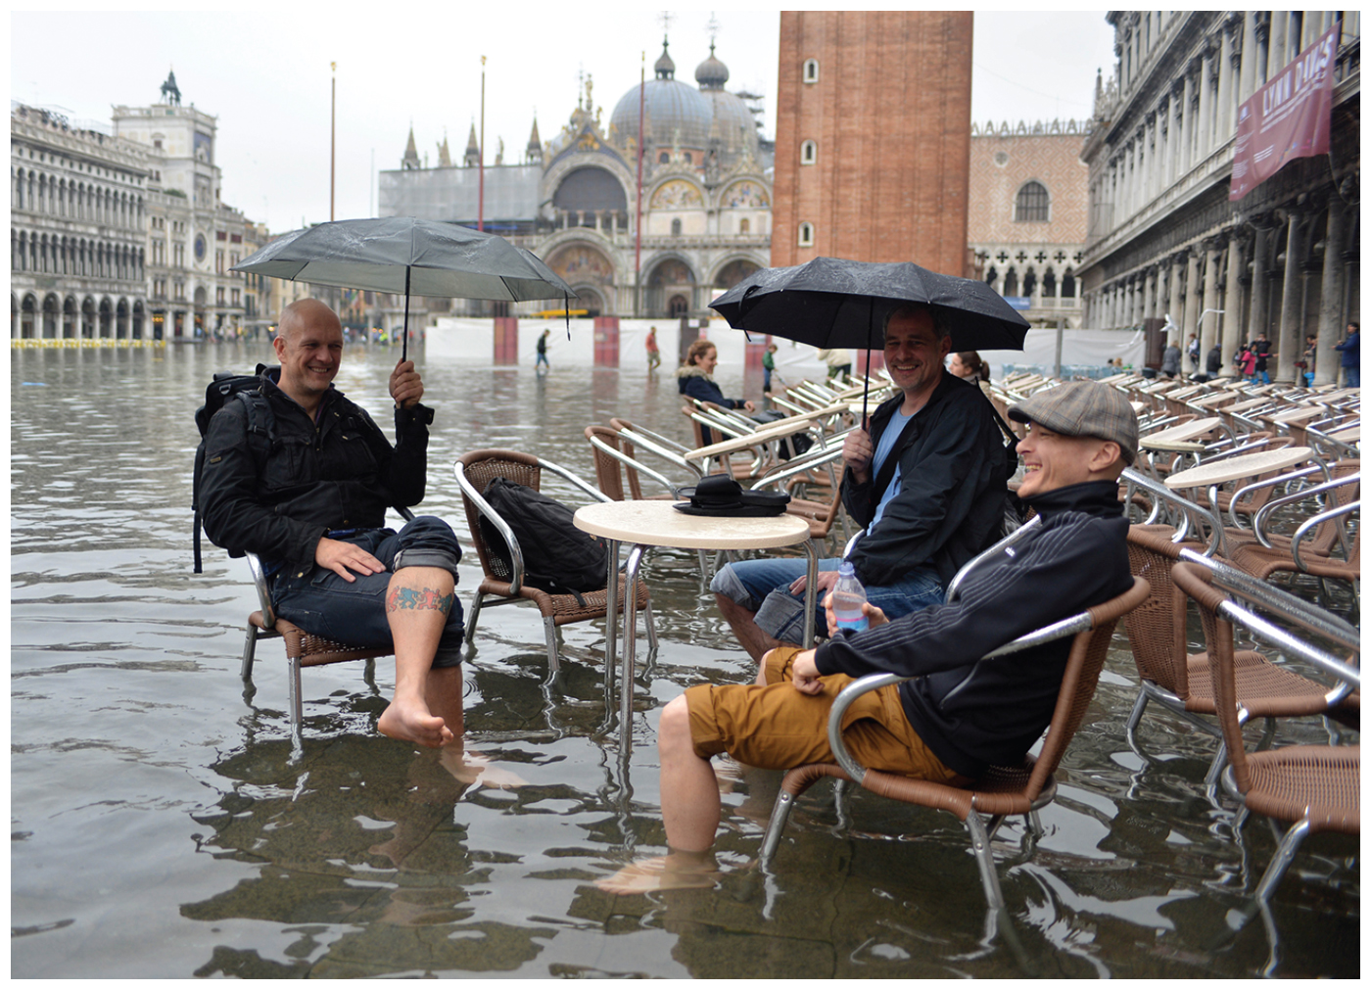
Notes:
31

Slide 32
11.3 Water Distribution
Saltwater intrusion
  Migration of salt water into freshwater aquifers
  May occur from overdrawing
  Detected as early as 1854 in New York City
  Issue in various areas worldwide
    China, Africa, U.S. coasts
Notes:
32

Slide 33
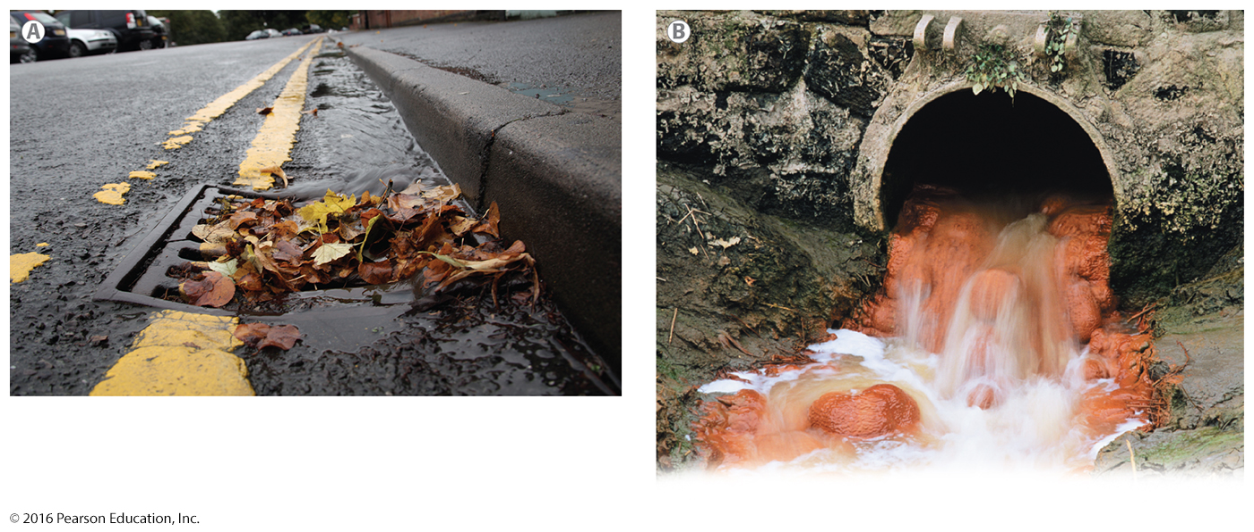
Notes:
33

