Slide 1
ENSP 2000
Chapter 3 – Part II

Slide 2
Organic chemistry

Slide 3
3.2 The Organic Chemistry of Life
Organic molecules
  Carbon atom covalently bonded to hydrogen and other atoms
  Primary structural and function component of life
  Range in size
  Inorganic molecules not made of carbon and hydrogen
Notes:
3

Slide 4
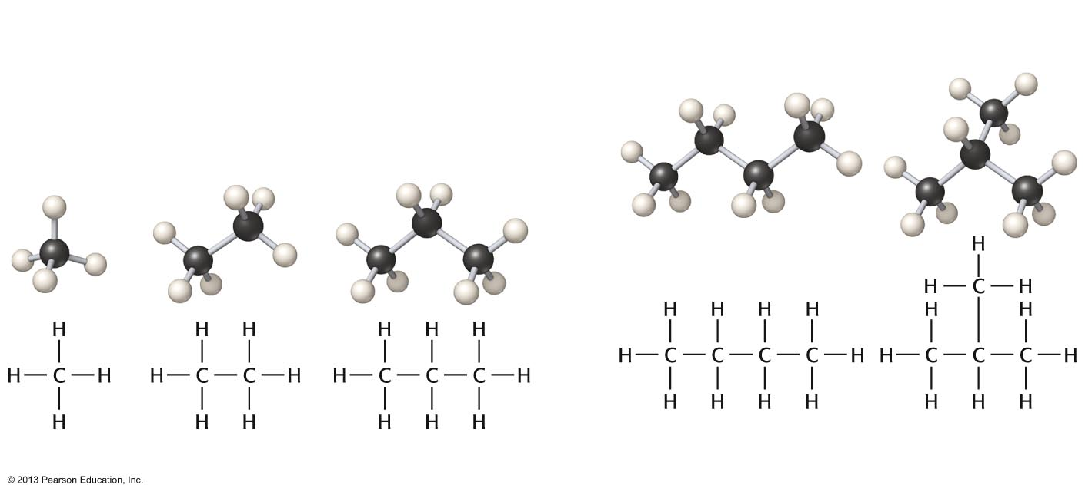
C₄H₁₀
Butane
(straight chain)
2-Methylpropane
(branched chain)
Methane CH₃
Ethane C₂H₆
Propane C₃H₈
Notes:
4

Slide 5
3.2 The Organic Chemistry of Life
Organic molecules–types
  Hydrocarbons
    Only made of carbon and hydrogen
  Carbohydrates
    Made of carbon, hydrogen, oxygen
    Sugars, (CH₂O)n, with n between 3 and 7
    Glucose (C₆H₁₂O₆) the basic form of energy for most organisms
    Sugars known as saccharides
Notes:
5

Slide 6
3.2 The Organic Chemistry of Life
Organic molecules–types
  Lipids
    Long chains of carbon and hydrogen and a shorter region with one to several oxygen molecules
  Fats and oils
  Nonpolar
  Lipids not water soluble
  Important energy storage
Notes:
6

Slide 7
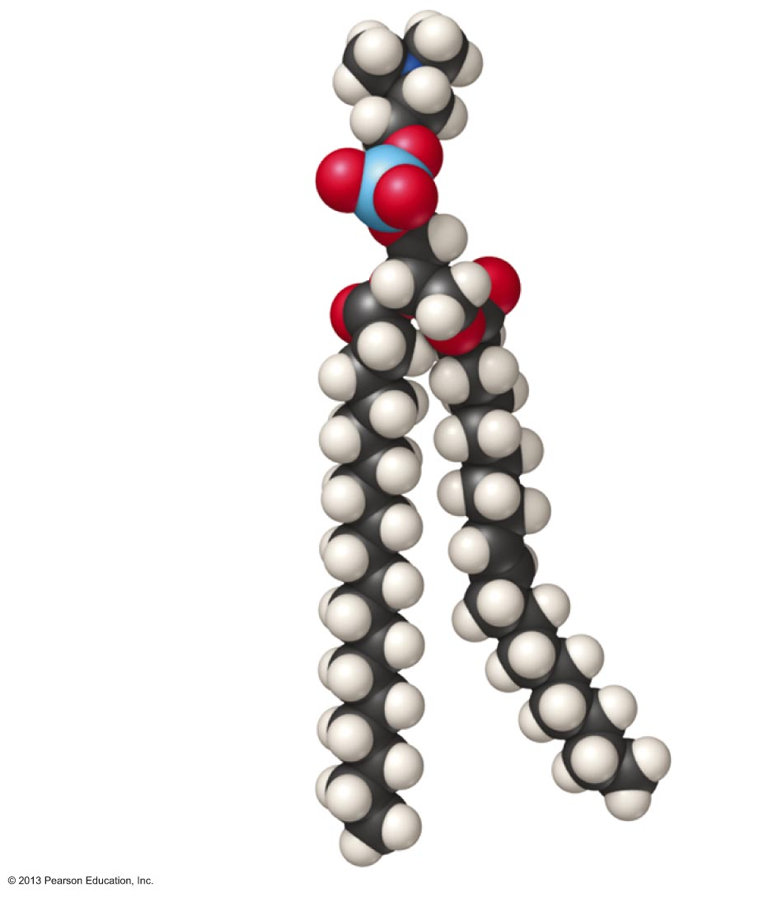
Polar region
Phosphorus
Oxygen
Carbon
Hydrogen
Nonpolar
region
Notes:
7

Slide 8
3.2 The Organic Chemistry of Life
Macromolecules
  Small organic molecule linked together
Polymers
  Linked together in long chains
Polysaccharides
  Polymers of simple sugars
    Starch
    Cellulose
Notes:
8

Slide 9
3.2 The Organic Chemistry of Life
Macromolecules
  Proteins
    Polymers of amino acids
    20 amino acids–same base structure
      Amino group (–NH₂)
      Carboxylic acid group (–COOH)
    Proteins made of chains of 100 to 1,000+ amino acids
Notes:
9

Slide 10
3.2 The Organic Chemistry of Life
Macromolecules
  Proteins
  Fold to particular shapes yielding function
  Structural or functional
  May act as catalysts
    Termed enzymes
    Almost all biological reactions use enzymes
Notes:
10

Slide 11
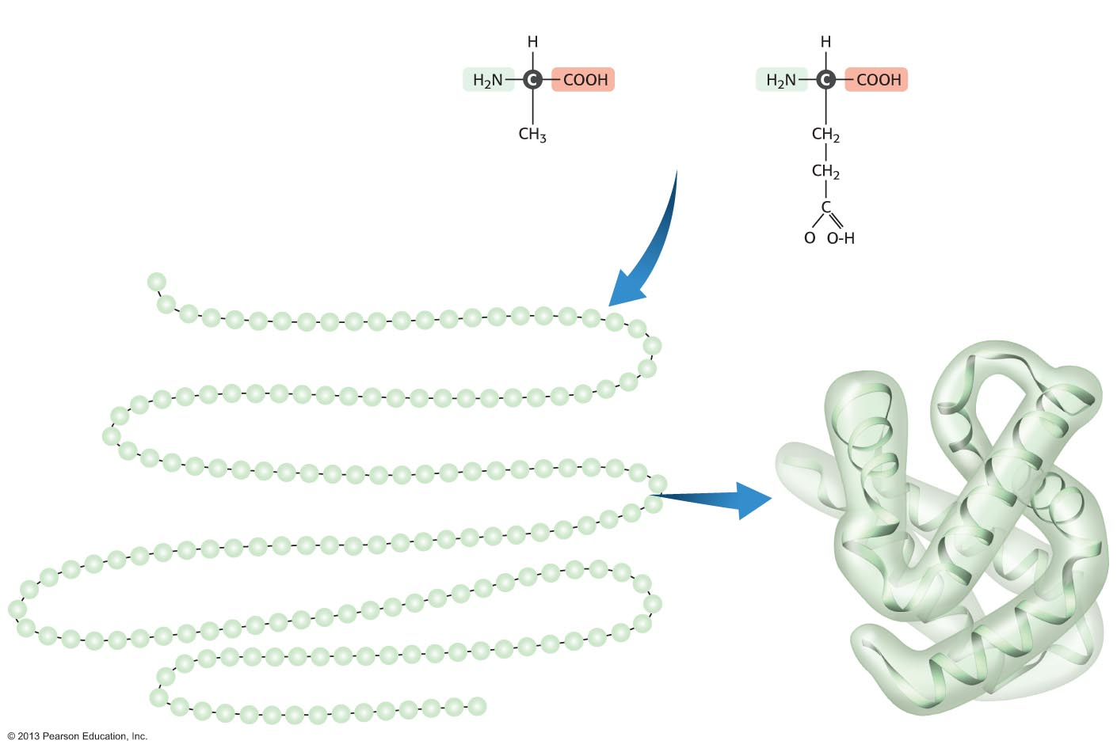
Typical amino acids
Acid group
Amine group
Alanine
Amino acids are linked to
form a protein chain
Glutamic acid
Protein chains assume a
three-dimensional structure
Notes:
11

Slide 12
3.2 The Organic Chemistry of Life
Nucleic acids
  Polymers of nucleotides
    5-carbon sugar, phosphate group, and nitrogenous base
  Deoxyribonucleic acid (DNA)
    Hereditary material
    Traits coded in sequence of bases
      adenine (A), thymine (T), cytosine (C), and guanine (G)
Notes:
12

Slide 13
3.2 The Organic Chemistry of Life
Nucleic acids
  Ribonucleic acid (RNA)
    Structure similar to DNA
    Protein synthesis
      Transcription
        DNA code to RNA
      Translation
        RNA code to protein
        Triplet sequences code for amino acids
Notes:
13

Slide 14
Energy and the Environment

Slide 15
3.3 Energy and the Environment
Energy
  Capacity to do work
    Work
      Force applied to an object over a distance
  Potential energy
    Stored energy
  Kinetic energy
    Energy in motion
Notes:
15

Slide 16

Notes:
16

Slide 17
3.3 Energy and the Environment
Laws of thermodynamics
  First law
    Energy can be neither created nor destroyed; can be transformed
  Second law
    Energy transformations increase disorder
      Entropy
      Energy often lost as heat
Notes:
17

Slide 18
3.3 Energy and the Environment
Forms of energy
Four types important for ecosystems
  Electromagnetic radiation
    Energy moves as photons in waves
    Electromagnetic spectrum–entire range of wavelengths
      Gamma rays, X-rays, visible light, radiation, infrared, microwaves, radiowaves
Notes:
18

Slide 19
3.3 Energy and the Environment
Forms of energy
Four types important for ecosystems
  Heat
    Kinetic energy of molecules
    Temperature
      Average kinetic energy
Notes:
19

Slide 20
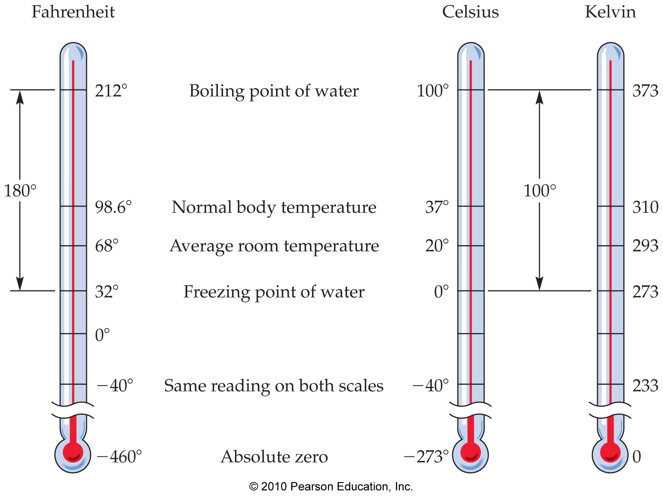
Temperature Scales

Slide 21
Temperature Conversion
  K = ºC + 273.15
  F = 1.8*ºC + 32

Slide 22
Practice Problem
Human body temperature is 37 ºC. Convert this to Kelvin.
    K = ºC + 273.15
    = 37 + 273.15
    = 310. K

Slide 23
3.3 Energy and the Environment
Forms of energy
Four types important for ecosystems
  Heat can move in four ways
    Conduction
    Convection
    Radiation
    Latent heat transfer
Notes:
23

Slide 24
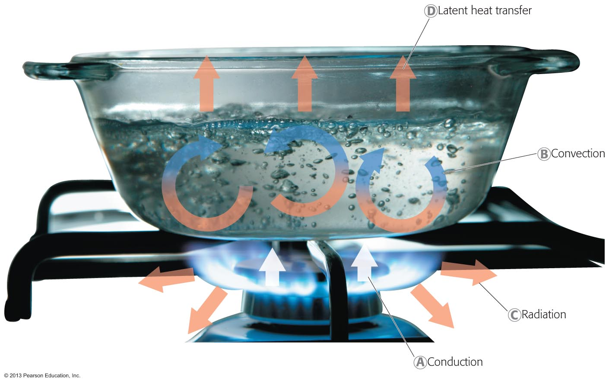
Notes:
24

Slide 25
3.3 Energy and the Environment
Forms of energy
  Chemical energy
    Potential energy
    Breaking and forming of chemical bonds
      Photosynthesis assembles carbohydrates
      Potential energy in glucose bonds
      When needed, energy released by respiration
Notes:
25

Slide 26

Notes:
26
.

Slide 27
3.3 Energy and the Environment
Forms of energy
  Nuclear energy
    Energy in the structure of matter
  Nuclear fission
    Nucleus of atom split, creating two smaller atoms and releasing vast amounts of kinetic and electromagnetic energy
  Nuclear fusion
    When atoms collide and fuse
    Process that powers the sun
Notes:
27

Slide 28
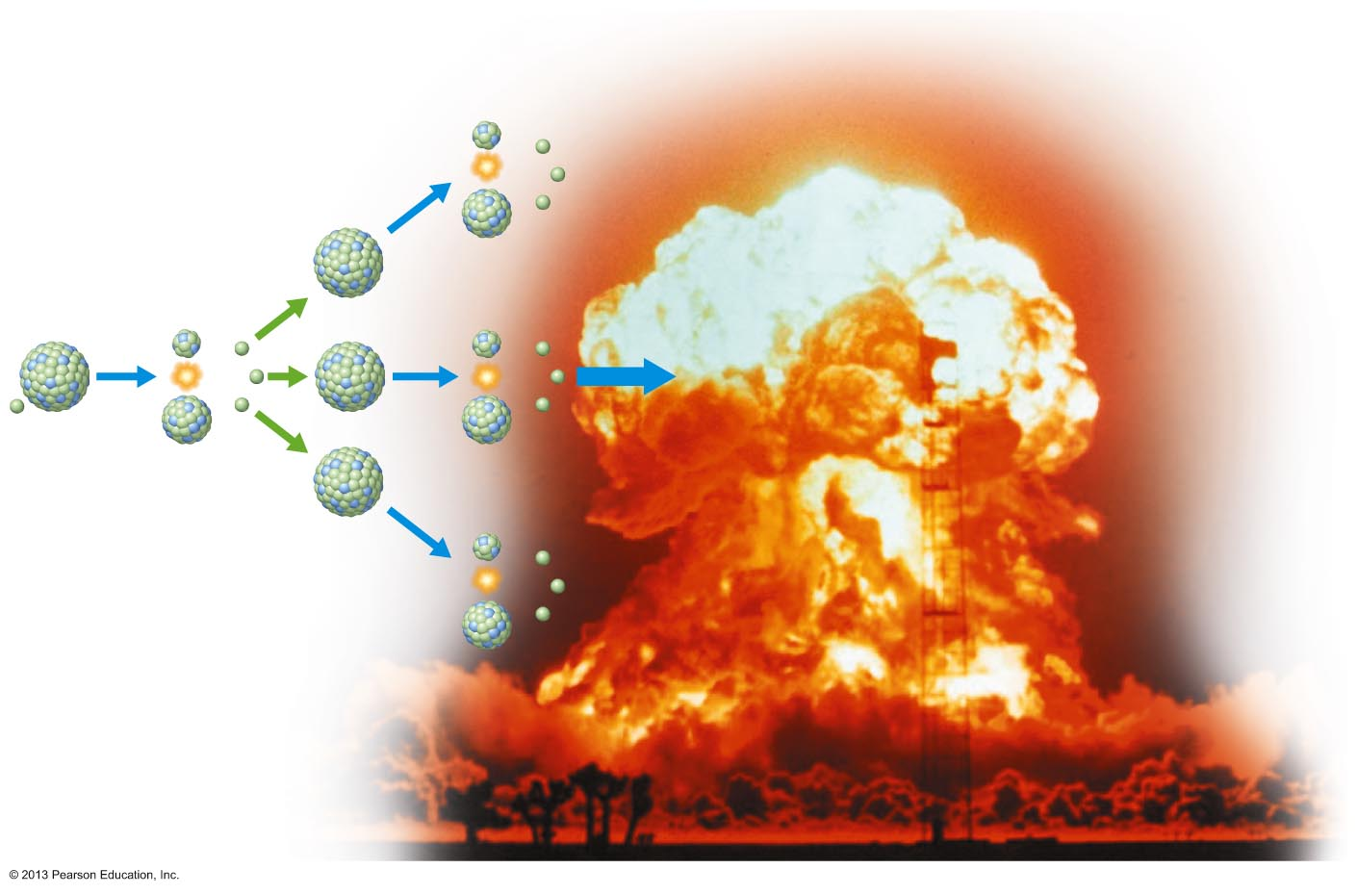
Neutrons are
produced, creating
a chain reaction
235
92
U
Neutron (n)
A small amount of mass
is converted to a large
amount of energy
Notes:
28

Slide 29
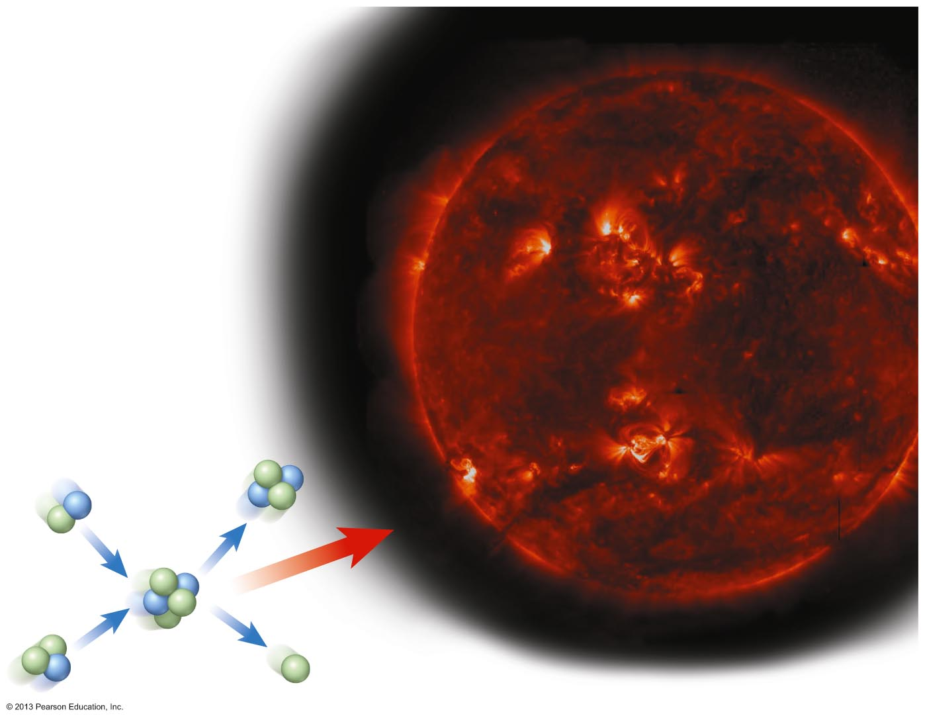
+
+
Helium
+
Hydrogen
isotopes
+
+
Energy
+
Neutron
Notes:
29

