Slide 1

CUSports
Tickets API
Presented by: CUSports Team 4 “Scrum Wizards”

Slide 2
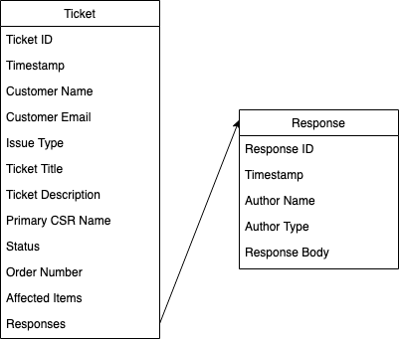
API Purpose & Specification
The CUSports Tickets API will provide a one-stop interface for creating and managing Customer Support requests in the form of Tickets and the Responses associated with those Tickets.

Slide 3
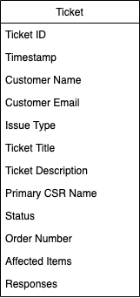
The Ticket Object
A Ticket includes details about the customer who submitted it, such as:
the title and description of their issue
the category of their issue
relevant order details

Slide 4
The Ticket Object
…as well as:
a unique Ticket ID
a timestamp
information about the Customer Support Representative (CSR) handling the issue
and more…

Slide 5
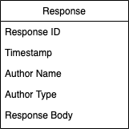
The Response Object
Tickets also contain Responses, which are further correspondences between customers and CSRs. They include:
a unique Response ID
a timestamp
information about the Response author
the Response content

Slide 6
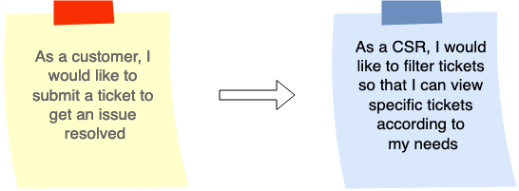
Complex User Stories
Stories 15 and 14 are complex stories which many other stories depend on, so they will be implemented first (sprints 1 - 4).

Slide 7
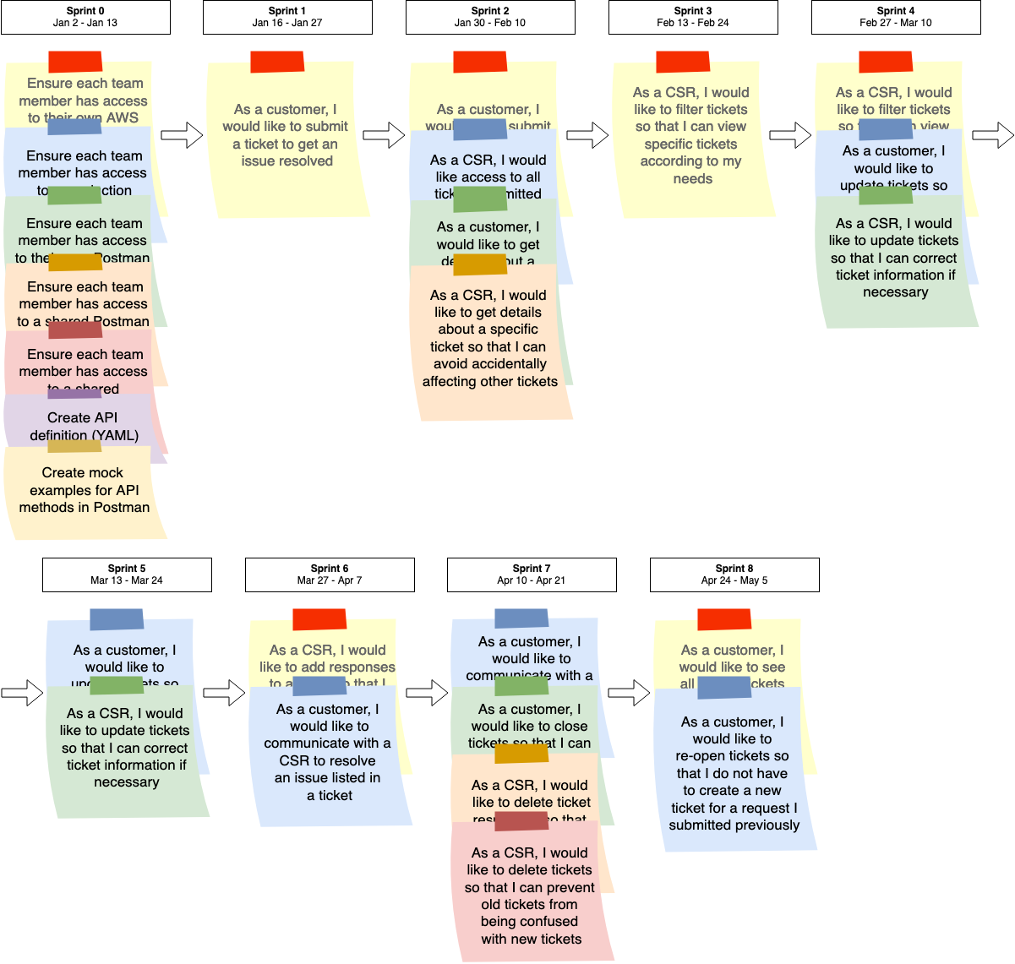
Implementation Timeline
Based on our team’s past performance, we believe the Tickets API can be implemented in nine (9) two-week sprints. This estimate includes a sprint dedicated to preparing dev environments for implementation.
Each sprint will require a maximum velocity of 20 SPs and will tackle user stories in order from least dependent to most dependent.

