Slide 1



Beacon Financial
Marketing Plan
Owen
Sullivan
Image credit: Beacon Financial Services, LLC

Slide 2

Executive
Summary
With roots in the corporate finance world going back decades, Beacon Financial wants to help small businesses succeed by providing outstanding accounting and outsourced CFO services (Beacon Financial Services, LLC, 2019).
To accomplish this goal, Beacon Financial will:
Maintain a strong Facebook presence
  Will increase total “Like” count to 1000+ and total “Follow” count to 500+
Create new referral bonuses for new and existing customers
  10% annual discount if 2 or more clients referred
  Aiming for an average of 1.2 referrals per client
Expand service offerings
  Generate a 7% total increase in revenue from new services
Image credit: iStock
https://media.istockphoto.com/id/941729686/photo/business-accounting-concept-business-man-using-calculator-with-computer-laptop-budget-and-loan.jpg?s=612x612&w=0&k=20&c=SlfDzm_rNa2XqM5t3AdqjPfp-RkmUJdbyMrdYi8C-8g=
2

Slide 3

Executive
Summary (Cont.)
With an increased marketing budget of $10,000, Beacon Financial will:
Purchase new Facebook ads
  Most significant area of marketing spending
  Targets existing and potential customers
  Reach 20,000+ people in the Charleston, SC area
Search Engine Optimization (SEO)
  Target the Charleston, SC, area and expand as budget permits
  Promote website as well as Facebook page
  Become the top result for “financial planning” in Charleston, SC
Ads in local papers
  Most clients are older and may engage more with print advertisements
  Target the Charleston, SC, area with a concentration on Daniel Island, SC, and Monks Corner, SC
  Attribute at least 4-5% of new revenue to paper ads
Image credit: Adobe Stock
https://t4.ftcdn.net/jpg/02/89/31/47/360_F_289314706_W1d6K5ZE1TkY2JBPRpY4nRvkufziOdtl.jpg
3

Slide 4
Mission Statement
“Our mission is to make corporate-grade accounting services available to the small business that run our local economies, starting in Charleston, SC.”
There are many offerings like ours, but none provide the same personal level of care that Beacon Financial can provide:
We are a small business ourselves, and we understand the struggles of maintaining a business firsthand. We will treat your business like our own, because that is our business.
We will treat you like family, because everyone in a small business is family.
We will dedicate more time to performing your services without inflating our fee structure, to give you access to the best financial services available at the best price.
4

Slide 5

Core Value
At Beacon Financial, we have one core value that drives our everyday interactions: Family Matters (Beacon Financial Services, LLC, 2019)
We don’t just treat our clients like family, we treat their businesses like family.
The extent of this dedication goes beyond the client’s decision-makers.
Image credit: Depositphotos
https://static9.depositphotos.com/1518767/1084/i/450/depositphotos_10846413-stock-photo-mother-and-father-giving-children.jpg
5

Slide 6
Market Analysis
Strengths | Weaknesses
Physical office in Charleston, SC Company founders have decades of experience in corporate finance Many happy customers to date Word-of-mouth advertising already strong | Small employee base Many clients do not see a need to expand financial services
Opportunities | Threats
Existing clients highly recommend us and can make high-quality referrals Many small businesses are opening or re-opening after the pandemic | Many similar businesses in the local financial space whose clients are reluctant to switch Chain CPAs can sometimes undercut our fees
6

Slide 7
Target Market Demographics
Although we will aim to continue targeting three main buyer personas, we understand the following as a part of our target demographics:
Age — We happily work with business owners of all ages, but we’re primarily geared towards working with young (25-40 years old) and middle-aged (40-60 years old) clients.
Gender — We have no preference about the gender of the clients we work with, however we plan to target men primarily as they make up the majority of our existing client base.
Economic Strata — Our fee structure is designed to work as a function of a small business’ revenue, and we primarily aim to target businesses that are comfortable spending 10%-15% of their annual budget.
Geography — We are interested in expanding our operations across the state of South Carolina through remote work, but we are most interested in capturing the markets of Charleston, SC, and the immediately surrounding areas.
Interests, Hobbies, etc. — We have no preference with respect to clients’ personal interests.
7

Slide 8
Buyer Personas
Small business owners — We primarily want to engage with the people that already operate a business and who require outsourced accounting information
1
Potential business owners — We want to engage with people who have an idea and are working to secure their finances before bringing their idea to market
2
Corporate decision-makers — We want to engage with the people responsible for corporate decisions, including cost-cutting, to provide corporate outsourcing services
3
8

Slide 9
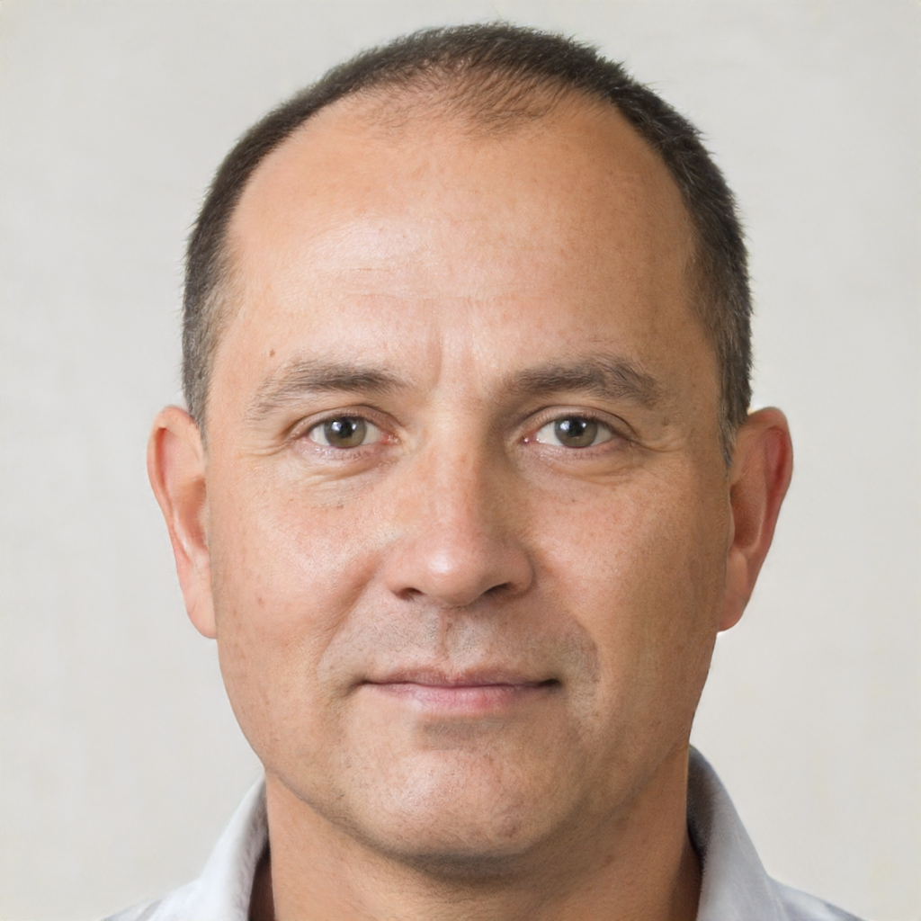
Buyer Personas (1)
Name: Anthony DeStefano
Demographic: 52 years old; male; small business owner from Charleston, SC; willing to spend 15% of budget
Motivations: Wants to reduce tax liabilities for his restaurant; wants to finance expansion to a new location
Frustrations: Operates on thin profit margins; tired of increased fees year-over-year
Misc.: Enjoys taking employees on company sailing retreats in the Charleston Harbor
Image credit: https://thispersondoesnotexist.com/
9

Slide 10
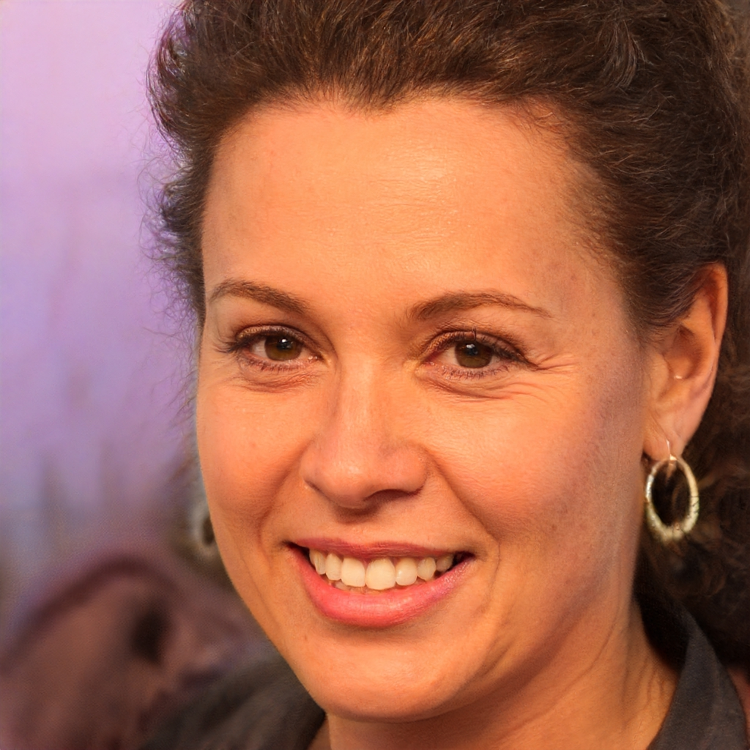
Buyer Personas (2)
Name: Gina McFarlane
Demographic: 40 years old; female; ex-manager at marketing firm; willing to spend 10-15% of budget
Motivations: Wants to open her own marketing firm
Frustrations: Has very little starting capital; lots of risk involved with starting her business
Misc.: Extremely knowledgeable about marketing strategies; has many connections with previous corporate world
Image credit: https://thispersondoesnotexist.com/
10

Slide 11

Buyer Personas (3)
Name: Tom Smith
Demographic: 34 years old; male; Junior VP at large corporation; willing to spend 20-25% of budget
Motivations: Wants to find the best outsourced accounting solution for his company
Frustrations: Needs approval from company’s executive board to spend large percentages of budget
Misc.: Avid hiker
Image credit: https://thispersondoesnotexist.com/
11

Slide 12
Competitor Analysis
Our primary competitors are other CPAs and accounting firms in the Lowcountry area, especially those with physical offices and more employees. We want to provide better service at a more reasonable price than larger firms.
Competitor Strategies:
Our competitors have been in business longer, and thus can leverage their larger client bases to attract new customers and expand their services.
Our competitors have more experience with the industries their clients work in, which helps them better understand a small business’ needs.
12

Slide 13
Competitor: Glaser and Company, LLC
Strengths | Weaknesses
Physical office location in Charleston, SC Open since 2006, meaning close to 20 years in business Owners have over 40 years of professional experience | Small social media presence with low following Website contains very little detail about what services are provided
Opportunities | Threats
They can more easily expand to another location since one location is already successful Existing positive reviews on Google can attract new clients | Their SEO optimization is significantly better They have more employees
(Glaser and Company, LLC, 2015)
13

Slide 14
Competitor: MassMutual South Carolina
Strengths | Weaknesses
Part of a widely-recognized chain of financial planning firms Office location on one of the most traveled streets in Downtown Charleston, SC | Large client base means that some requirements could be overlooked or confused with other clients Larger business size means more regulatory scrutiny
Opportunities | Threats
Chain offices like MassMutual are sometimes regarded as less personal with clients Small businesses are always looking for cheaper options that large chains sometimes cannot offer | Have the resources to hire new CPAs, which increases the ability to take on new clients Have the resources to make riskier investments, which could result in higher ROI
(MassMutual South Carolina, n.d.)
14

Slide 15
Goals
As an expanding business, our primary goals are to attract new clients and expand our offerings to better fit the needs of new and existing clients. We aim to gain 25 or more new clients in Q4 2023 through Q3 2024.
1
We want to reach more potential clients through heavier use of social media and online advertising, as well as increase brand recognition in a competitive financial space. We aim to receive 3,500+ clicks in Q4.
2
The ultimate goal of everything we do is to help small business owners achieve their dreams. We aim to help at least 10% of new clients decrease liabilities in 2024.
3
15

Slide 16
Competitor Price Strategies
Glaser and Company, LLC:
Prices are determined on a case-by-case basis
No information about prices has been made public
MassMutual South Carolina:
Prices are determined based on a few major criteria
  Investment market conditions
  Risk assessment
  Customer segregation
  Etc.
Our Price Strategy
At Beacon Financial, we aim to meet our clients in the middle and find a price that fits their service requirements and budget. Generally speaking, we aim to provide as many services as are feasible based on a percentage of the client’s budget that will be dedicated to financial services.
16

Slide 17
Competitor Analysis Notes
It should be noted that finding specific information about competitors in the Financial Planning industry is difficult without insider knowledge, which we lack at this time. Most significantly, finding information pertaining to competitors’ price strategies is difficult.
To make up for this lack of available information, details about competitors’ price strategies are inferred from common market analyses and public reviews. Thus, this information may not be reliable and is not referenced from a citable source.
17

Slide 18
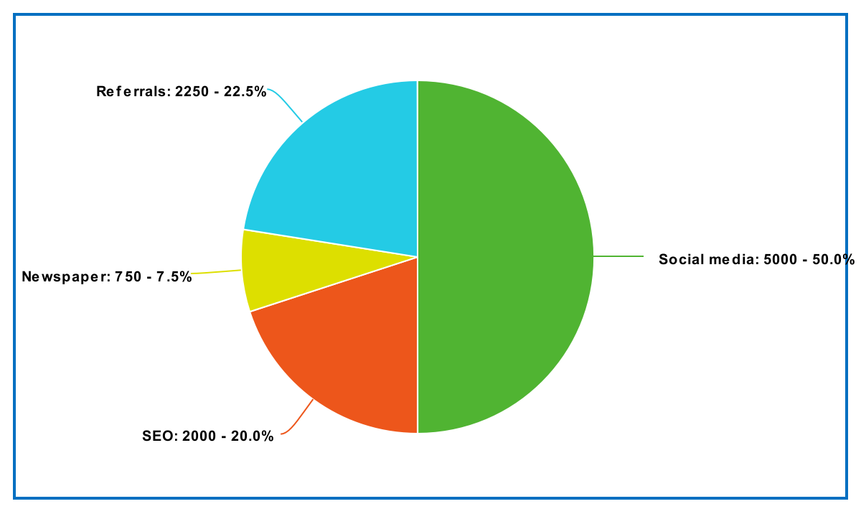
Budget Breakdown
We have allocated a budget of $10,000 to marketing that will be used in the following ways:
Social media advertising (Facebook)
SEO optimization (including website hosting costs)
Newspaper advertising
Referral bonuses
18

Slide 19
References
(2019). Beacon Financial Services, LLC. Beacon Financial Services, LLC. https://mybeaconfinancial.com/
(n.d.). Financial and Insurance Products and Services | MassMutual South Carolina. MassMutual South Carolina. https://southcarolina.massmutual.com/
(2015). Glaser & Company | CPA Near Me | Accounting Firm Charleston SC. Glaser & Company Certified Public Accountants. http://www.glasercompany.com/
19

