Slide 1
penguinsay
Kalyaan Narnamalpuram, Aidan McPherson, Laura Morgan, Owen Sullivan

Slide 2
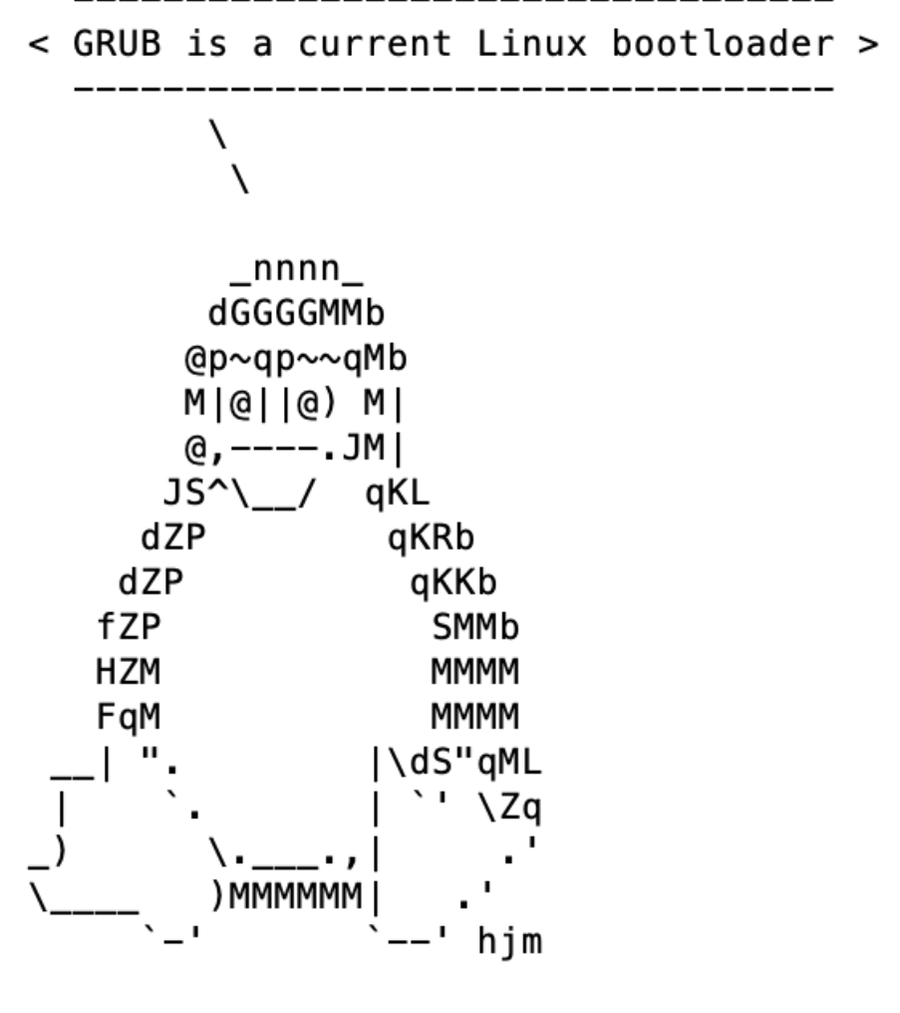
What is penguinsay?
Seemingly harmless command-line utility that outputs ASCII art of Tux saying Linux facts
The package uses linux-exploit-suggester to scan for kernel vulnerabilities
Data is sent to external listening server without the user’s knowledge
Terminal display of penguinsay for the user

Slide 3
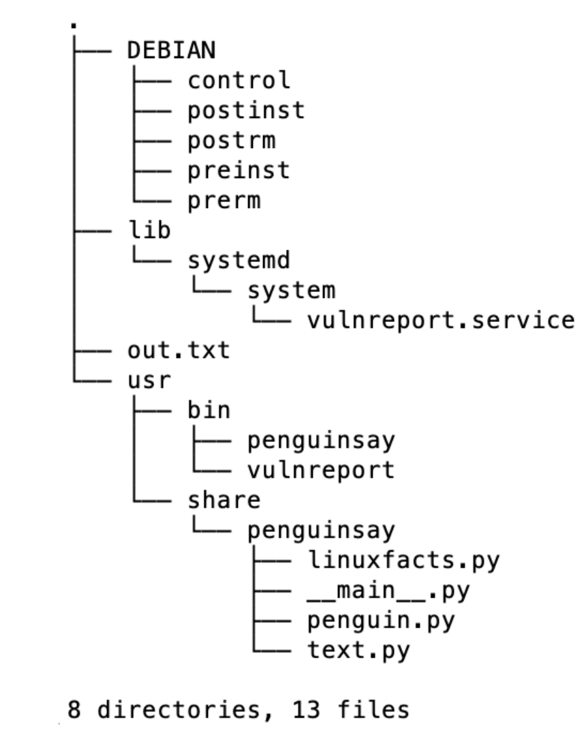
Creation of penguinsay
Developed python command-line scripts to print Tux.
Utilized debian scripts to hide vulnerability report output.
Cloned and utilized linux-exploit-suggester for reporting information.
Wrote Go programs to send, receive, and save vulnerability data.
Directory structure of penguinsay package
Notes:
Potential bullet points.
Created a debian directory with control, changelog, and rules files.
Write package metadata in control and define dependencies.
Build the package using dpkg-deb or debuild.

Slide 4
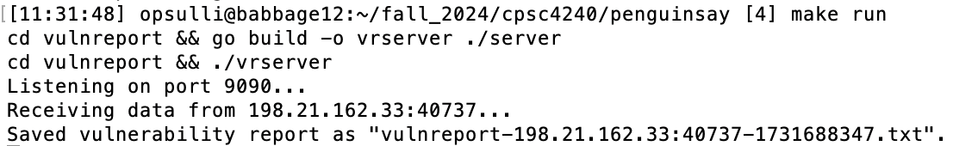
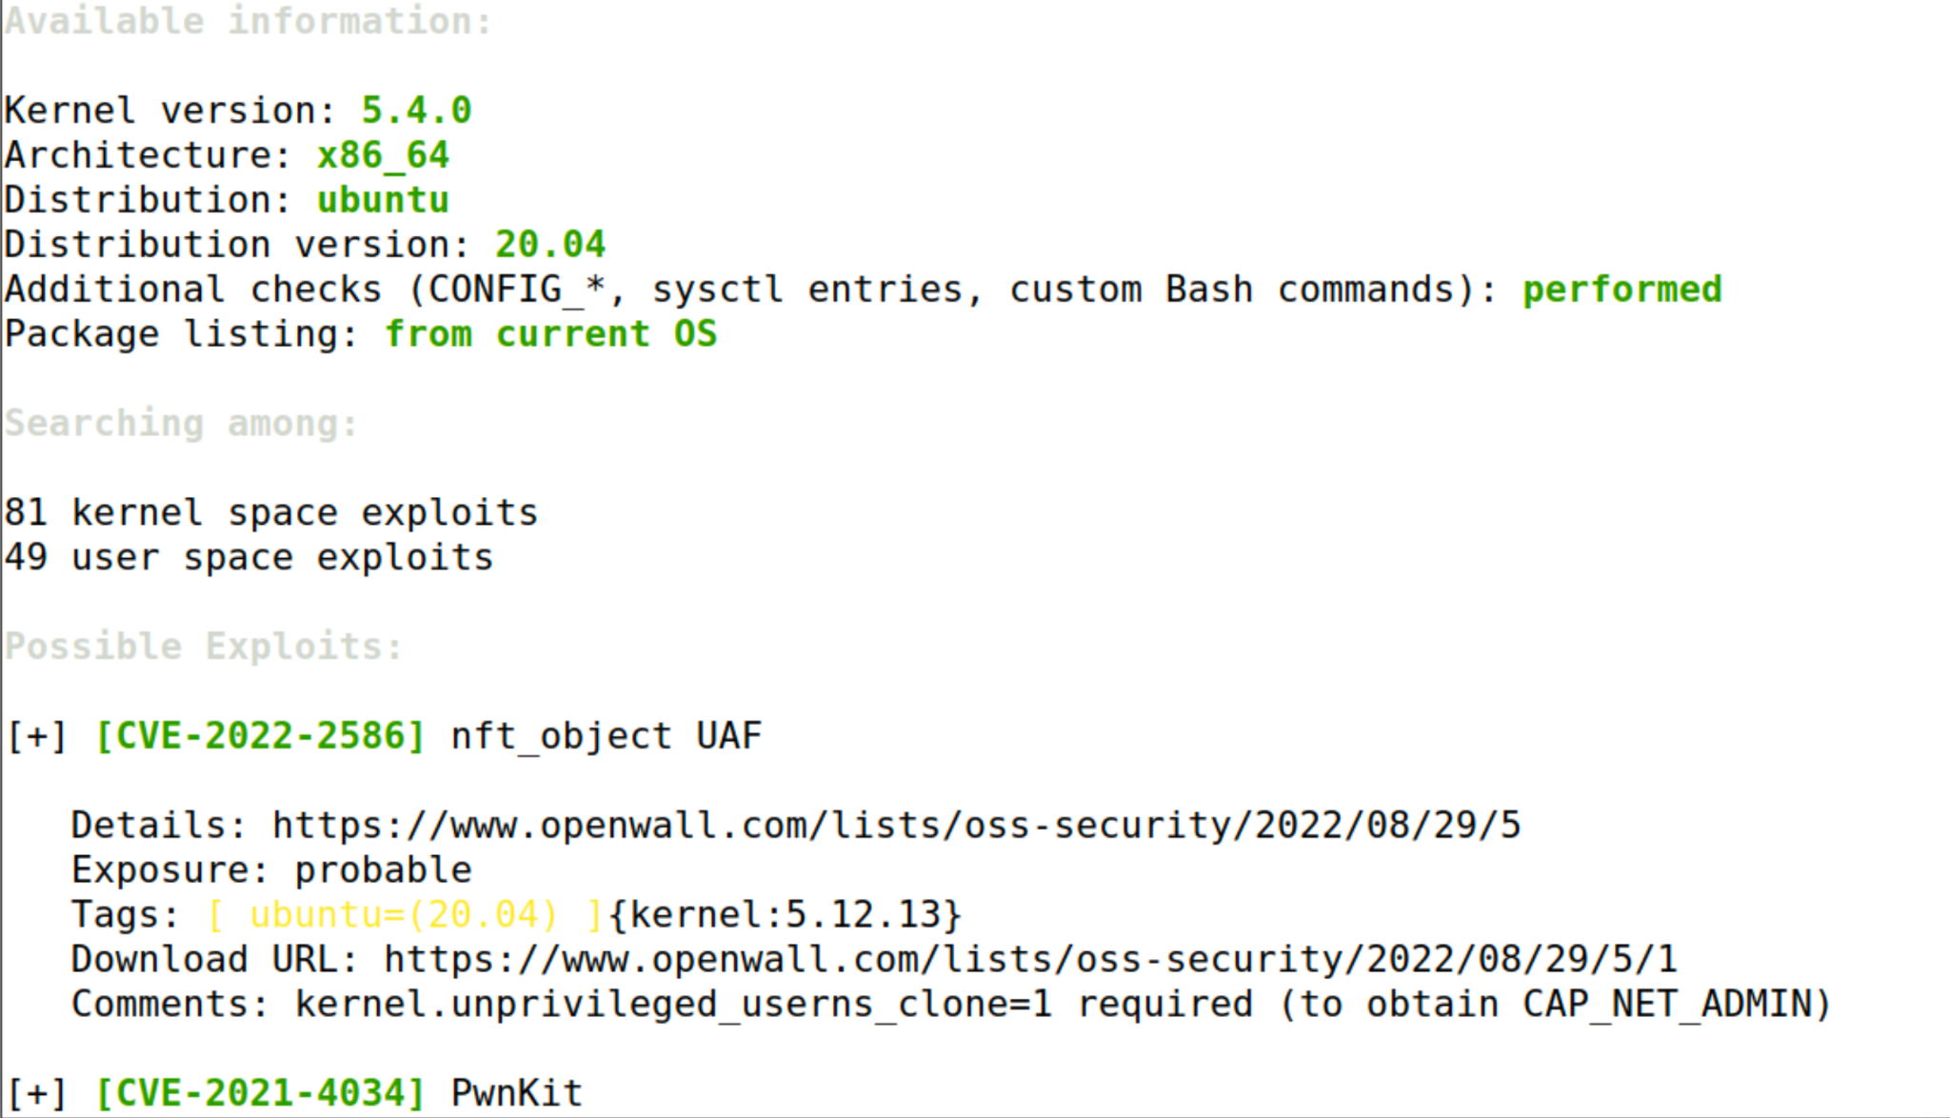
penguinsay’s Malware
linux-exploit-suggester
  Used scripts to install and redirect outputs away from the victim
vulnreport
  Runs in background and reports vulnerabilities when the victim’s system boots
  vrclient
    Bundled to match Linux default directory structure
    Linux daemon created to allow automatic execution on target system
  vrserver
    Used on separate Linux server to act as listener
Output from vrserver
Output of linux-exploit-suggester ->

