Slide 1

Chapter 1
Introduction to Public Speaking
Notes:
You will need a half sheet of paper for this lesson.

Slide 2
What is public speaking?
On a half sheet of paper, brainstorm and write down your personal definition of public speaking.
Next, pair up with the person sitting next to you and try to agree on a definition together.
Write your shared definition down.

Slide 3
Defining Public Speaking (Chapter 1)
Public speaking – Any oral communication in which an individual tries to influence others through language.
Some questions:
  Why were your initial definitions different?
  How long do you think this would’ve taken if we all had to agree?

Slide 4
The role of language in communicating
Language is complex: arbitrary, ambiguous, abstract, and powerful.
Denotative vs. Connotative
Framing – How ideas can be strategically described to illicit reactions and feelings from an audience or listeners.

Slide 5
Political Divide
Agreeing on a definition is one thing, but framing also has a role to play in how we use public speaking to participate in our democracy.
Using the following memes, write whether you agree or disagree and then briefly list three reasons why!
In 3…2…1

Slide 6
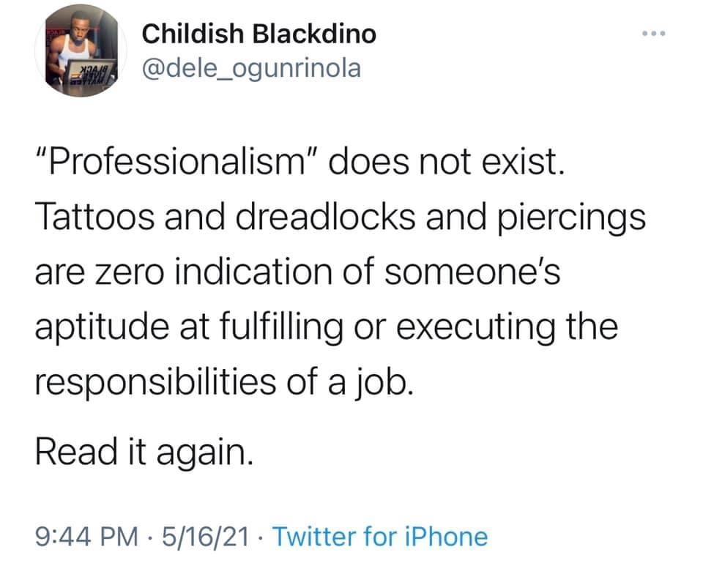
Meme #1: Professionalism

Slide 7
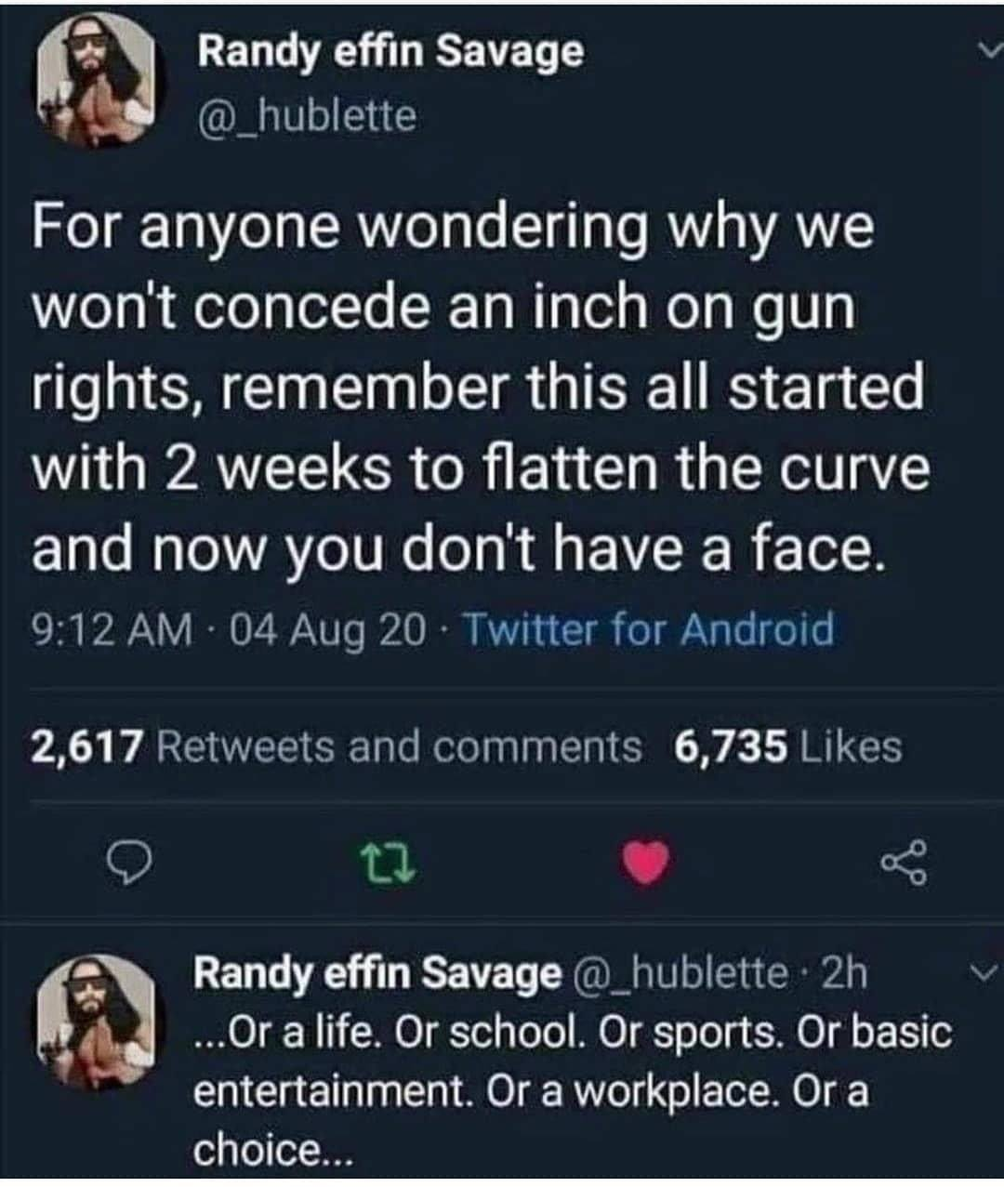
Meme #2: Less restrictive gun control

Slide 8
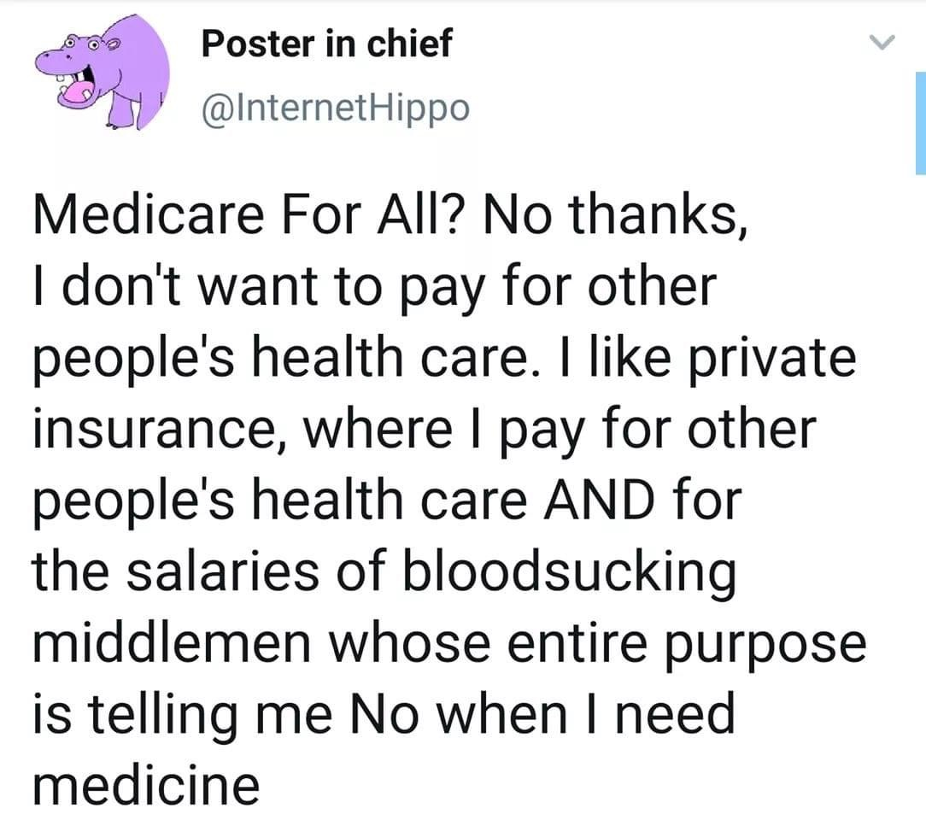
Meme #3: Universal healthcare

Slide 9
Framing (lol) this activity:
Encoding & Decoding
Transmission Model – Communication looks like a one-way street (Shannon & Weaver, 1949)
Transactional Model – Communication is a tool to create shared meaning (Barnlund, 1970)
  Encoding – Assigning meaning through a channel.
  Decoding – The interpretation of that meaning.
  Noise – Anything that interferes with the message.
What is the problem? Miscommunication and disagreements still happen, even if we aren’t willing to engage fully.

Slide 10
Political Divide
Based on this activity, did anyone’s views surprise you? Why?
Were you persuaded to think differently about an issue based on someone’s reasons? Why?
Why and how do communication context and environment relate to this activity?
How do ethics relate to this activity?
Why do you think its easier to find common ground on certain issues, and more difficult in other cases?

Slide 11
The Art of Public Speaking
Rhetoric – strategies we use when communicating to teach or persuade others more effectively (Aristotle).
  The Big 3: Ethos, Pathos, and Logos
Realize that truly persuading someone to see the world differently takes time. Communication is a process.
Daryl Davis – Exemplifies these skills and the attitude we should all have going forward!

Slide 12
Important Myths About Communication (And why you shouldn’t believe them!)
Communication is a cure-all
Quantity means quality
Meaning is in the words we use
We are all naturals at it
Communication is reversible

Slide 13
Final Takeaways
Definitions:
The communication models, encoding, decoding, sender/receiver, etc.
Saussure’s triangle.
Denotative vs. Connotative
Skills:
Eye contact
Buddy system – No one wants you to fail!
Respect, compassion, and open-mindedness

Slide 14
Preview for next class:
Next Class: Chapter 2 – Communication Apprehension
Questions?

