Slide 1
Advocating and Persuading
Chapter 11

Slide 2
What is persuasion?
Communication designed to change your audience’s attitudes, beliefs, or behaviors.
Persuasion is different than advocacy.

Slide 3

What are some examples of times you’ve had to persuade someone?
What are some ways you are persuaded daily?

Slide 5
Social Judgment Theory & Ego-Involement
Persuasion involves any degree of movement of the listener from left to right.
Strongly Opposed
Strongly in Favor
It’s okay to be realistic about how much change will occur in someone’s beliefs or actions.

Slide 6
Persuasive
Informative
Gaining fair and favorable consideration for our points of view
Urge choice among options
Are advocates
Develop supporting material as evidence to justify advice
Ask for more audience commitment
Leadership is more important in persuasive speeches
Appeals to feelings are more appropriate
Reveal the options
Function as teachers
Provide supporting material to enlighten
Don’t ask for as much commitment
Doesn’t appeal to feelings as much
Ethical obligation is not as important or great

Slide 7
Types of Persuasive Speeches
Speeches on questions of fact
The speaker argues if something is true/real or not.
Speeches on questions of value
The speaker attempts to change the audience’s attitudes about something (right or wrong, good or bad).
Speeches on questions of policy*
The speaker presents an argument about whether a specific course of action should or should not be taken.

Slide 8
Fact, Value, or Policy? (Specific Purpose Ed.)
To persuade my audience that an earthquake of 9.0 or above on the Richter scale will hit California in the next ten years.
To persuade my audience that capital punishment is morally and legally wrong.
To persuade my audience that our state should require mandatory recertification of lawyers every ten years.

Slide 9
Fact, Value, or Policy? (Thesis Ed.)
A federal law should be passed requiring that trunk release systems be standard on all new cars sold in the U.S.
If trunk release systems were standard equipment on all cars sold in the U.S., we could save a number of children’s lives each year.

Slide 10
Organizational Patterns for Policy Speeches
Problem-Solution
Problem-Cause-Solution
*These are required for your speech. You must choose either P.S. or P.C.S. for your next formal presentation!

Slide 11

Problem-Solution
Main point I: Documents the existence of a problem.
Main point II: Presents a solution to the problem.

Slide 12
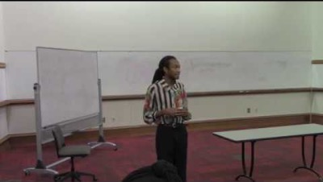
Problem-Solution Example

Slide 13

Problem-Cause-Solution
Main point I: Documents the existence of a problem.
Main point II: Analyzes the causes of the problem.
Main point III: Presents a solution to the problem.

Slide 14
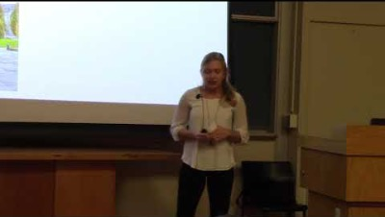
Problem-Cause-Solution Example

Slide 15
Misc. Organizational Patterns for Persuasion
Monroe’s Motivated Sequence:
Attention
Need
Satisfaction
Visualization
Action
The Argumentative Pattern of Organization (3 reasons)
Comparative Advantages Pattern of Organization (2 clear choices)

Slide 16
Reminders for this week!
Resources exist to help: Persuasive Speech Module
First extra credit opportunity: Persuasive Speech Discussion Board
  MWF – Due October 21st
  MW – Due October 24th
Next Class: We are not meeting! (Film those interviews)
Pay attention to the syllabus, and sign up for your required meetings!

