Slide 1
Commemorating Important Events
Chapter 13

Slide 2
Learning Objectives
Review the upcoming speeches and answer questions about what’s expected.
Take a deep dive into the world of ceremonial speaking.
Use example speeches as inspiration for brainstorming, preparing, practicing, and writing ceremonial presentations.

Slide 3
The Basics of Commemorative Speaking
Commemorative Speech – A presentation designed to honor a person or event or to be a tribute to a special occasion.
  Toasts
  Awards and Honors
  Eulogies

Slide 4
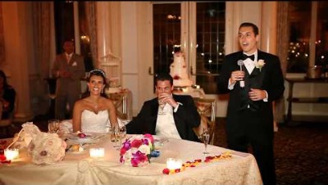
The Toast

Slide 5
The Toast
Introduction: Self-introduction that includes a description of the event, venue, and your relationship to the subject being toasted.
Body: Use stories, quotes, and memories to describe those involved.
Conclusion: This is where the actual toast takes place! End memorably and include the audience!

Slide 6
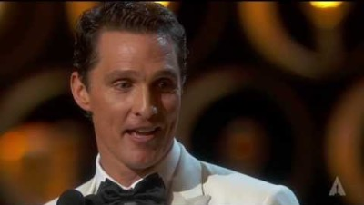
Awards and Honors

Slide 7
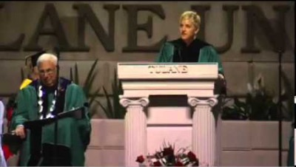
Awards and Honors

Slide 8

Awards and Honors

Slide 9
Awards and Honors
Introduction: Self-introduction that includes a description of the event, the award, and that includes a moment of thanks for key figures.
Body: The Rule of 3!
Conclusion: End with resolution by using a quote, humor, or with a final thank you to the audience.

Slide 10
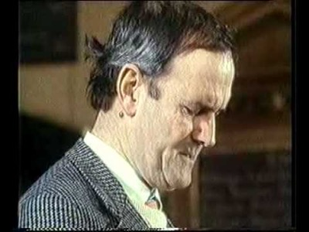
EulogieS

Slide 11
EulogieS
Introduction: Self-introduction that includes a description of the event and your relationship with the deceased.
Body: Very biographical – include key details about the person’s life to tell their story.
Conclusion: Closure and comfort! Offer support, use a quote, and describe the lasting impact of the person’s contributions.

Slide 12
Practice: Vivid Language and Imagery
In groups, change the highlighted word to make each description more vivid. Have three people in the group read their favorite phrase change.
“Clemson is really unique”
“Teresa is not nice”
”This company is doing well because of you”
“Tracy and Jane make the perfect couple”
“This candy tastes great"

Slide 13
Your Ceremonial Speech
Time limit: 2-3:30 minutes
Prepare a speaking outline (notecard) and a preparation outline (full content and sentences) – due the day you speak.
Should have supporting details: narratives and analogies.
Be creative, give us something to think about, and have fun!

Slide 14
A look ahead…
Introductory & Ceremonial Speeches
Any questions?

