Slide 1


Managing Anxiety and delivering your speech
chapter 2

Slide 2
Objectives
Define communication apprehension - Where it comes from and ways to deal with it!
Learn Some Strategies for Managing It.
Apply Those techniques to preparing your introductory speech

Slide 3
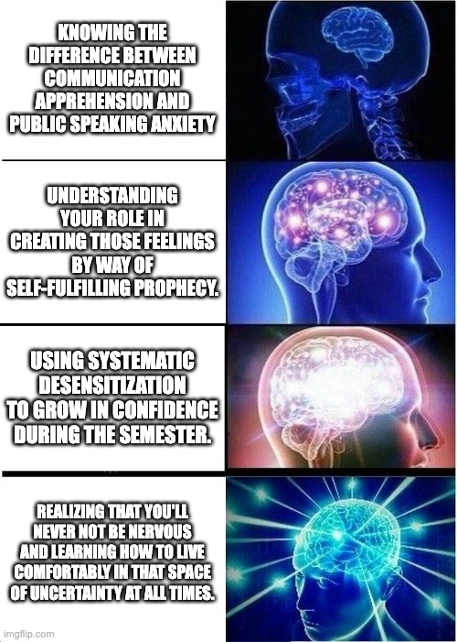
Comm apprehension vs. Public speaking anxiety
What is it? (Clips)
What are Some symptoms?
Where does it come from?
How do we manage it?

Slide 4
The Three P’s of public speaking
Practice
Prepare
Present

Slide 5
Prepare
Know What is expected of You!
What kind of speech are you delivering?
What is the time limit?
Are there instructions for what to do?
Your strategy should change based on the constraints of your speech!
Find ways to make yourself care
Know your self – personality and interests Matter!
Include content in your Speech that You are Passionate About!
Organize the information in a way that’s meaningful to You!

Slide 6
Prepare
Of the two impromptu speaking prompts listed choose One:
  If I were an animal, I’d Be . . .
  If I Ruled the world . . .
Use a half-sheet of paper to Prepare a 2-3 minute speech on your chosen topic (1 minute)
Afterwards, let’s talk shop!

Slide 7
Practice
Occurs once your speech is Drafted:
Timing/recording yourself is key
Embrace Mistakes
Search for Feedback
Be positive – perfection is overrated

Slide 8
Practice
Let’s practice Together: Find a partner and Deliver your impromptu Speech.
Important Caveats:
  If you’re listening for the first round, tally up the Number of Fillers you Hear (Feedback)
  The person speaking must make it to 2 minutes. If not, then you both need to look each other dead in the eye (Please feel free to talk. This doesn’t have to be awkward silence)
  Think about Timing!

Slide 9

Present
Does not work without preparation and practice!
At the end of the day, all you can do is your best
Deep breathing exercises, Meditation, and Mindfulness – AKA, Horsey Breathing

Slide 10
Speech critique – “Any Old bag”
What are some delivery glows that this speaker had? (things they did well)
What are some delivery grows that they need to focus on? (Areas of improvement)
This speech example and YOUR introductory speech

Slide 11
Key takeaways
Definitions:
  Communication apprehension vs. Public Speaking anxiety
  Systematic desensitization and Self-Fulfilling Prophecy
Skills:
  Reducing apprehension through the Three P’s
  Horsey Breathing and Anxiety Reduction Techniques
Assignment:
  The Introductory Speech

Slide 12
Next time: Practicing Delivery
Vocal quality
Vocal variety
  Rate and Pause
  Force
  pitch
Gestures

