Slide 1
Understanding Your Audience
Chapter 4

Slide 2
Theme & Preview for Today’s Content
Self & Audience go hand in hand!
Define audience analysis and demographic analysis and look at why they matter!
Molding Identity – How self-understanding can enhance audience analysis.
Robert Kennedy’s announcement about MLK’s death.

Slide 3
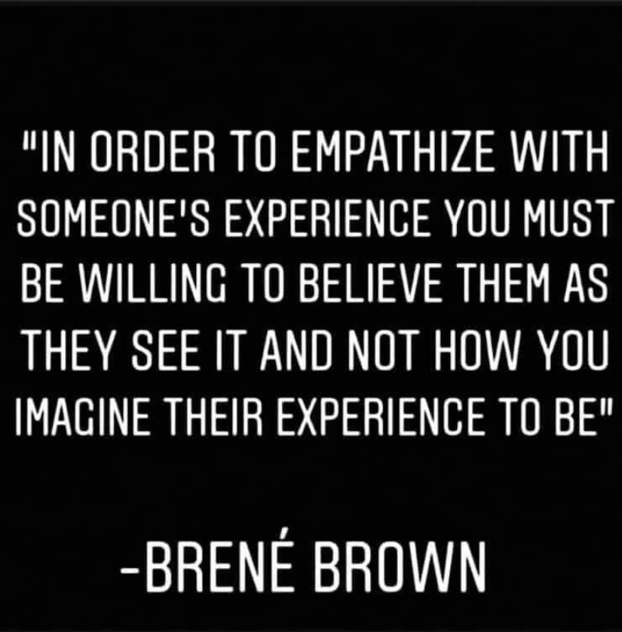
Empathy is at the Heart of Connecting with your audience!

Slide 4
Demographic vs. Audience Analysis
Demographic Analysis includes:
Age
Gender
Cultural or Ethnic Background
Education
Occupation
Religion
Geographic Origins
Group memberships
Audience Analysis: values, beliefs, attitudes

Slide 5
Molding Identity
Using the Play-Doh provided, complete the following steps.
Make something with your Play-Doh that represents who you are. Try to prioritize and pick what you believe is the most important element of your identity. Afterward, take a picture and smush the Play-Doh.
Write instructions for your partner on how to recreate your original masterpiece.
Person B, try to recreate your buddy’s first sculpture using the instructions they wrote for you.

Slide 6
Discussion
Questions
What are the most influential things that have contributed to and informed your unique identity?
Why did you choose the design you did?
How accurate was your partner in recreating the design?

Slide 7
Discussion
Questions Cont’d.
What songs was I playing in the background?
What were the lyrics about?
How do we feel about these messages, and how do they connect to audience analysis?

Slide 8
Concepts Addressed within this Activity
Socializing Agents – the places, people, and social norms that teach us the value and roles of certain identities and traits.
Intersectionality – the idea that we can never experience different aspects of our identity singularly.
Embodiment – the physical components of identity that impact our lived experiences (can be inherent or external).
Reflexivity – the ability to understand and interrogate your own beliefs and values.

Slide 9
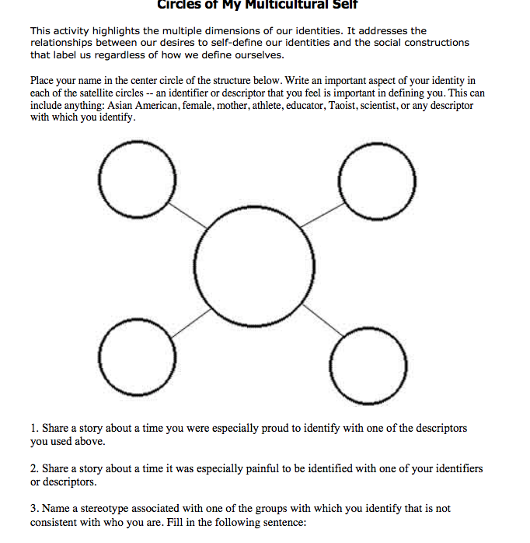

Identi-fly Yourself

Slide 10

Colloquial Language & Dunning-Kruger

Slide 11
Big takeaways
Definitions and Concepts :
1. Audience analysis vs. demographic analysis
2. Embodiment, Intersectionality, Code-Switching, Reflexivity
Skills:
1. Learning how to adapt to the audience through empathy
2. Increasing your self-awareness to better deliver messages
3. When to use colloquial language, code-switching, and more formal methods of speech.

