Slide 1

Chapter 10: Being a Critical Consumer of Messages

Slide 2
Content Overview
Cognitive Biases and Their Impact
The Listening Styles and Stereotyping
Common Logical Fallacies

Slide 3
The Smartphone Activity
Person A (Smartphone user)
Person B (Ancestor from the distant past)
Person A, attempt to explain to Person B what a smartphone is so that they can understand its purpose in today’s world. Person B, pretend that you’re only knowledge is that of a world without technology. Basically, make Person A’s task a difficult one.

Slide 4
Processing Styles
Peripheral – snap decision-making
Heuristic – shortcuts based on small bits of info.
Central – careful evaluation before deciding.
Confirmation Bias – the tendency to interpret data, evidence, or info in a way that is most aligned with our beliefs/positions.

Slide 5
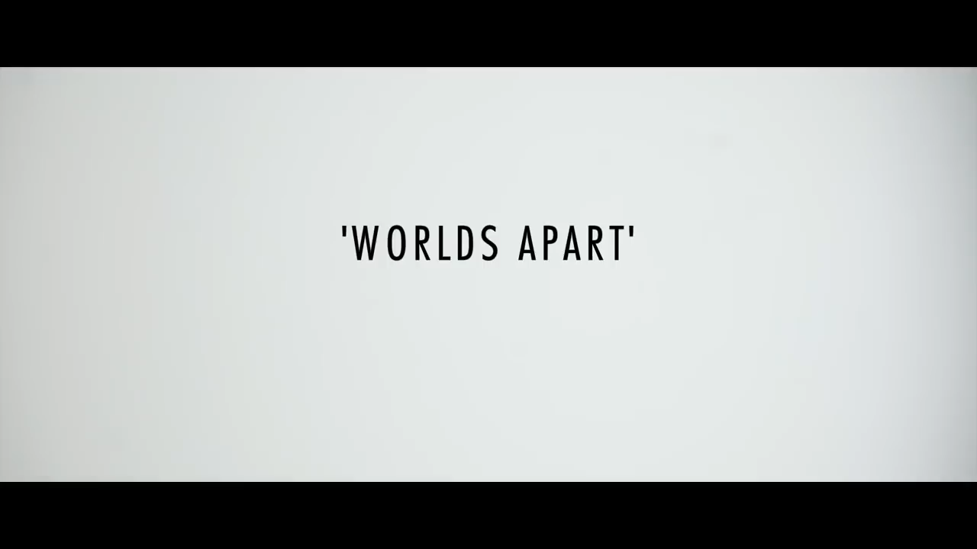
People have limitations though, causing people to stereotype before getting to know someone.

Slide 6
First, what were the stereotypes, and how do they even work?
“Feminism today is man hating” / “Men need you to have our children”
“Those people (climate change activists) need to solve credible problems that actually exist.”
“You’re a man; be a man. You’re a woman; be a female.”
Stereotyping is generalizing about a group with no regard for the characteristics of the individual people that belong to it.

Slide 7
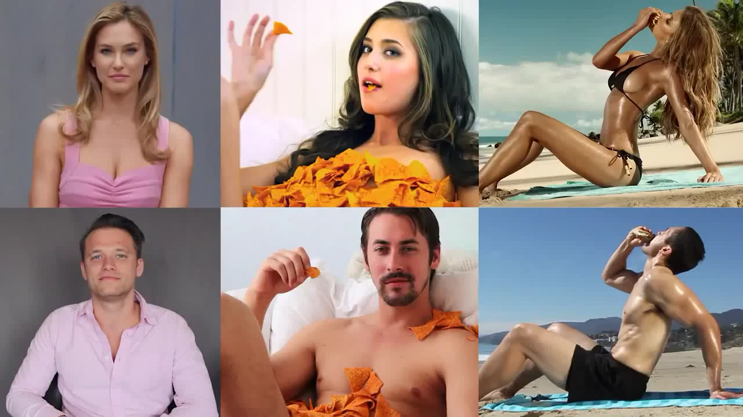

AND stereotypes affect both genders too!

Slide 8
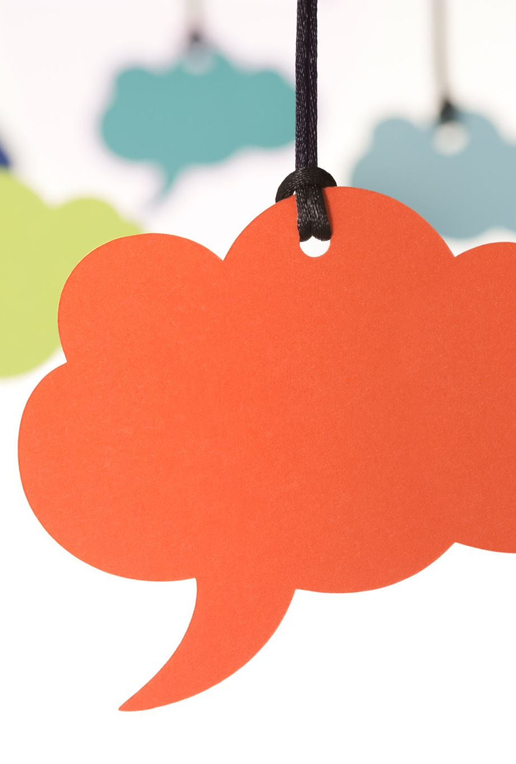
Let’s talk!
What are your impressions of this clips/these clips?
Were there any other stereotypes being thrown around that I didn’t catch? If so, what were they?
Why do you think we, as humans, form stereotypes about others?
What are some stereotypes you’ve observed in your lives, or what are some ways you’ve been stereotyped?

Slide 9
The Listening Steps
(HURIER)
Sensing (Hearing and Understanding)
Processing (Remembering and Interpreting)
Responding (Evaluating and Responding)

Slide 10
Different types of listening
Discriminative (auditory vs. visual)
Comprehensive (recall)
Critical (evaluation)
Therapeutic (empathetic)
Appreciative (enjoyment)
Social (media channels)

Slide 11
Image One

Slide 12
Image Two

Slide 13
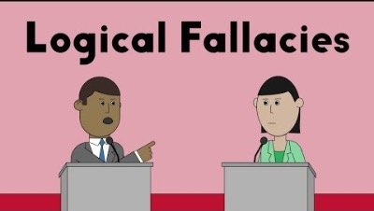
Logical Fallacies

Slide 14
In Review…
Key definitions:
Know all the different ways we process and form biases (peripheral, heuristic, central, confirmation bias).
Key skills:
Listening actively to prevent stereotypes and unfair judgments.
The different forms of listening, stereotyping, and logical fallacies.
Identifying gaps in logic when evaluating debates to be a better citizen.

