Slide 1
Mathematical Induction
Rosen, 6th ed. 4.1, 4.2

Slide 2
Climbing A Ladder
Suppose we have a ladder of n rungs. Let’s say we can guarantee two things:
We can reach the first rung of the ladder.
If we can reach the i^{th} rung of the ladder, then we can reach the next (i.e., the (i + 1)^{st}) rung.
What can we conclude, then?
We can conclude that we can reach the n^{th} rung for any n.
2

Slide 3
Basics
The Well-Ordering Property - Every nonempty set of nonnegative integers has a least element.
Many theorems state that P(n) is true for all positive integers.
For example, P(n) could be the statement that the sum of the first n positive integers 1+2+3+ . . . + n = n(n+1)/2
Mathematical Induction is a technique for proving theorems of this kind.

Slide 4
Steps in an Induction Proof to show that P(n) is true.
Goal: to prove P(n) is true (where n is a positive integer).
Basis step : The proposition is shown to be true for n=1 (or, more generally, the first element in the set)
Inductive step: The implication P(n)→P(n+1) is shown to be true for every positive integer n.
For n∈Z⁺, [P(1)∧∀n(P(n)→P(n+1))] →∀nP(n)
Note: Here P(k) is called the inductive assumption (or inductive hypothesis).
Note: Both steps are necessary.

Slide 5
Example 1: Show 2 ^{n}> n
Proof: Basis step: When n = 1, we have 2n = 2 > 1 =
n. So the proposition is true for n = 1.
Inductive step: Assume that the proposition is true for n = k (where k is a positive integer), i.e., 2^{k} > k.
Now we prove that it is also true for n = k + 1, i.e., 2^{k+1} > k + 1. From 2^{k} > k we get that 2^{k+1} = 2 × 2^{k}
> 2 · k ≥ k + 1.
This completes the induction proof.
5

Slide 6
Understanding first example
In the first example, we have shown two things: (a) 2¹ > 1;
(b) If 2^{k} > k for positive integer k, then 2^{k+1} > k + 1. Hence, we have the following statements being true:
(1) 2¹ > 1; (This is (a))
If 2¹ > 1, then 2² > 2; (This is (b) when k = 1)
If 2² > 2, then 2³ > 3; (This is (b) when k = 2)
...
(n) If 2^{n−1} > n − 1, then 2^{n} > n; (This is (b) when k = n − 1)
Putting all of them together, we see that 2^{n} > n.
6

Slide 7
Example 2: Show that 3|n³ − n for positive integer n.
Proof: Basis step: When n = 1, we have n³ − n = 0. Clearly,
3|n³ − n.
Inductive step: Assume that 3|k³ − k for positive integer k.
We’ll show that 3|(k + 1)³ − (k + 1).
It is easy to see (k + 1)³ − (k + 1) = k³ + 3k² + 2k = (k³ − k) +
3(k² + k).
Since 3|k³ − k, we can write k³ − k = 3j where j is an integer.
So,
(k + 1)³ − (k + 1) = 3j + 3(k² + k) = 3(j + k² + k)
Hence, 3|(k + 1)³ − (k + 1).
7

Slide 8
Understanding second example
In the second example, we have shown two things: (a) 3|1³ − 1;
(b) If 3|(k³ − k) for positive integer k, then 3|{(k + 1)³ − (k
+ 1)}.
Hence, we have the following statements being true: (1) 3|1³ − 1; (This is (a))
(2) If 3|1³ − 1, then 3|2³ − 2; (This is (b) when k = 1)
(3) If 3|2³ − 2, then 3|3³ − 3; (This is (b) when k = 2)
. . .
(n) If 3|(n − 1)³ − (n − 1), then 3|n³ − n; (This is (b) when k = n
− 1)
Putting all of them together, we see that 3|n³ − n.
8

Slide 9

Example: If p(n) is the proposition that the sum of the first n positive integers is n(n+1)/2, prove p(n) for n∈Z⁺.
i.e., Prove
Basis Step: Show that p(1) is true.

Slide 10
Inductive Step: Show that p(n) → p(n+1)
For this problem we want to show that
Assume that
Then

Slide 11
Inductive Step: Show that p(n) → p(n+1)
For this problem we want to show that
Why (n+1) and (n+2)?
Why can we assume this?
Assume that
Then
Same sum, different format
What we wanted to show.

Slide 12
What have we shown?
works for n = 1.
And if it works for n =1, then it works for n = 2
and if it works for n = 2, then it works for n = 3
and if it works for n = 3, then it work for n = 4
etc.
So the closed form solution must work for all integers > 0.

Slide 13
Variants of Mathematical Induction
In the mathematical induction we just studied, the constraint is
that n is a positive integer. In fact, we can have variants:
n is a non-negative integer; or, n is a positive integer ≥ m.
To deal with the above situations, all we need is:
adjust the basis step, so that it considers n = 0 or n = m
instead of n = 1.
adjust the inductive step, so that P(k)→P(k + 1) is proved for all
non-negative integer k or all integer k ≥ m.
13

Slide 14
Example for variant
Suppose that, for a finite set S, |S| = n. Show that |P(S)| = 2^{n}.
Note that we cannot consider n = 1 in the basis step! Because S could be the empty set and thus n could be 0. That means, we have to make sure the above statement is
true for all non-negative integer n (not just all positive
integer n).
If we consider n = 1 in the basis step, then the entire proof
ignores the possibility of n = 0.
Similarly, when we do the inductive step, we cannot just prove it for all positive integer k. We should prove it for all non-negative integer k.
14

Slide 15
Example for variant
Proof: Basis step: When n = 0, S is the empty set. Hence, P(S) = {ϕ}, which means |P(S)| = 1 = 2⁰.
Inductive step: Assume that, for all S such that |S| = k (where k s a non- negative integer), |P(S)| = 2^{k}.
Now we show that, for all S’ such that |S’| = k + 1, |P(S’)| = 2^{k+1}.
Clearly, all S’ such that |S’| = k + 1 can be written as S’ = S ⋃ {a}, where
|S| = k and a is not in S.
To count |P(S’)|, i.e., the number of subsets of S’, we only need to count:
(a) |P(S)|, i.e., the number of subsets of S; By the inductive assumption, we know that |P(S)| = 2^{k}.
(b) The number of subsets of S’ that contains a.
We note that each subset containing a uniquely corresponds to a subset not containing a (by eliminating a from the subset).
Hence, this number is also |P(S)| = 2^{k}.
We sum up these two numbers and get that |P(S’)| = 2^{k} + 2^{k} = 2^{k+1}.
15

Slide 16
Prove: If p(n) is the proposition that the sum of the first n odd integers is n², prove p(n) for n ∈Z⁺
Let’s first look at an example so we can figure out what we are trying to prove! Try first 5 odd integers.
1+3+5+7+9 = 5²
If a₁, a₂, a₃, are all odd integers, then what does a general term look like?
2k-1, for k=1,2,3,…,n
So we want to prove that

Slide 17
Prove that
Basis Step:
Inductive Step: Show that
Assume that

Slide 18
If p(n) is the proposition that prove p(n) when n is a non-negative integer.
Basis Step: We will show p(0) is true.
Inductive Step: We want to show that p(n)→p(n+1) i.e.,
Assume: then

Slide 19
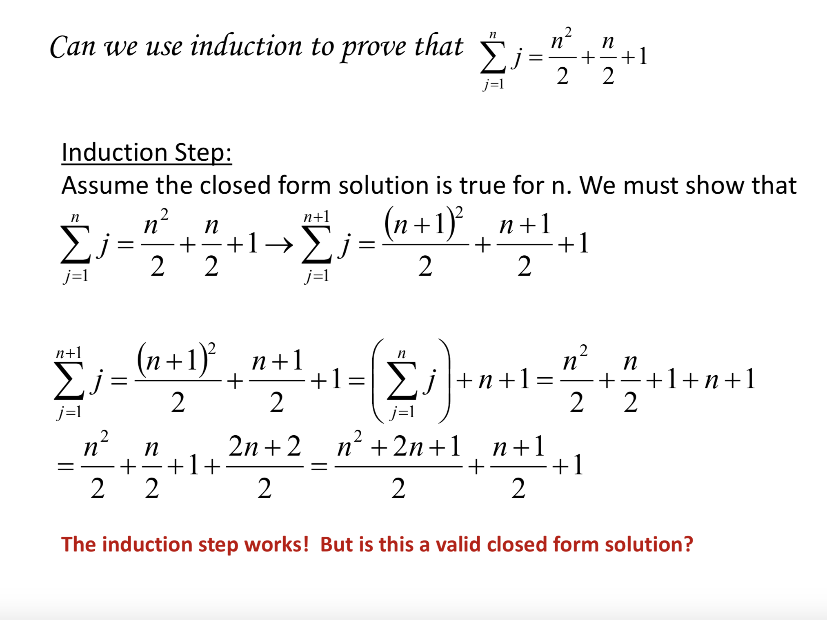

Slide 20
Basis Step:
1
₁2
∑
j =1
1
2 2
j = 1
+ +1 = 2
but, 1≠2
Since the basis step does not work, the closed form solution is not valid!
An induction proof is a valid proof only if the basis step AND the induction step are both true. Neither step by itself proves anything.

Slide 21
More General Example
Let p(n) be the statement that n! > 2^{n}. Prove p(n) for n ≥4.
Inductive Proof:
Basis Step: We will show that p(4) is true.
4! = 24 > 2⁴ = 16
Inductive Step: We want to show that ∀k≥4, p(k) →p(k+1). Assume k! > 2^{k} for some arbitrary k≥4.

Slide 22
n! > 2^{n} (cont.)
(k+1)! = (k+1)k!
> (k+1)2^{k} (inductive hypothesis)
> 2*2^{k} (since k≥4)
= 2^{k+1}
Since p(4) is true and p(n) → p(n+1), then p(n) is true for all integers n≥4.

Slide 23
Let p(n) be the statement that all numbers of the form 8^{n}-2^{n} for n∈Z⁺ are divisible by 6 (i.e., can be written as 6k for some k∈Z). Prove p(n)
Inductive Proof
Basis Step: We will show that p(1) is true.
8¹-2¹ = 6 which is clearly divisible by 6.
Inductive Step: We must show that ∀k∈Z⁺ (8^{k}-2^{k}) is divisible by 6→(8^{k+1}-2^{k+1}) is divisible by 6.

Slide 24
Divisible by 6 Example (cont.)
8^{k+1} - 2^{k+1} = 8(8^{k}) - 2^{k+1}
= 8(8^{k}) -8(2^{k}) + 8*2^{k} - 2^{k+1}
= 8(8^{k}-2^{k}) + 8*2^{k} - 2^{k+1}
= 8(8^{k}-2^{k}) + 8*2^{k} - 2*2^{k}
= 8(8^{k}-2^{k}) + 6*2^{k}
By the inductive hypothesis 8(8^{k}-2^{k}) is divisible by 6 and clearly 6*2^{k} is divisible by 6. Thus 8^{k+1} - 2^{k+1} is divisible by 6. Since p(1) is true and p(n) → p(n+1), then p(n) is true for all nonnegative integers n.

Slide 25
Prove that 21 divides 4^{n+1} + 5^{2n-1} whenever n is a positive integer
Basis Step: When n = 1, then 4^{n+1} + 5^{2n-1} = 4¹⁺¹ + 5²⁽¹⁾⁻¹ = 4²+5 = 21 which is clearly divisible by 21.
Inductive Step: Assume that 4^{n+1} + 5^{2n-1} is divisible by 21. We must show that 4^{n+1+1} + 5^{2(n+1)-1} is divisible by 21.

Slide 26
Contd. from the last page
4^{n+1+1} + 5^{2(n+1)-1} = 4*4^{n+1} + 5^{2n+2-1}
= 4*4^{n+1} + 25*5^{2n-1}
= 4*4^{n+1} + (4+21)5^{2n-1}
= 4(4^{n+1}+ 5^{2n-1}) +21*5^{2n-1}
The first term is divisible by 21 by the induction hypothesis and clearly the second term is divisible by 21. Therefore their sum is divisible by 21.

Slide 27
Second Principle of Mathematical Induction (Strong Induction)
Basis Step: The proposition p(1) is shown to be true.
Inductive Step: It is shown that [p(1)∧p(2)∧ …
∧p(n)] → p(n+1) is true for every positive integer n.
Sometimes we have multiple basis steps to prove.

Slide 28
Consider the sequence a₁, a₂, a₃, … defined as a₁ =1, a₂=2, a₃=3
and a_{n} = a_{n-1}+ a_{n-2} + a_{n-3}. Prove that a_{n} < 2^{n}.
Basis Step:
a₄ = a₁ + a₂ + a₃ 1+2+3 = 6 < 2⁴ = 16.
Inductive Step:
Show that (a_{i} < 2^{i} for i ∈ Z+ and i < k) → a_{k} < 2^{k} a_{k} = a_{k-1} + a_{k-2} + a_{k-3} < 2^{k-1} + 2^{k-2} + 2^{k-3}
< (2² + 2 + 1)2^{k-3} = 7(2^{k}-3) < 8(2^{k-3}) =2³(2^{k-3})= 2^{k}.
Therefore a_{k} < 2^{k}

Slide 29
Consider the sequence a₁, a₂, a₃, … defined as a₁ =1, a₂=2, a₃=3
and a_{n} = a_{n-1}+ a_{n-2} + a_{n-3}. Prove that a_{n} < 2^{n}.
Basis Step:
a₄ = a₁ + a₂ + a₃ 1+2+3 = 6 < 2⁴ = 16.
Inductive Step:
Show that (a_{i} < 2^{i} for i ∈ Z+ and i < k) → a_{k} < 2^{k} a_{k} = a_{k-1} + a_{k-2} + a_{k-3} < 2^{k-1} + 2^{k-2} + 2^{k-3}
< (2² + 2 + 1)2^{k-3} = 7(2^{k}-3) < 8(2^{k-3}) =2³(2^{k-3})= 2^{k}.
Therefore a_{k} < 2^{k}

Slide 30
Example of Strong Induction
Consider the sequence defined as follows:
b₀ = 1, b₁ =1
b_{n} = 2b_{n-1} + b_{n-2} for n>1 1,1,3,7,17,…
Prove that b_{n} is always odd

Slide 31
Inductive Proof Using Strong Induction
Basis Cases: (one for n=0 and one for n=1 since the
general formula is not applicable until n>1.)
b₀ = b₁ = 1 so both b₀ and b₁ are odd. Inductive Step:
Consider k>1 and assume that b_{n} is odd for all 0 ≤ n ≤ k.
We must show that b_{k+1} is odd.

Slide 32
Proof Example (cont.)
From the formula we know that
b_{k+1} = 2b_{k} + b_{k-1}. Clearly the first term is even. By the inductive hypothesis the second term is odd. Since the sum of an even integer and an odd integer is always odd (which we proved in number theory), then b_{k+1} is odd.
In this example we did not need all p(n), 0≤n≤k, but we did need p(k-1). Note that a proof using weak induction would only be able to assume p(k).

Slide 33
Another Example for strong induction
Show that any positive integer n > 1 can be written as the product of primes.
Note this is actually part of the fundamental theorem of arithmetic. Here we prove it using strong induction.
Proof: Basis step: Here we consider n = 2 instead of n = 1, because there is a restriction n > 1.
When n = 2, since 2 is by itself a prime, the proposition is clearly true.
33

Slide 34
Previous Example Contd.
Inductive step: Assume every n such that 1 < n ≤ k (where k is an integer > 1) can be written as the product of primes.
Now we show that k + 1 can also be written as the product of primes. We
Consider two cases:
Case A: k + 1 is a prime. Then we are done. Case B: k + 1 is a composite.
Then there exist positive integers a > 1 and b > 1 such that k + 1 = a· b.
Since a > 1, we know a ≥ 2, and thus b ≤ (k + 1)/2 < k. [why?] By the inductive assumption, b can be written as the product of primes.
Similarly, a can also be written as the product of primes.
Combining these two results, we see that
k + 1 = a · b can be written
as the product of primes.
34

Slide 35
Understanding the previous example
In this example, we have shown two things:
2 can be written as the product of primes;
If all n such that 1 < n ≤ k can be written as the product of primes, then
k + 1 can be written as the product of primes.
Hence, we have the following statements being true:
  2 can be written as the product of primes; (This is (a))
  If 2 can be written as the product of primes, then 3 can be written as the product of primes; (This is (b) when k = 2)
  If 2 and 3 can be written as the product of primes, then 4 can be written as the product of primes; (This is (b) when k = 3) . . .
(n-1) If 2, 3, . . ., and n − 1 can be written as the product of primes, then n can be written as the product of primes; (This is (b) when k = n − 1)
Putting all of them together, we see that
n can be written as the product of
primes.
35

Slide 36
Harmonic Numbers
An Inequality for Harmonic Numbers: The harmonic numbers H_{j}, j = 1, 2,
3, . . . , are defined by
_{Hj} = 1+1/2 +1/3 + ... 1/j, Example: _{H4} = 25 / 12
Prove that
H
n
n ≥ 1+
2
2
when n is a nonnegative integer.
H ₂
n
n ≥ 1 +
2
In order to prove this, let P be the proposition
n
Basis Step: P(0) is true since H₁ = 1 ≥ 1+0/2 [2⁰= 1]
For the sake of simplicity of typing, let’s say N(k) = 2^{k}, for any nonnegative integer k.
36

Slide 37
INDUCTIVE STEP: The inductive hypothesis is the statement that P(k) is true, that is, H_{N(k)} ≥ 1 +k/2. where k is an arbitrary nonnegative integer. We must show that if P(k) is true then P(k+1), i.e., H_{N(k+1)} ≥ 1 +(k+1))/2.
H_{N(k+1)} = 1 +1/2 +1/3 + … + 1/N(k) + 1/{N(k)+1} + … + 1/N(k+1)
= H_{N(k)} + 1/{N(k)+1} + … + 1/N(k+1)
≥ 1 +k/2 +1/{N(k)+1} + … + 1/N(k+1) [inductive hypothesis]
≥ 1 +k/2 +N(k)*1/N(k+1) [because there are N(k) terms each
≥1/N(k+1)
≥ 1 +k/2 + 1/2
[canceling a common factor of N(k) in second term]
= 1+ (k+1)/2
This establishes the inductive step of the proof. Thus, Harmonic series is a divergent infinite series.
37

Slide 38
Another Problem
Problem: Suppose that you have two different algorithms for solving a problem. To solve a problem of size n, the first algorithm uses exactly n(log n) operations and the second algorithm uses exactly n^{3/2} operations. As n grows, which algorithm uses fewer operations?
Solution:
Proof: We have already seen earlier that n(logn) is O(n^{3/2}), but the opposite is not true. So, for large n, the first algorithm uses fewer operations.
Let us see how to solve n(logn) < n^{3/2} . Take logarithm on both sides to get the following: log₂n +log₂log₂n < (3/2) log₂n, or log₂log₂n < 0.5logn.
Note that both sides of the above inequality are monotonically increasing with n and Put n = 4 to get 2 + 1 = (3/2)⋅2 = 3.
We get that the first algorithm uses fewer operations for all n > 4.
page<#>

Slide 39
Prove that every 2^{n} by 2^{n} (n > 1) chessboard can be tiled with T-ominos
A T-omino is a tile pictured as shown in the figure.

Slide 40
Basic Case: 2² × 2² Board

Slide 41
Basic Case: 2² x 2² Board

Slide 42
Basic Case: 2² x 2² Board

Slide 43
Basic Case: 2² x 2² Board

Slide 44
Inductive Step
Assume that we can tile any board of size 2² by 2² up to to 2^{n} by 2^{n}. We must show that this implies that we can tile a board of size 2^{n+1} by 2^{n+1}.
Proof: Divide the 2^{n+1} by 2^{n+1} board into 4 parts, each of size 2^{n} by 2^{n}. Since we know that each of these boards can be tiled, then we can put them together to tile the 2^{n+1} by 2^{n+1} board.

Slide 45
Show that every amount of postage that is at least 12 cents can be made from 4-cent and 5-cent stamps.
Basis Step: If the postage is 12 cents then we can use three 4 cent stamps. If the postage is 13 cents we can use two 4 cent stamps and one 5 cent stamp. If the postage is 14 cents we can use one 4 cent stamp and two 5 cent stamps. If the postage is 15 cents we can use three 5 cent stamps.
12 = 4+4+4
13 = 4+4+5
14 = 4+5+5
15 = 5+5+5

Slide 46
Show that every amount of postage that is at least 12 cents can be made from 4-cent and 5-cent stamps.
Inductive Step:
Assume that we can represent any postage value from 12 cents up to k cents. We must show that we can represent a postage of k+1 cents.
We have already shown that we can represent any value < 16 cents so assume k+1 ≥ 16 cents.
If k+1 ≥ 16 then (k+1) – 4 ≥ 12. So by the inductive hypothesis, we can represent (k+1) – 4 using m 4-cent stamps and n 5-cent stamps where m,n ∈N.
i.e., (k+1) – 4 =4m + 5n ⇒ k+1 = 4 + 4m +5n = 4(m+1) + 5n.
So we can represent k+1 cents of postage with (m+1) 4-cent
stamps and n 5-cent stamps.

