Slide 1
Learning and Decision Making
By Erin Cole, John Frick, Alexander Gido, Emily Ray, and Owen Sullivan

Slide 2

Learning
An employee’s knowledge or skills attained from experience.
This ties into:
Hierarchy
Time at company
Effectiveness
Salary
Overall company performance
Notes:
why is learning important for employees?
tools employees can use for good decision makings
more knowledge = better position

Slide 3
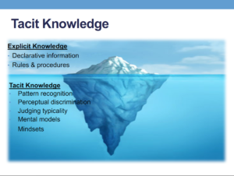
Types of Knowledge
Explicit vs. Tacit
Tacit - Experience based and gained through maturity and longevity
Ex: Social skills and wisdom
Explicit - Information based knowledge that is easy to pick up on through various sources
Ex: Information from Google and technical skills

Slide 4

Decision-Making
The process of generating and choosing from a set of alternatives to solve a problem.
This process includes:
Research
Time
Trust
Confidence
Ability
Employees who have MORE knowledge are MORE likely to make accurate decisions.

Slide 5
An Example of Good Decision-Making:
According to the Harvard Business Review in 2010, Ford’s renewed focus on decision-making contributed to a massive business turnaround.
Starting in 2000, Ford was rapidly losing market share and was struggling to stay afloat.
As CEO, Alan Mulally began restructuring the company in 2006.
Alan’s emphasis on defining and making decisions that were necessary before restructuring led to returned profitability in 2010.
Source: The Decision-Driven Organization
Notes:
Let’s take a look at how good decision-making can affect a business. A 2010 article in the Harvard Business Review noted how Ford, the then-largest automobile manufacturer in the United States, turned its failing business model around by focusing on better decision-making processes. CEO Alan Mulally pushed off a large-scale restructuring within Ford until the decisions required to streamline production and address shortcomings were planned and implemented. This ultimately led to Ford returning to making a profit in early 2010.

Slide 6
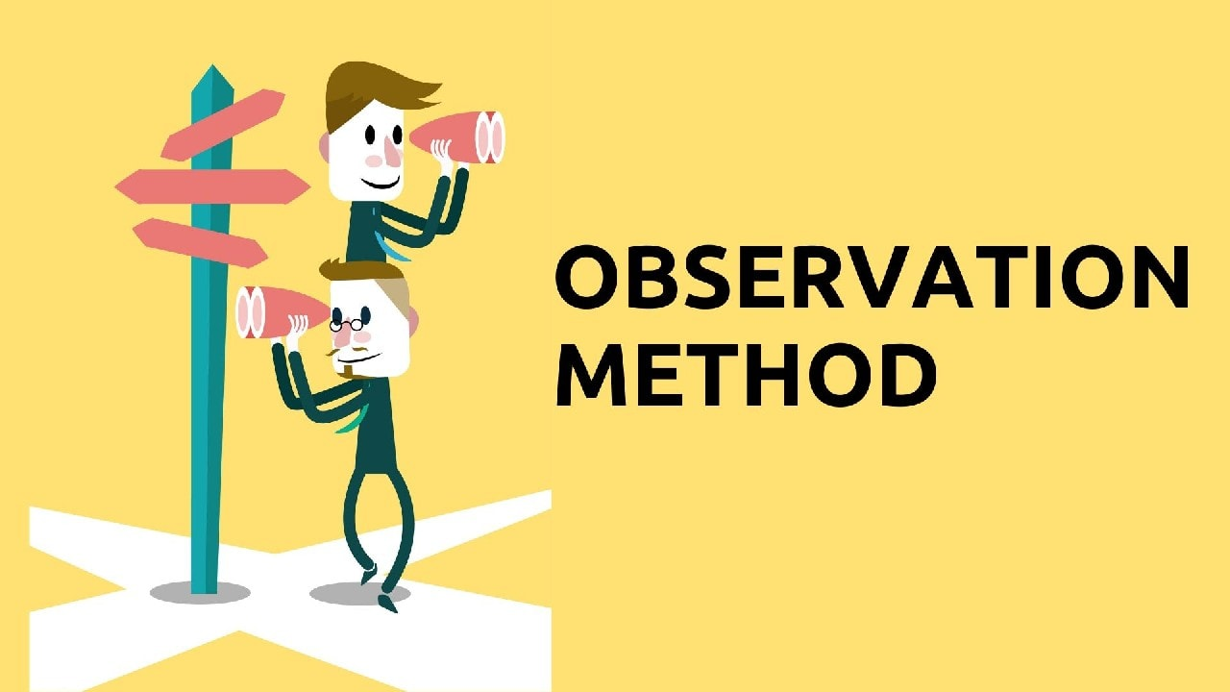

How Do Employees Learn?
Reinforcement
Observation
Goal Orientations
Notes:
reinforcement:
also known as “operant conditioning”
learn by observing the link between “voluntary behavior” and the “consequences that follow”
your employee engages in a desirable behavior → you reward them
your employee engages in an undesirable behavior → you punish them
contingencies of reinforcement
positive reinforcement: positive outcome follows a desirable behavior
negative reinforcement: negative outcome is removed following a desired behavior
punishment: negative outcome follows an undesirable behavior
extinction: positive outcome is removed following an undesirable behavior
positive reinforcement and extinction tend to do so “without” creating feelings of animosity and conflict (both between the manager-employee amongst coworkers)
negative reinforcement and punishment tend to bring other detrimental consequences among with them
2. Observation
social learning theory suggests that people in organizations have the ability to learn through the observation of others
applicable in many settings including workplace, child-parents, education, etc.
behavioral modeling in the workplace:
3. Goal Orientations
learning orientation
building competence is deemed more important than demonstrating competence
learning itself >>> showing that you’re good at it
tends to be associated with positive outcomes such as:
improved self confidence; feedback-seeking behaviors learning performance
performance-prove orientation
focus is on demonstrating competence so that others think favorably of you
learning itself <<<< showing that you’re good at it
mixed evidence on performance prove orientation
performance avoid orientation
focus is on demonstrating competence so that others will not think poorly of you
tends to be associated with negative outcomes such as:
learning less; experiencing higher levels of anxiety

Slide 7
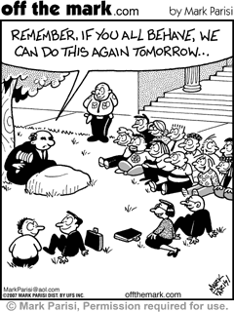
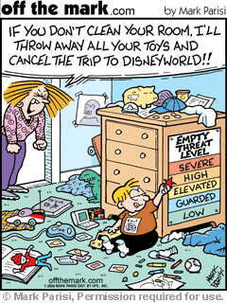

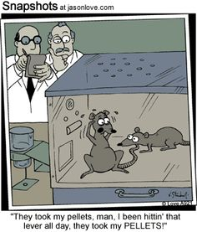
Contingencies of Reinforcement
Positive Reinforcement
Negative Reinforcement
Punishment
Extinction

Slide 8
How Do Employees Make Decisions?
Programmed Decisions
Intuition
Nonprogrammed decisions
In a study conducted by Lisa Sayegh and others, they found that decision making based on intuition is most effective when the manager has more experience in the field
Experienced naval officers’ decision making strategies were studied to see how they made defensive decisions under stress
  The naval officers did best when they were able to rely on prior experiences throughout their military careers
  For example: some of the officers excelled in defense against air attacks while other officers decision making skills suffered due to lack of experience against air threats
Managerial decision-making under crisis: The role of emotion in an intuitive decision process - ScienceDirect

Slide 9
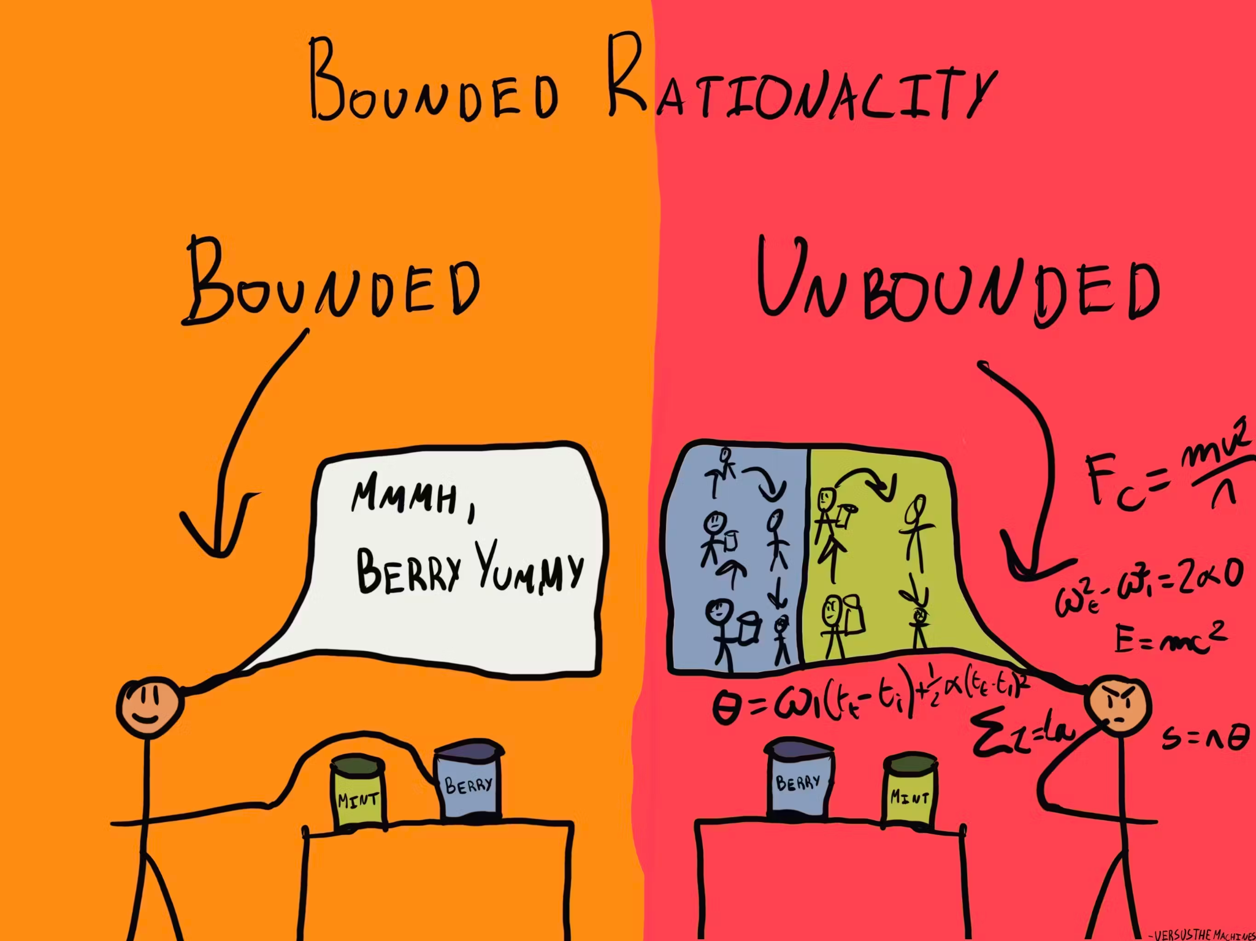
Decision-Making Problems:
Due to Limited Information
Bounded Rationality: individuals do not have ability to process all available information to make a rational decision (22%)
Satisficing: when decision makers select the first acceptable alternative (3%)
Simplification: when decision makers simplify information to make sense of the complex problem
Image: https://thedecisionlab.com/biases/bounded-rationality
Notes:
erin
Bounded rationality: individuals do not have ability to process all available information to make a rational decision
Simplification: when decision makers simplify information to make sense of the complex problem
Satisficing: when decision makers select the first acceptable alternative

Slide 10
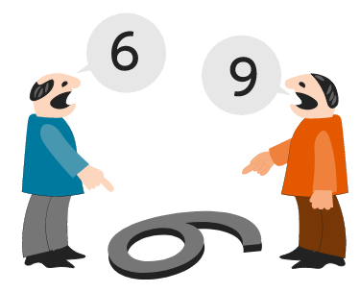
Decision-Making Problems:
Faulty Perception
2. Faulty Perceptions
Selective Perception: tendency to see their
environment only as it affects them as it is
consistent with their expectations (44%)
Projection Bias: project one’s own thoughts, attitudes, and motives onto other people
Social Identity: the way one identifies themselves based on where they think they belong impacts how they view the world
Image: Image: https://thedecisionlab.com/biases/bounded-rationality
Notes:
Erin
tendency to see their environment only as it affects them as it is consistent with their expectations

Slide 11
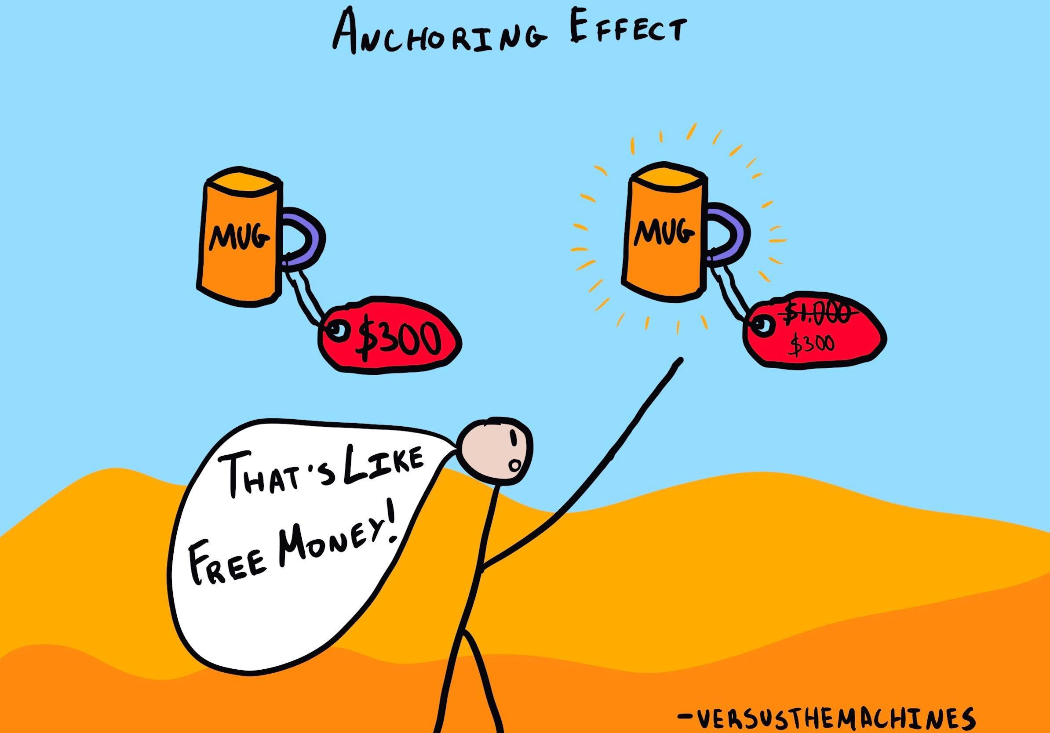
Decision-Making Problems:
Faulty Perception
Anchoring Bias: people's tendency to rely too
heavily on the first piece of information they
receive on a topic (9%)
Stereotype: assumptions are made about others based on their memberships in a social group (16%)
Heuristics: simple, efficient rules of thumb that
allow us to make decisions more quickly
2. Faulty Perceptions
Availability Bias: tendency for one to base their judgments on information that is easier to recall (6%)
Image: https://thedecisionlab.com/biases/anchoring-bias
Notes:
Erin
people's tendency to rely too heavily on the first piece of information they receive on a topic

Slide 12
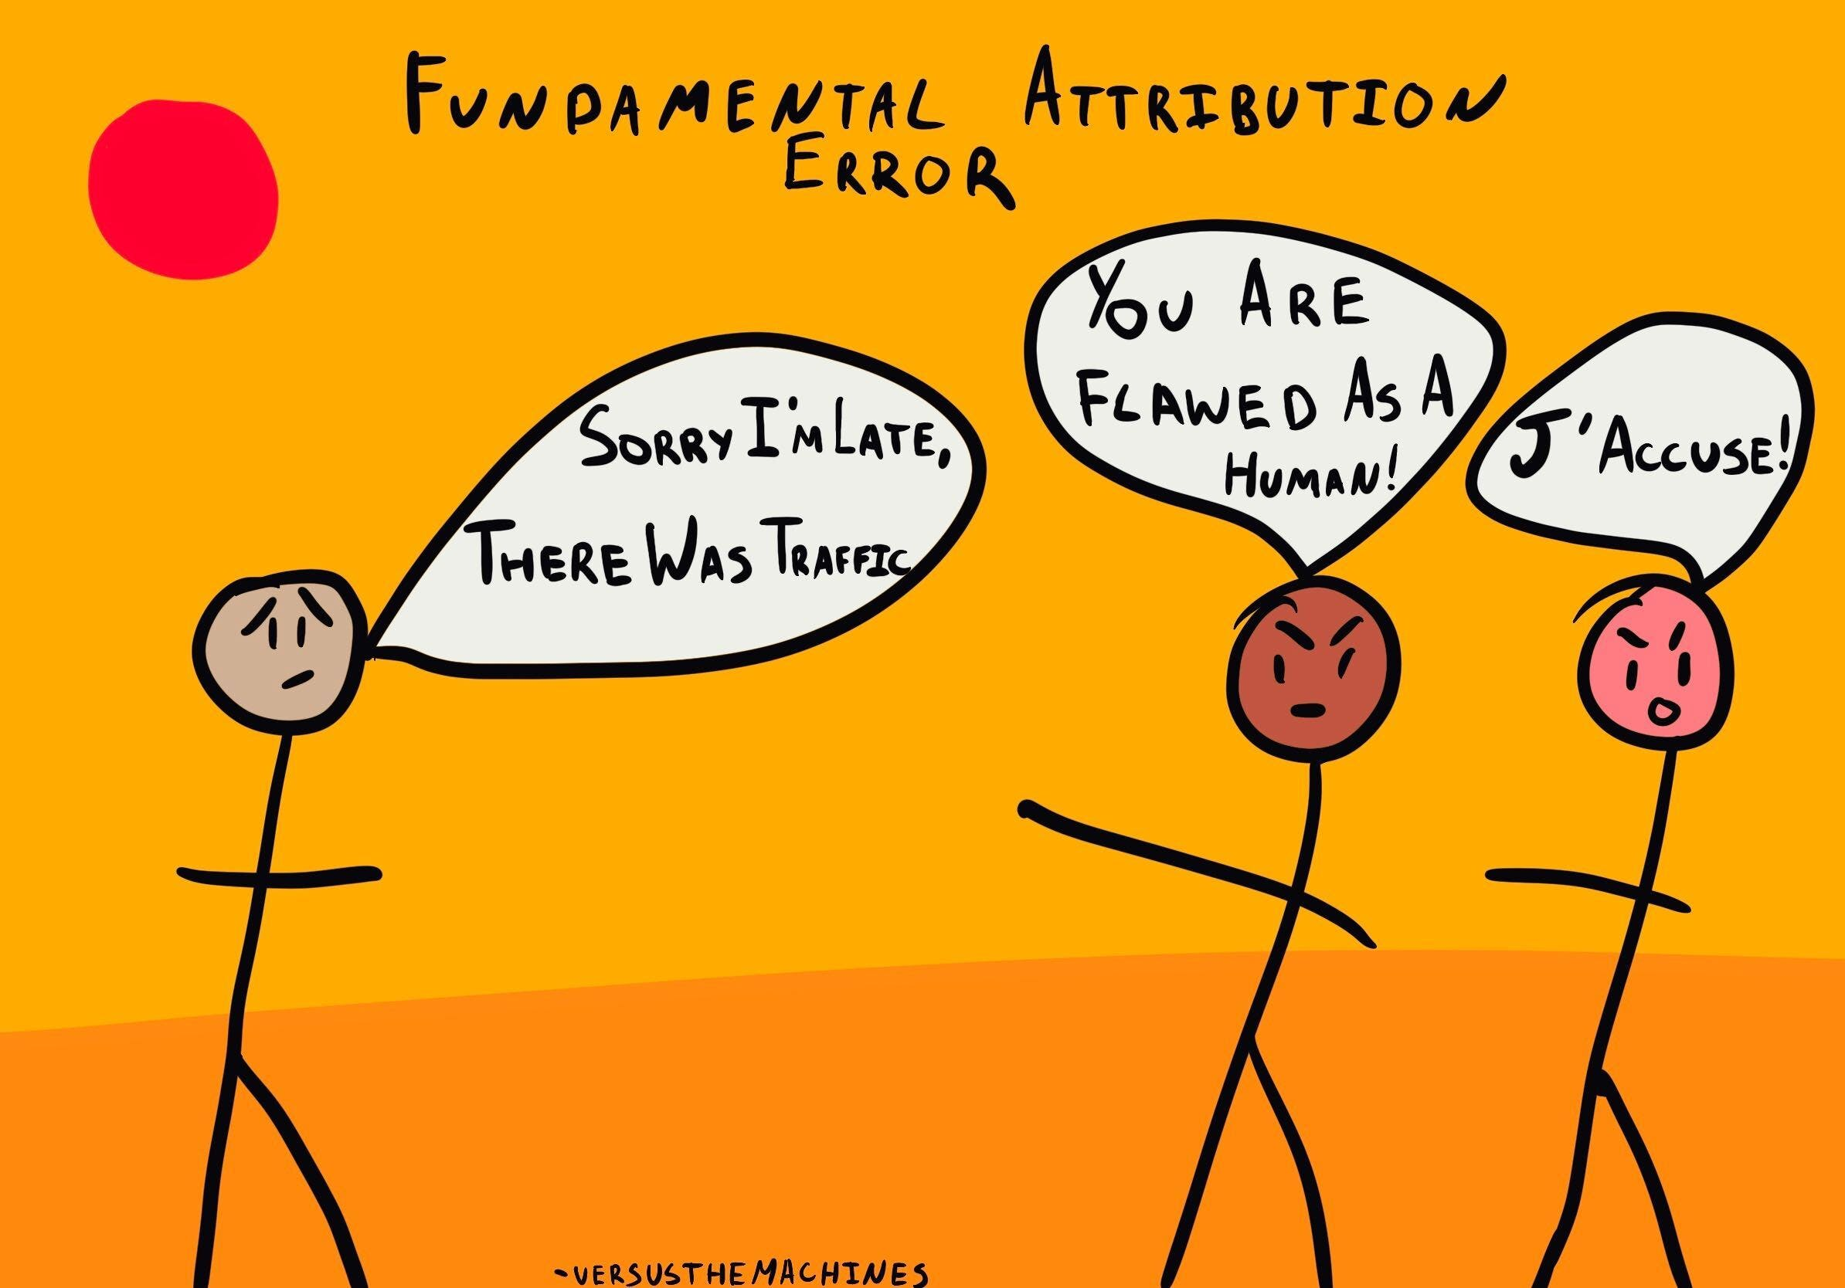
Decision-Making Problems:
Faulty Attributions
3. Faculty Attributions
Fundamental attribution error:
Self-serving bias:
attribute one’s failures to external factors and one’s successes to internal factors
image: https://thedecisionlab.com/biases/fundamental-attribution-error
Notes:
erin
a tendency to judge others’ behaviors as due to internal factors such as ability or attitude

Slide 13

An Example of Bad Decision-Making:
In 1999, Excite (which owned Ask.com) had the opportunity to purchase Google for only $750K.
Excite’s CEO, George Bell, passed on the offer.
Google is now worth nearly $1.4T.
Bell’s decision was limited by Bounded Rationality.
Source: 7 biggest business blunders ever committed
Notes:
Now, let’s look at how poor decision-making can affect a business. Before Google were a number of smaller search engines, such as Ask.com. Excite, the corporation that came to own Ask.com, turned down the chance to buy Google for only $750K. George Bell, the CEO of Excite, made a poor business decision because he did not have access to the information that might have predicted Google’s rise to one of the largest corporations on the planet.

Slide 14
Why is this important?
Learning is moderately positively correlated with task performance
Learning is less positively correlated with OCB and CWB
Learning is weakly positively correlated with organizational commitment
Employee’s with more knowledge are more likely to make better decisions
Programmed Decisions
Intuition
Nonprogrammed decisions
Notes:
erin

Slide 15
Kahoot

